Slide 1
Bishops’ Lent Challenge 2024 This is the time ‘For I know the plans I have for you… plans to give you hope and a future’ Jeremiah 29:11
Week Six - Recreation

Slide 2
Welcome and Response
This is the time
We can make a difference

Slide 3
What kind of world do you want YOUR CHILDREN to see?
Make a list of all the things you want your children to see in the world
Does your list include some of these things?
Animals in nature
Beautiful trees and flowers
Natural habitats
Sunny Days
Happy Humans
This is what God wants the world to be like!

Slide 4
What kind of world do you NOT want YOUR CHILDREN to see?
Make a list of all the things you DON’T want your children to see in the world
Does your list include some of these things?
Wars
Illness and diseases
Lack of animals, destroyed planet
Lots of natural disasters
Worried and anxious people
This is not what God wants the world to be like!

Slide 5
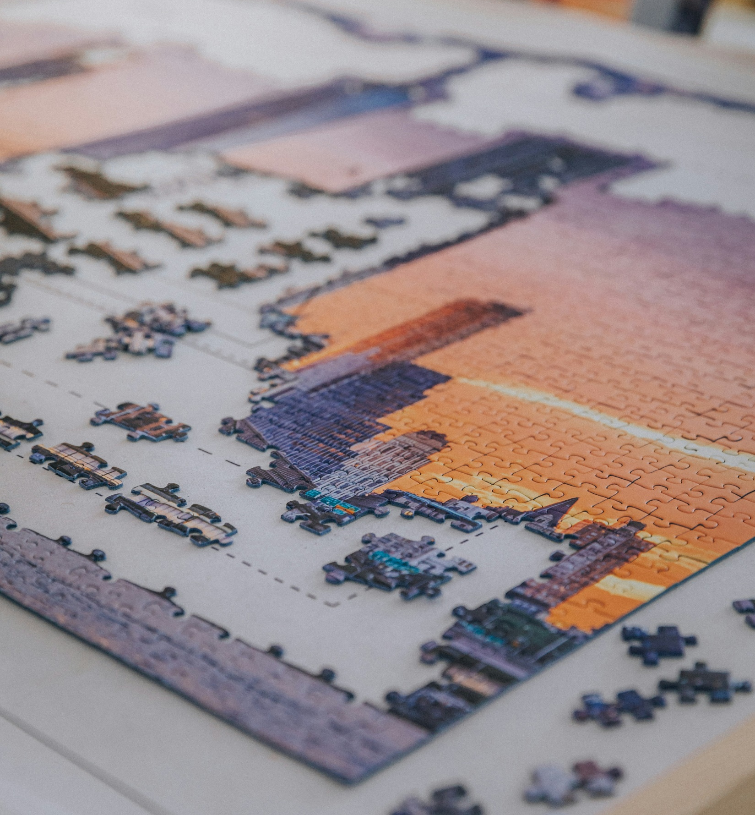
PUZZLE TIME!
Photo by Jonny Gios on Unsplash
Photo by Bianca Ackermann on Unsplash

Slide 6
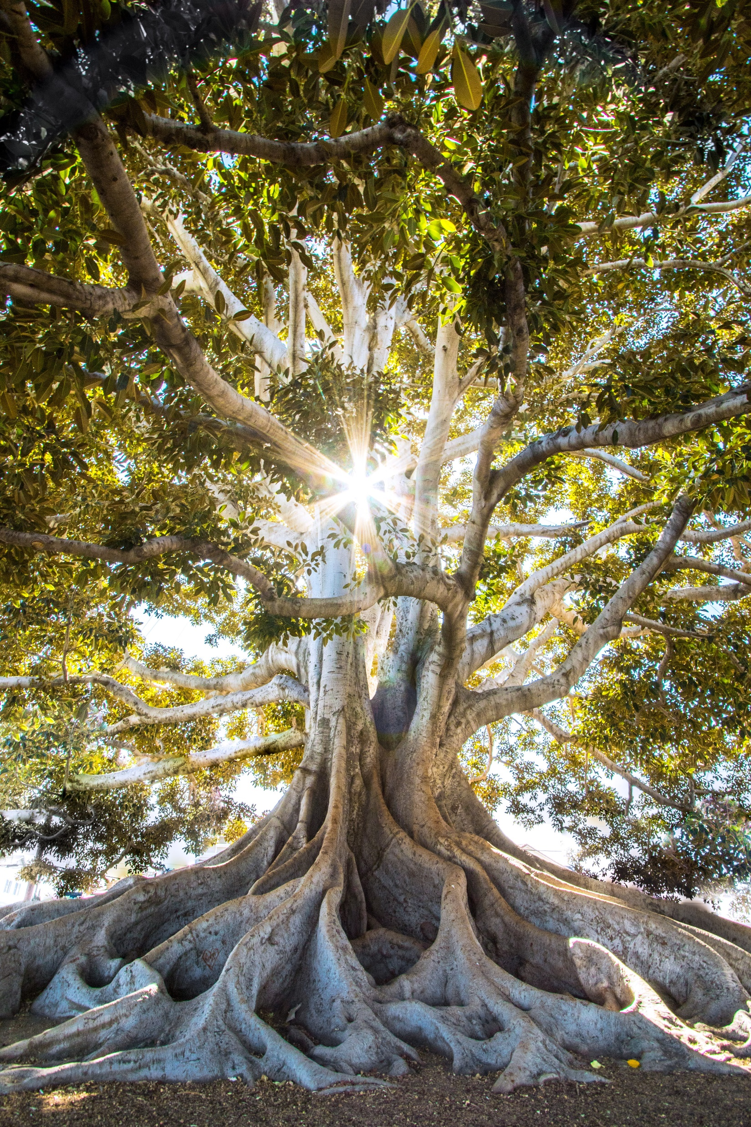
BIBLE FOCUS – Revelation 21
Hope
The New Jerusalem
21 Then I saw a new heaven and a new earth. The first heaven and the first earth had disappeared. Now there was no sea. ² And I saw the holy city coming down out of heaven from God. This holy city is the new Jerusalem. It was prepared like a bride dressed for her husband. ³ I heard a loud voice from the throne. The voice said, “Now God’s home is with men. He will live with them, and they will be his people. God himself will be with them and will be their God. ⁴ He will wipe away every tear from their eyes. There will be no more death, sadness, crying, or pain. All the old ways are gone.”
⁵ The One who was sitting on the throne said, “Look! I am making everything new!” Then he said, “Write this, because these words are true and can be trusted.”
⁶ The One on the throne said to me: “It is finished! I am the Alpha and the Omega, the Beginning and the End. I will give free water from the spring of the water of life to anyone who is thirsty. ⁷ Anyone who wins the victory will receive this. And I will be his God, and he will be my son.
Photo by Jeremy Bishop on Unsplash

Slide 7
What can we learn from this passage?
This passage teaches us about ‘Hope’. In Chapter 21, it describes a New Jerusalem and describes heaven for those who have shown perseverance and endurance. The new heaven and the new earth is something we cannot fully understand or even imagine. However, it is the most beautiful place where the fulness of God’s love fills everyone and everything. There will be peace between people and nations, there will be no more suffering or pain or sadness.
In this chapter, God tells us he is the beginning and the end of all things. God created us as humans and one day He will take all things and make them new again (in Heaven). He has always been there, since the beginning and will be with us forever. God will comfort, protect, guide and strengthen us. He will make all things new and transform our lives, on Earth and in Heaven.

Slide 8
To help us further understand Revelations….
New heaven and a new earth - YouTube
The best is yet to come – A visual representation of Revelations 21:1-7
Video is embedded on the next page.

Slide 9
New heaven and a new earth - YouTube

Slide 10
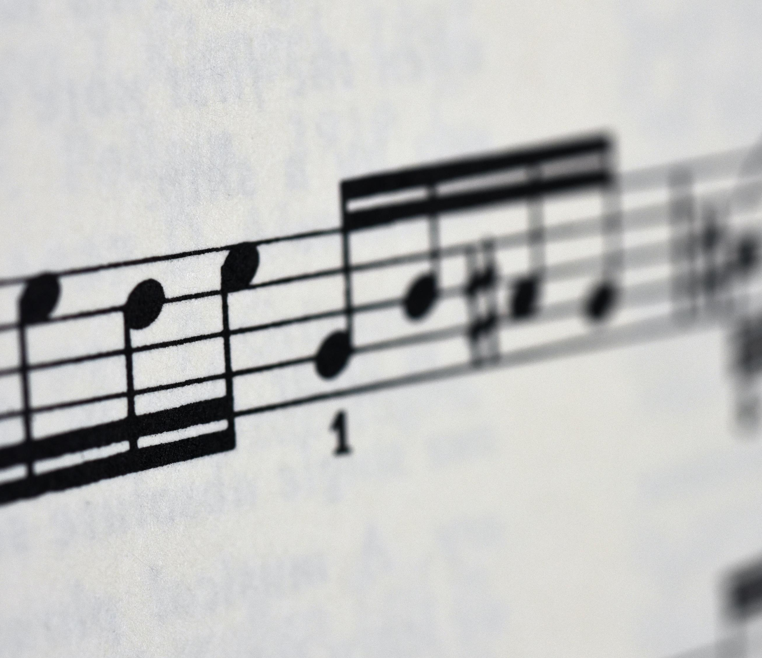
Let’s Sing! Choose
Heaven is our home – Hillsong Kids
When I get to Heaven – Be the light
Walking On Heaven's Road – Christian Songs and Videos

Slide 11
Let’s Sing!
https://www.youtube.com/watch?v=xdb_cttBKB0

Slide 12
Let’s Sing!
https://www.youtube.com/watch?v=zJIYLjU-wqE

Slide 13
Let’s Sing!
https://www.youtube.com/watch?v=LANKDZKFJ2Y

Slide 14
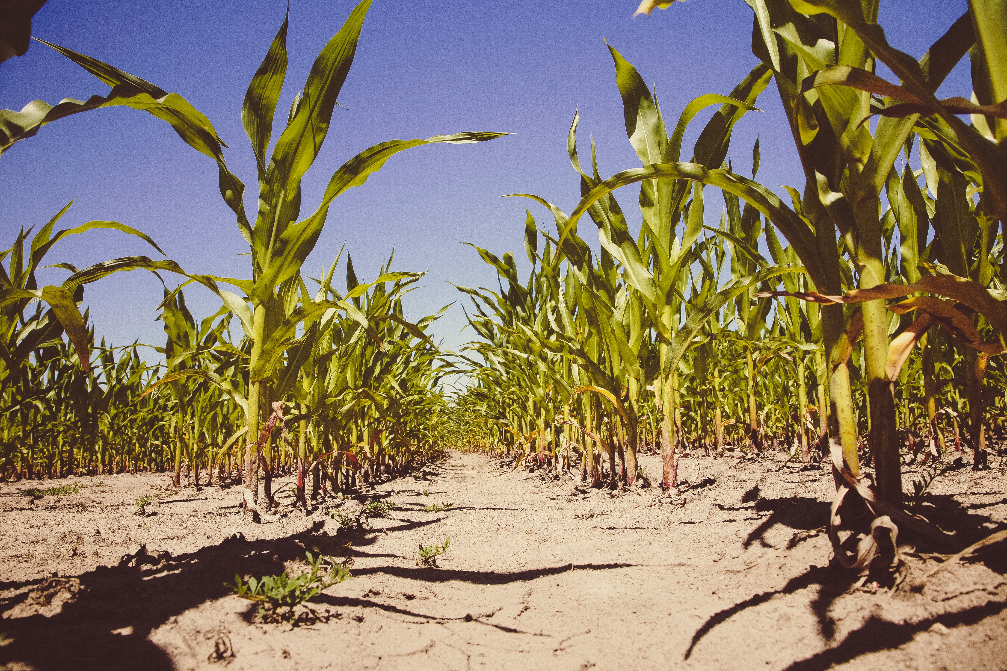
Communities around the world work at growing and harvesting from the soil and they do more than just produce food. They re-create their lives. From continuously working the soil, sowing seeds, caring for livestock, and communal harvesting, to meals shared at a common table, the entire process is one of nourishment for the body and the soul. As they gather to share the fruits of one another’s labour, they remember and have our eyes opened to God’s work that brings life out of Creation and, through the community, to one another. As they work the soil, as they train participants, and as they welcome visitors, they see God at work transforming each of them and Creation itself, to the image of Jesus Christ.
Photo by Markus Spiske on Unsplash

Slide 15
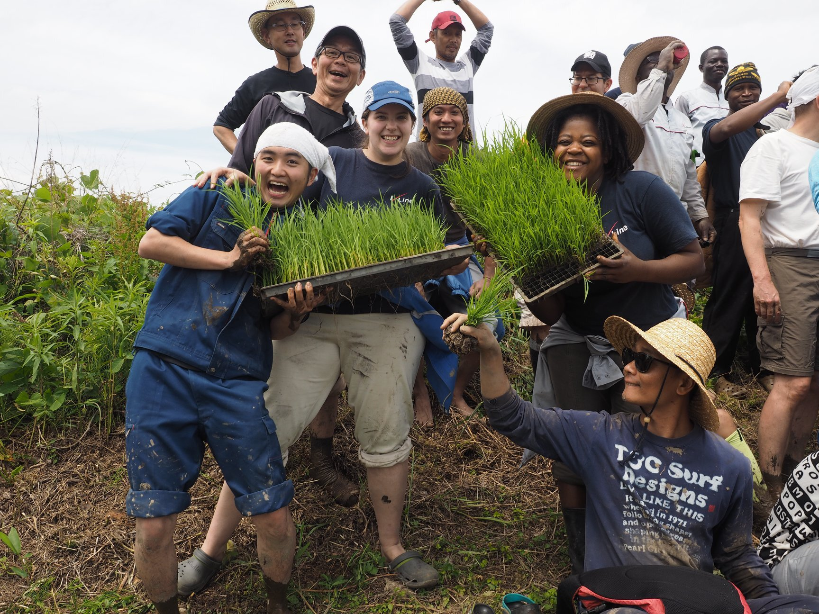
At the Asian Rural Institute (ARI) they live out a ‘three loves’ theology in its community.
In loving God, loving one another, and loving the soil - the three loves
- they seek to realise God’s coming heavenly kingdom; a re-Creation of the life that God has envisioned for us. This work is not only about joy, for as the world suffers in the midst of disease and conflict, we also suffer. We face daily difficulties with one another, with the soil and with understanding how God is working in the world.

Slide 16
Questions The Bible passage gives us a vision of a ‘transformed’ Earth, restored to its original, God-centred glory. What kind of world do we want to see? What hope can you offer the future generations? What do you think Heaven is like? Do you think we should preserve and protect – even if there is no God? Should we all be good stewards no matter our religious or non-religious views?

Slide 17
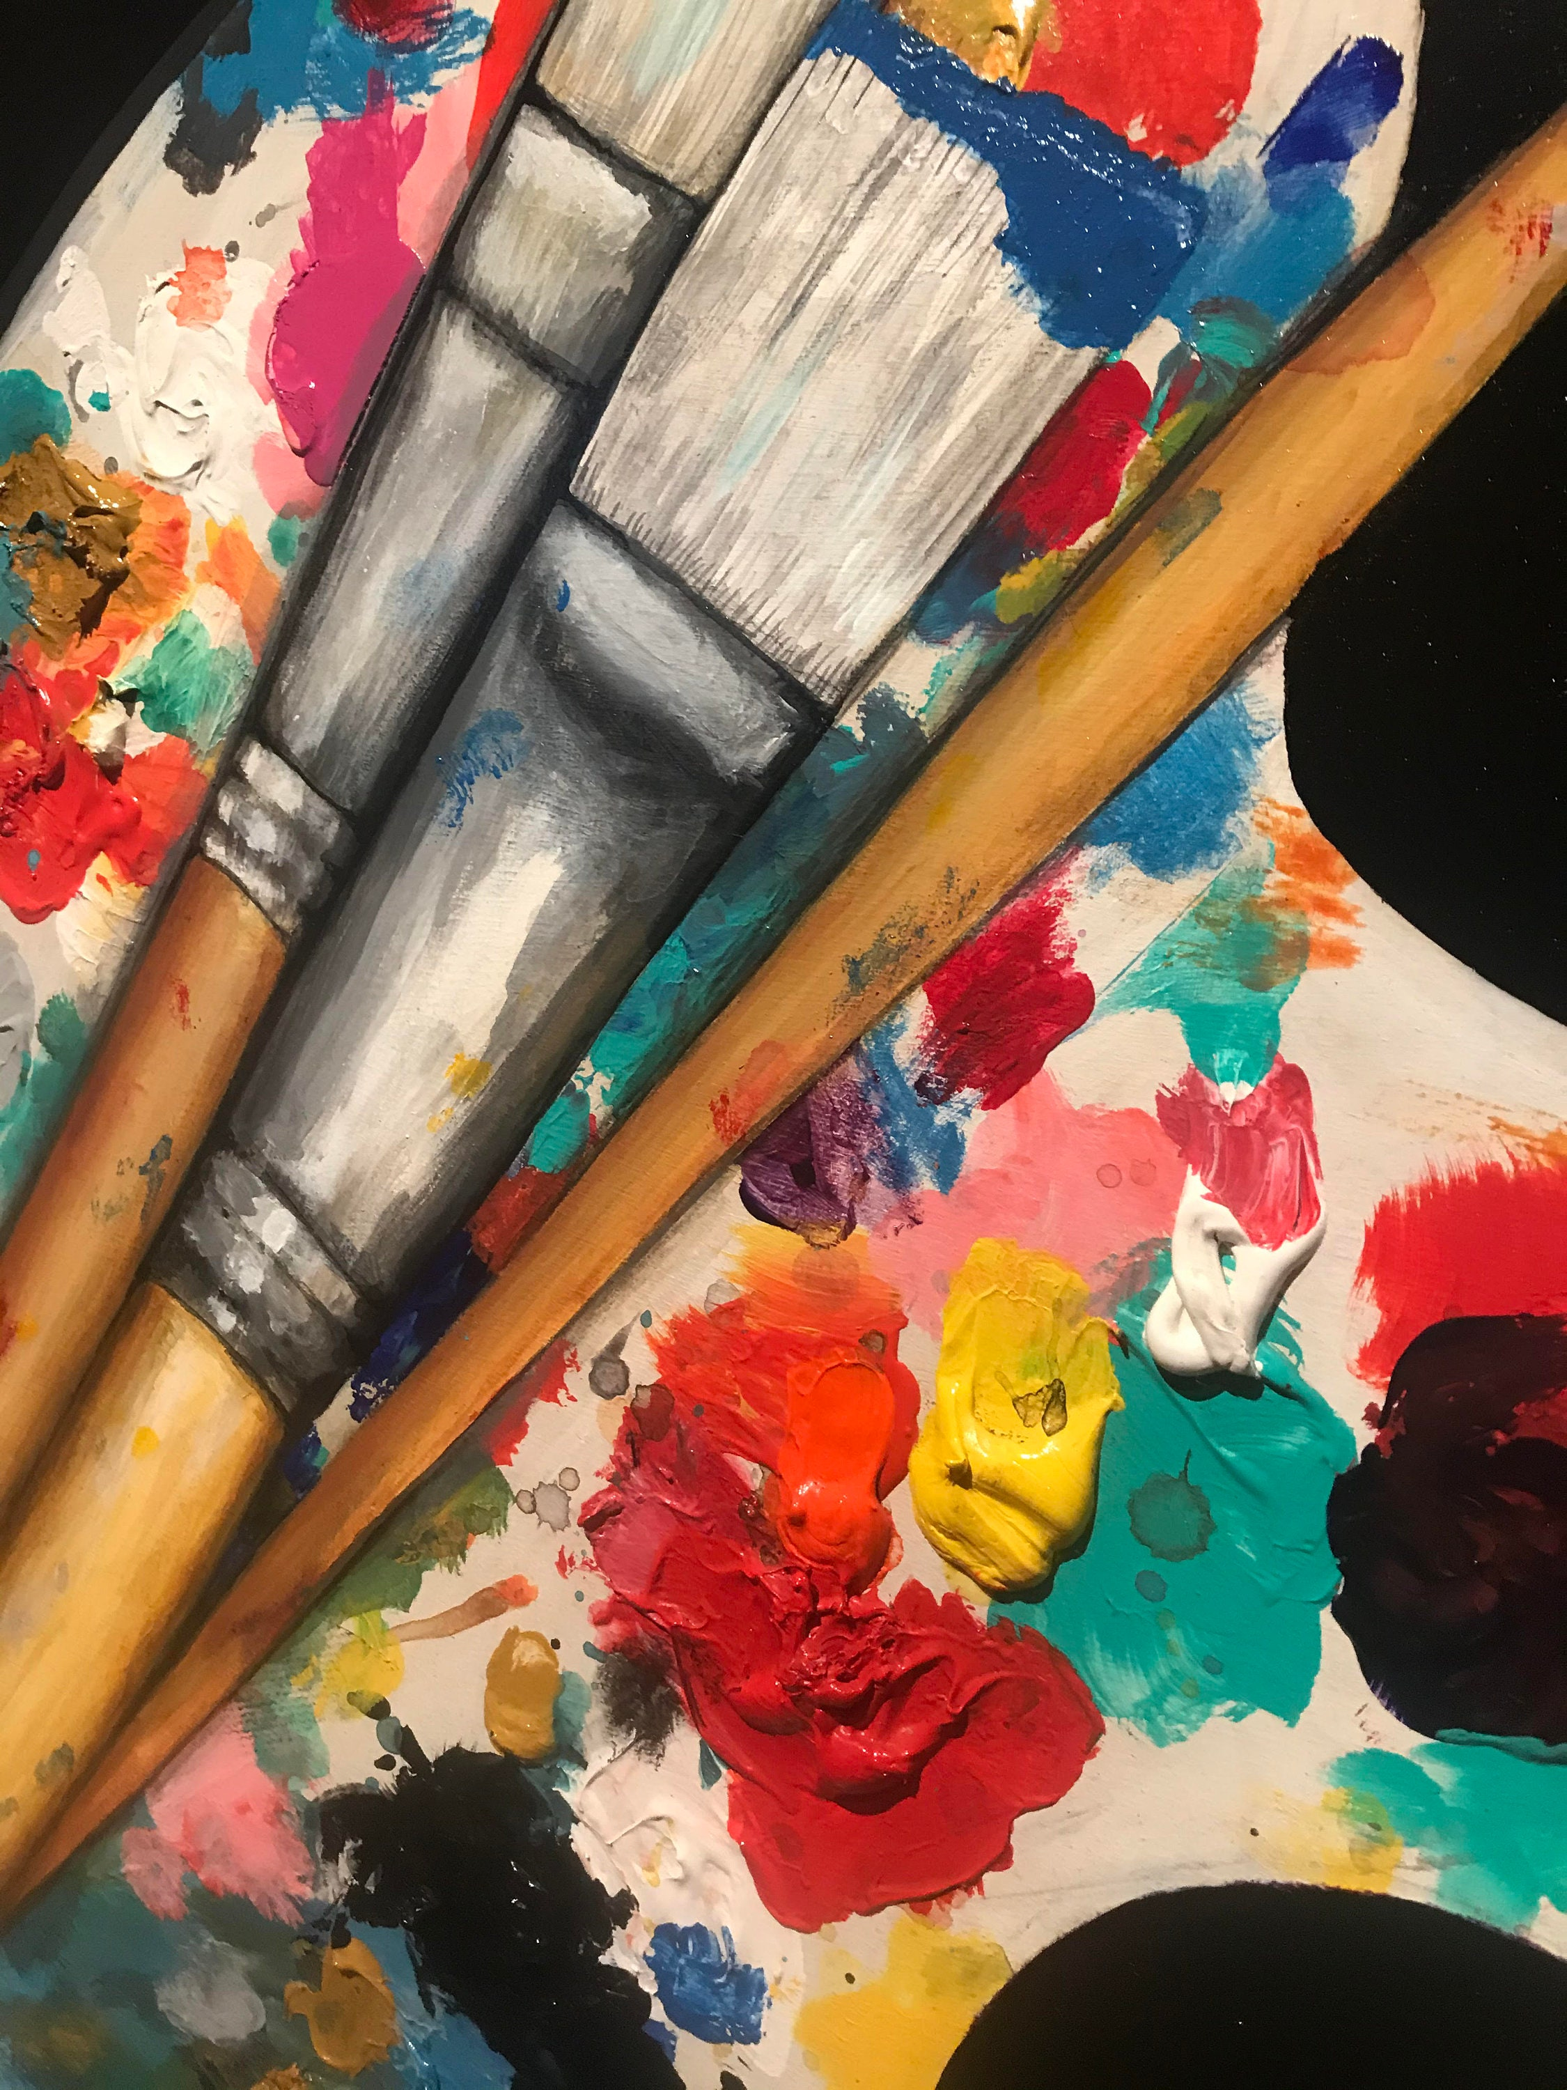
Reflection
What hope can we offer to future generations?
What image of Heaven do you see?
https://www.etsy.com/market/home_depot_paint_palette?utm_source=bing&utm_medium=cpc&utm_term=home_b&utm_campaign=Search_UK_DSA_BNG_ENG_Home_Categories_All&utm_ag=Home%252B%26%252BLiving-Catch%252BAll&utm_custom1=_k_346745a48c7b110aa94b200af019b10a_k_&utm_content=bing_420599364_1297424087855778_81089080912543_dat-2332888796375585:aud-808167869:loc-188_c_&utm_custom2=420599364&msclkid=346745a48c7b110aa94b200af019b10a

Slide 18
Prayer
God our creator,
As individuals and groups, may we come together in solidarity
to think and act for the future, keeping sincere eyes on Christ.
As you work inside of us and in Creation, may we be alert to the
moving of the Holy Spirit, in order to live in ways to sustain life in the
future.
Amen
(USPG Prayer - For a time such as this)

Slide 19
Go and Do!
Look at NATRE Spirited Arts Competition 2024 title ‘Where is God today?’- host an in-school competition and create an entry. Don’t forget to send examples to us to share with Bishop Dagmar and on the Ely Diocese Education website.
Email to: schoolsmission@elydiocese.org
https://www.natre.org.uk/uploads/Spirited%20Arts/2023/Spirited%20Arts%202023%20themes%20-%20Art%20in%20Heaven%20themes.pdf

