Slide 1

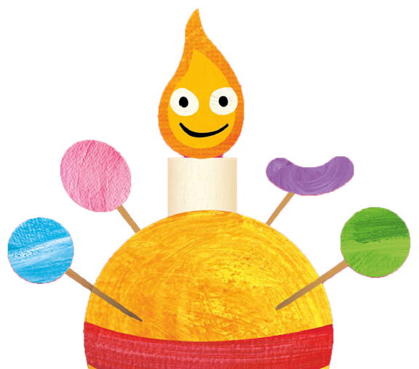





Advent Challenge
Complete 24 small acts of kindness over Advent - they can be done in any order, just tick them off as you go along - and make the world around you just that little bit better. On Christmas Day ask everyone in your home to read the prayer overleaf.
Make your own Christingle or bake a Christingle cake! Visit bit.ly/tcs-cake for the
Make a Christmas
Tell the Christmas story to your pet, or to a plant or
decoration for your tree
■
teddy bear
recipe.
■
■
Invite a neighbour in for
Donate some food to a
Donate a toy to charity
tea
food bank
■
Make a thank you card or picture for someone who
■ ■
helps or cares for you
■
Make up with someone
you have argued with
Pray for children who are alone this Christmas
Surprise your mum or carer by tidying your room!
■
■
■
Talk to someone who may
be sad / lonely
■
Become a campaigner for The Children’s Society! Go to bit.ly/tcs-campaign to
Put out some food for
Pray for someone you think
Buy a gift for someone special from a Children’s
birds
is having a difficult time
■ ■
Society shop
find out how
■
■
Spend a day
Write to someone telling
Give a small bunch of flowers to someone
saying nice things to everyone you meet!
Think of 3 things to thank
Ask your teacher if the school choir can sing carols after school to raise money for charity
them why you love them
God for
■
■ ■
■
■
Stand up for someone who is struggling
Drop in on an elderly neighbour - maybe with a cake or picture you’ve
Tell someone your favourite Christmas cracker joke!
Ask someone new to play
with you at break time
■
drawn
■
■
■
[Insert your Church logo here]

Slide 2
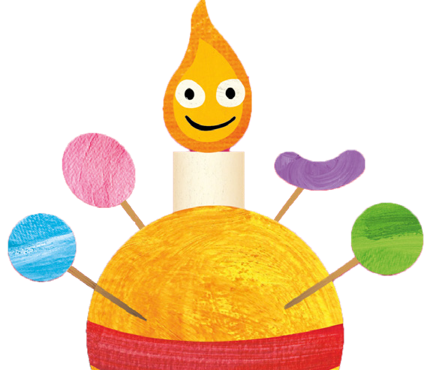
A Christmas prayer for the work of
The Children’s Society
Loving God
As we hear again the songs of Christmas praising the wonderful things you have done,
we remember those who don’t yet know about you.
We pray for children everywhere, that they may live in safety and peace.
We pray for the children living in unsafe places and for those who don’t have enough to eat and drink.
We pray too for those who are worried, lonely and scared.
We thank you for all the people working together to help children, including St Andrew’s and The Children’s Society.
This Christmas, we ask for your help so that this work gets stronger and we can help more and more children.
Through Jesus Christ our Lord.
Amen
CAMPAIGN FOR CHANGE IN 2023
Become a Children’s Society campaigner in 2023. Find out how by following this link: bit.ly/tcs-campaign (please note it’s case-sensitive!)
[Insert your Church logo here]

