Slide 1
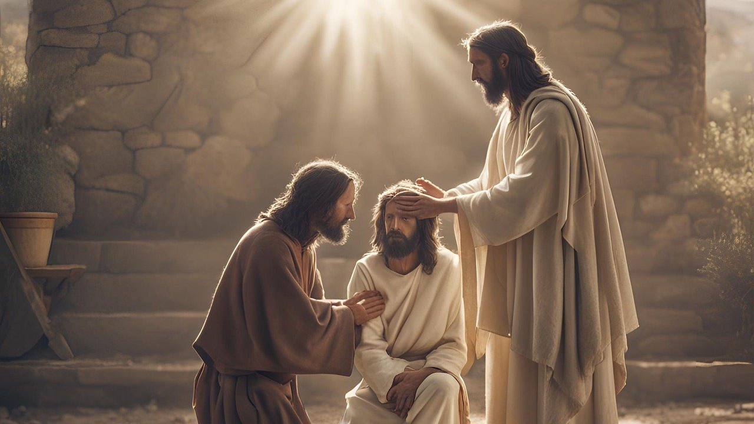
Good Morning – Bishop’s Lent Challenge – Week 1

Slide 2
Worship Leader Wave!

Slide 3
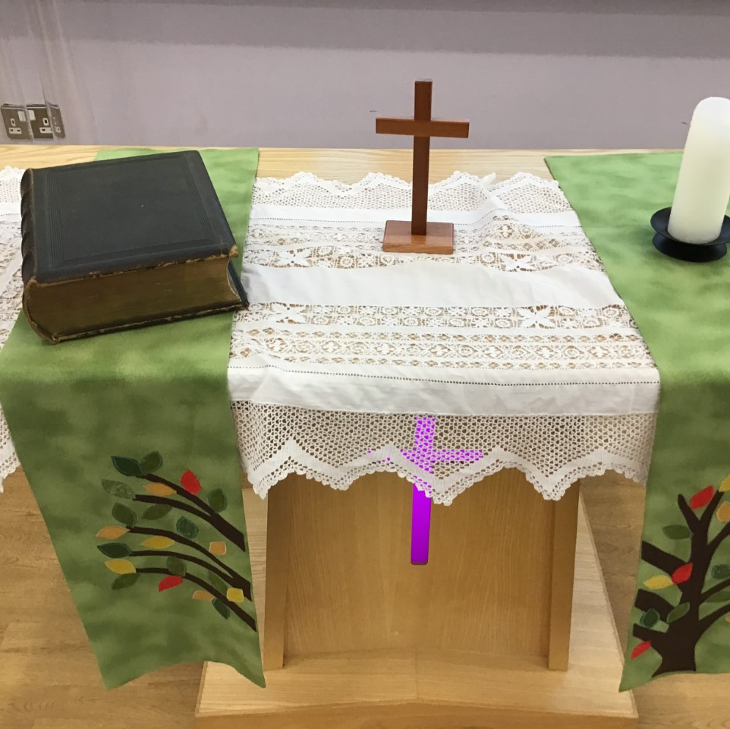
Worship Leader Welcome
We open the Bible as we think about … God the Father
We place the Cross as we think about … Jesus his Son
We light the Candle as we think about … The Holy Spirit

Slide 4
Worship Leader
Greeting
Lead: Jesus’ hands were kind hands…
Response: Doing good to all

Slide 5
Jesus was an amazing man.
Many people had been waiting hundreds of years for God to send someone to save them. God’s people had suffered at the hands of their enemies.
They wanted someone who could free them, who could guide them back to God, who could do special things and who would bring peace to the world.

Slide 6
Many people thought Jesus was indeed the man to do this.
They believed he was the Messiah, the one they had been waiting for.
Some believed he was more than that, some believed he was the Son of God.

Slide 7
Through the gospels, we hear of Jesus performing miracles. He showed himself as someone who could do extraordinary things.

Slide 8
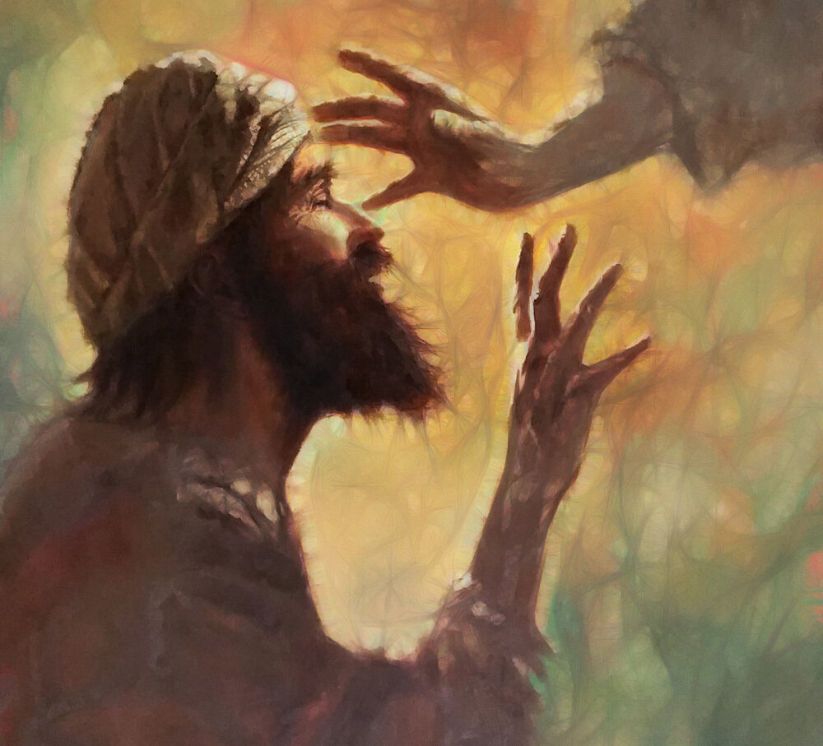
Mark 10:46-52
JESUS
BARTIMAUEUS
CROWD OF PEOPLE
DISCIPLES
https://godricm.wordpress.com/2021/10/26/mark-1046-52-oct-24-2021-gospel-30th-sunday-of-ordinary-time-year-b-reflections/

Slide 9
I wonder…
What would you ask for?
What difference could you make in the world if you asked people the question ‘What do you want me to do?’
Who would you seek help from?

Slide 10
Choral Worship

Slide 11
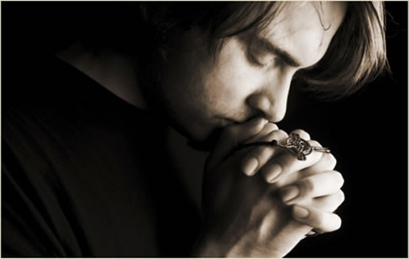
I invite you to
Pray with me.
If you want to make it your prayer, please find your quiet place, read out loud or ask a grown up to help and say
Amen at the end.
If you choose to take a moment to reflect, I invite you to think about
Helping someone in need

Slide 12
Dear God,
Help us to place our faith and trust in you,
Knowing that you are with us.
Help us to behave in the way Jesus showed us,
Make us strong to ask ‘What do you want me to do?’
Help us to act with compassion,
And show love for those around us who need help.
Lord in your mercy,
Hear our prayer,
Amen

Slide 14
Go in peace – Bishop’s Lent Challenge

