Slide 1
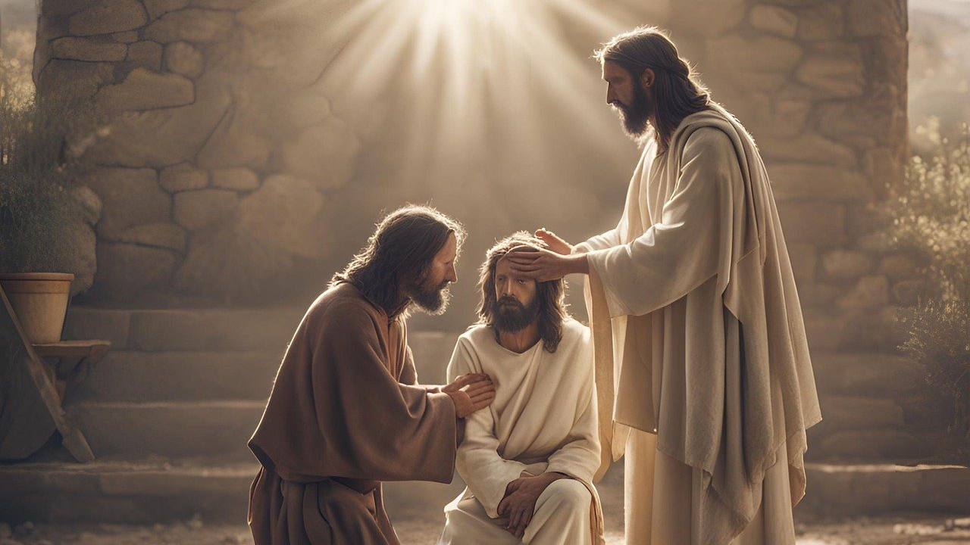
Good Morning – Bishop’s Lent Challenge – Week 2

Slide 2
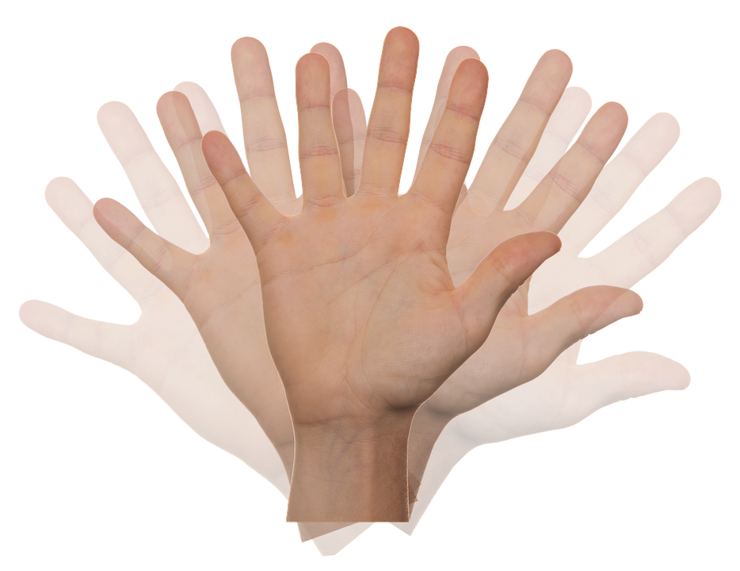
Worship Leader Wave!

Slide 3
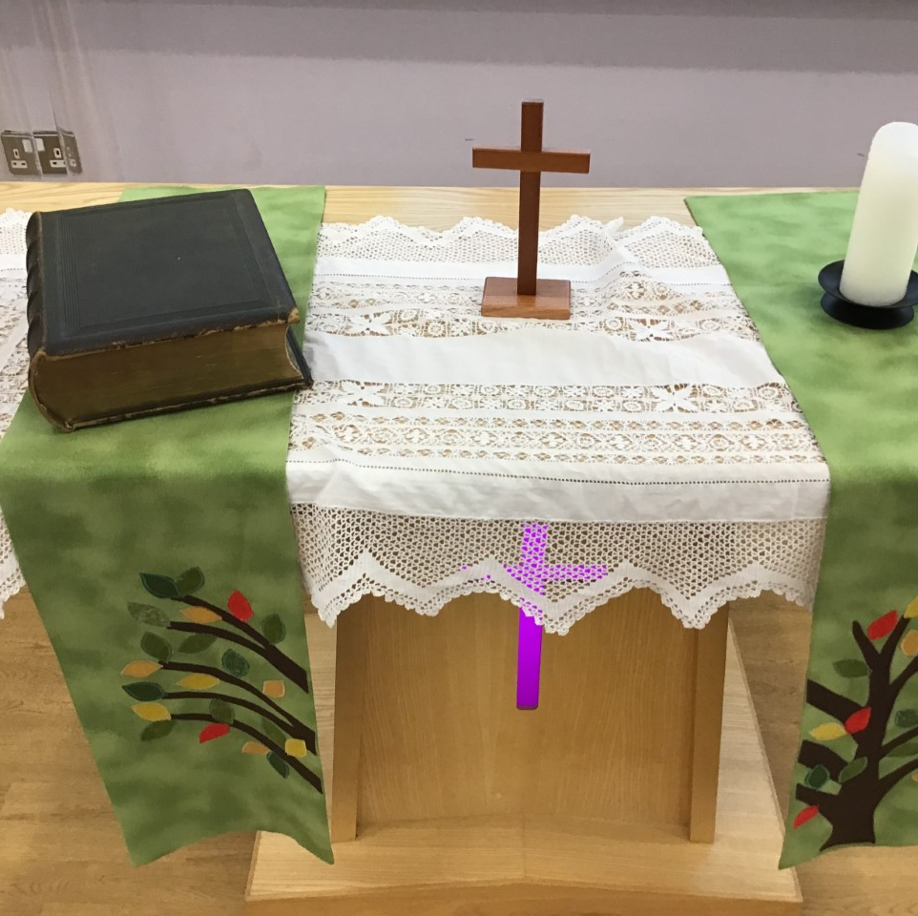
Worship Leader Welcome
We open the Bible as we think about … God the Father
We place the Cross as we think about … Jesus his Son
We light the Candle as we think about … The Holy Spirit

Slide 4
Worship Leader
Greeting
Lead: Jesus’ hands were kind hands…
Response: Doing good to all

Slide 5
Jesus was an amazing man.
Many people had been waiting hundreds of years for God to send someone to save them. God’s people had suffered at the hands of their enemies.
They wanted someone who could free them, who could guide them back to God, who could do special things and who would bring peace to the world.

Slide 6
Many people thought Jesus was indeed the man to do this.
They believed he was the Messiah, the one they had been waiting for.
Some believed he was more than that, some believed he was the Son of God.

Slide 7
Through the gospels, we hear of Jesus performing miracles. He showed himself as someone who could do extraordinary things.

Slide 8
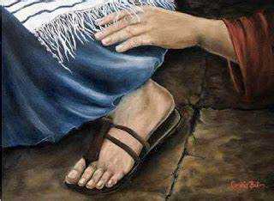
MARK 6:53-56
JESUS
CROWD OF PEOPLE
DISCIPLES

Slide 9
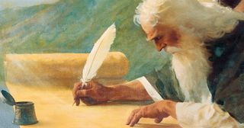
ISAIAH
OLD TESTAMENT
PROPHET
MESSIAH
https://www.churchofjesuschrist.org/media/image/prophet-isaiah-foretells-christs-birth-f8470fa?lang=eng

Slide 10
I wonder…
How it would feel to be healed by Jesus?
How would it feel waiting to get close enough to touch him?
What people felt when they touched his coat?
Would you keep the news to yourself or would you share it with others?

Slide 11
Choral Worship

Slide 12
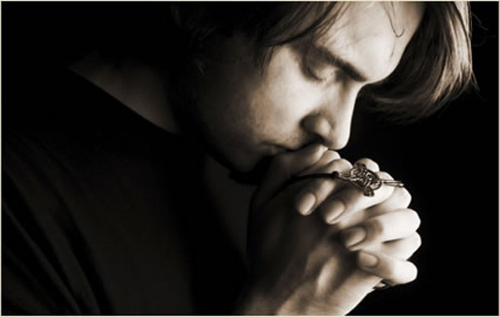
I invite you to
Pray with me.
If you want to make it your prayer, please find your quiet place, read out loud or ask a grown up to help and say
Amen at the end.
If you choose to take a moment to reflect, I invite you to think about
Having kind hands

Slide 13
Dear God,
Lord in your mercy,
Hear our prayer,
Amen
Thank you for…
Sorry for…
(Pause)
(Pause)
Please can you…
(Pause)

Slide 14
Classroom and Enrichment Challenge:
Create a school picture collage to show how pupils demonstrate these skills and values to make an acrostic poem that spells BISHOPS LENT CHALLENGE
You can choose to create one word or all three

Slide 15
Go in peace – Bishop’s Lent Challenge

