Slide 1
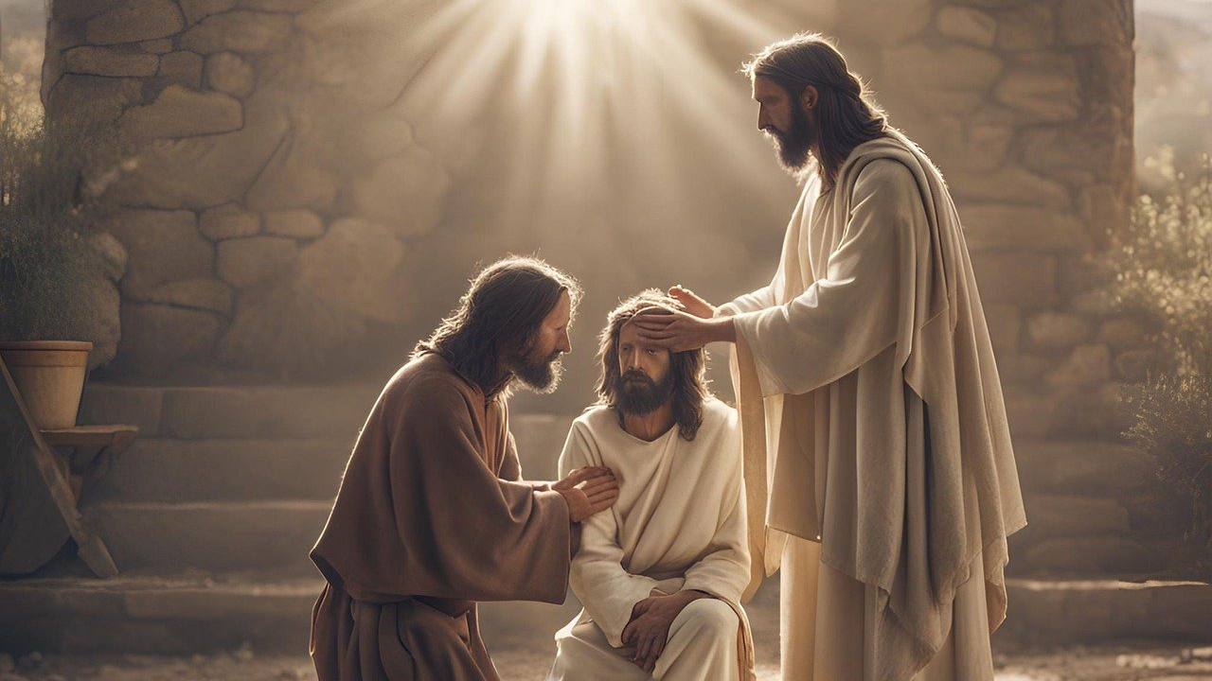
Good Morning – Bishop’s Lent Challenge – Week 3

Slide 2
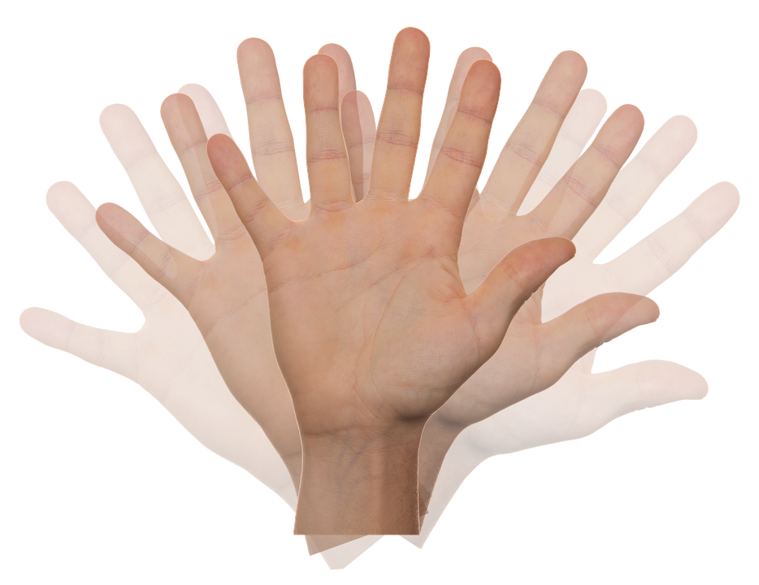
Worship Leader Wave!

Slide 3
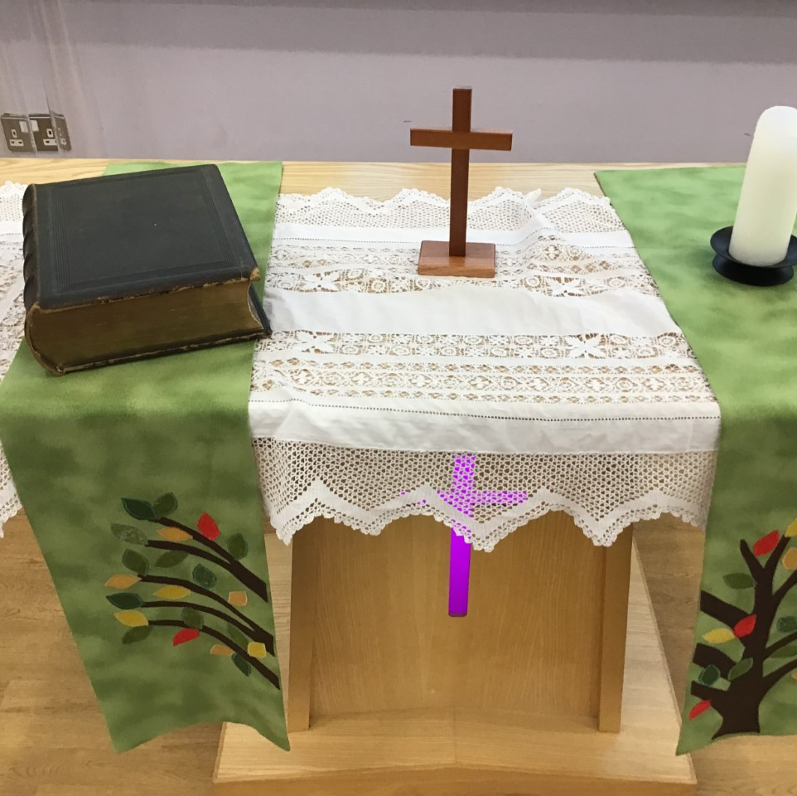
Worship Leader Welcome
We open the Bible as we think about … God the Father
We place the Cross as we think about … Jesus his Son
We light the Candle as we think about … The Holy Spirit

Slide 4
Worship Leader
Greeting
Lead: Jesus’ hands were kind hands…
Response: Doing good to all

Slide 5
Jesus was an amazing man.
Many people had been waiting hundreds of years for God to send someone to save them. God’s people had suffered at the hands of their enemies.
They wanted someone who could free them, who could guide them back to God, who could do special things and who would bring peace to the world.

Slide 6
Many people thought Jesus was indeed the man to do this.
They believed he was the Messiah, the one they had been waiting for.
Some believed he was more than that, some believed he was the Son of God.

Slide 7
Through the gospels, we hear of Jesus performing miracles. He showed himself as someone who could do extraordinary things.

Slide 8
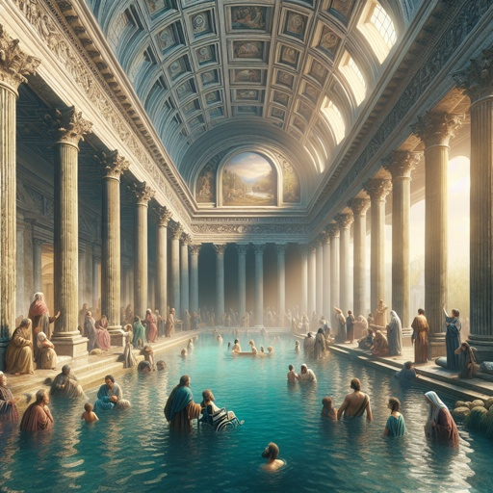
JOHN 5:2-10
JESUS
CROWD OF PEOPLE
PARALYSED MAN
https://bible.art/meaning/john-5:2

Slide 9
I wonder…
How it felt to be waiting for the angel to appear.
How it felt to be healed by the spiritual water.
How brave the man felt when he reached out to Jesus.
How many people Jesus told to keep their healing secret… and how many shared the good news.

Slide 10
Choral Worship

Slide 11
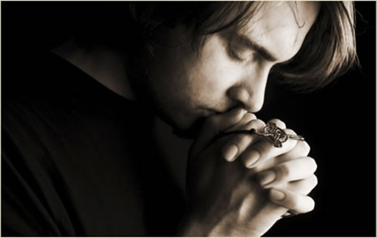
I invite you to
Pray with me.
If you want to make it your prayer, please find your quiet place, read out loud or ask a grown up to help and say
Amen at the end.
If you choose to take a moment to reflect, I invite you to think about
Helping those around us

Slide 12
Dear God,
Today I pray for …
Lord in your mercy,
Hear our prayer,
Amen
People in authority
People who need help
People who give you direction
You
People close to me

Slide 13
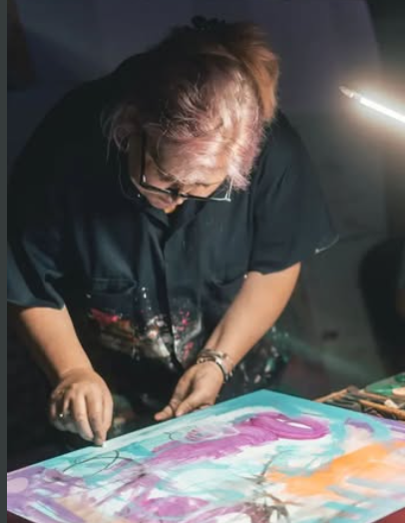
Reflection & Enrichment
Kristin VG Bailey - ‘Unveiled Faces’ Project
Kristin sees we are the people of God. She creates artwork in the style of Christian iconography. She adds symbols connected to them within her work too. Watch the video challenge for the reflection and enrichment for this week.

Slide 14
Go in peace – Bishop’s Lent Challenge

Slide 15
