Slide 1

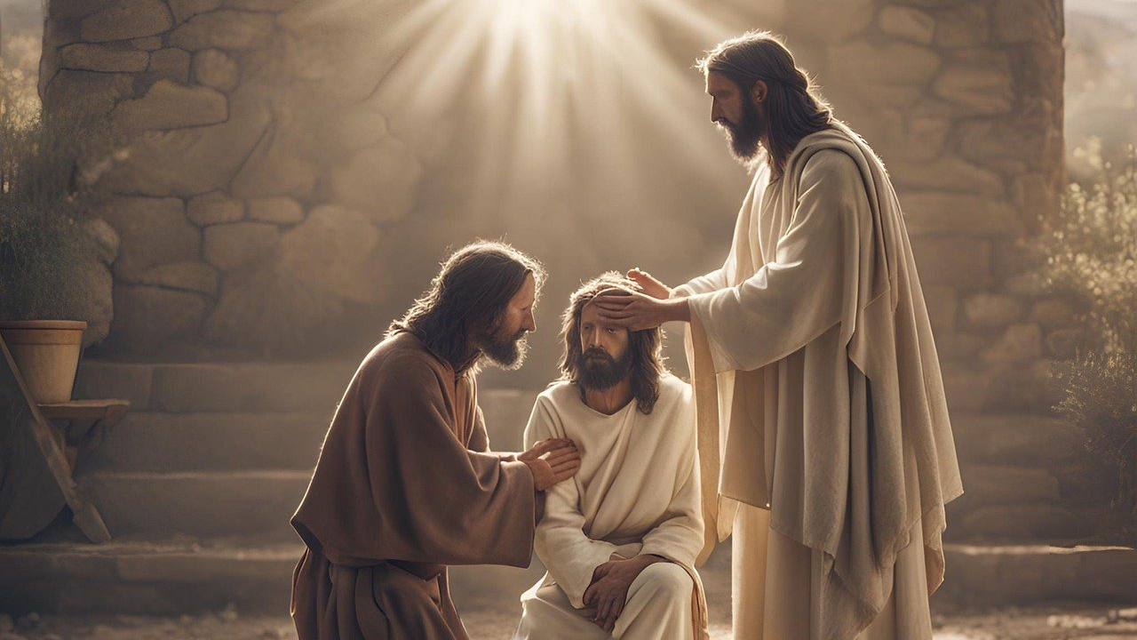
Good Morning – Bishop’s Lent Challenge – Week 4

Slide 2

Worship Leader Wave!

Slide 3
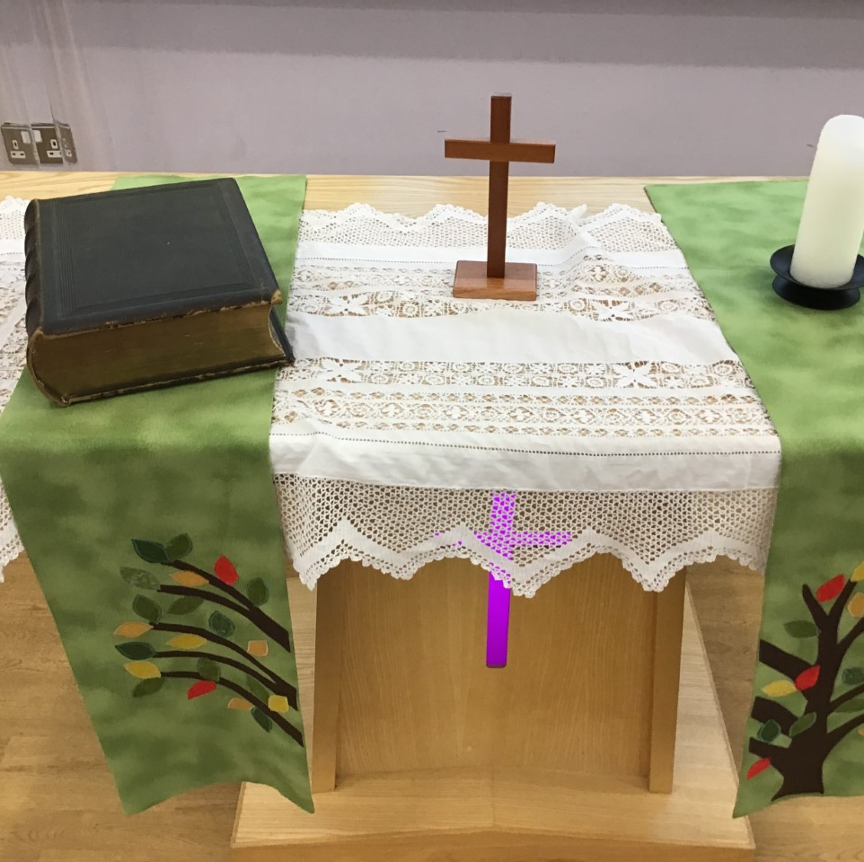
Worship Leader Welcome
We open the Bible as we think about … God the Father
We place the Cross as we think about … Jesus his Son
We light the Candle as we think about … The Holy Spirit

Slide 4

Worship Leader
Greeting
Lead: Jesus’ hands were kind hands…
Response: Doing good to all

Slide 5

Jesus was an amazing man.
Many people had been waiting hundreds of years for God to send someone to save them. God’s people had suffered at the hands of their enemies.
They wanted someone who could free them, who could guide them back to God, who could do special things and who would bring peace to the world.

Slide 6

Many people thought Jesus was indeed the man to do this.
They believed he was the Messiah, the one they had been waiting for.
Some believed he was more than that, some believed he was the Son of God.

Slide 7

Through the gospels, we hear of Jesus performing miracles. He showed himself as someone who could do extraordinary things.

Slide 8
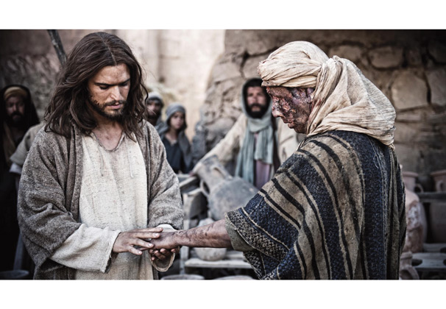
LUKE 5:12-16
JESUS
MAN WITH LEPROSY
https://redeeminggod.com/sermons/luke/luke_5_12-16/

Slide 9


I wonder…
How it felt to be rejected by society when you were poorly.
Why people believed leprosy was a punishment from God.
How it felt to be healed by the words of Jesus.
How many people were healed by the water in the pool of Bethesda.

Slide 10
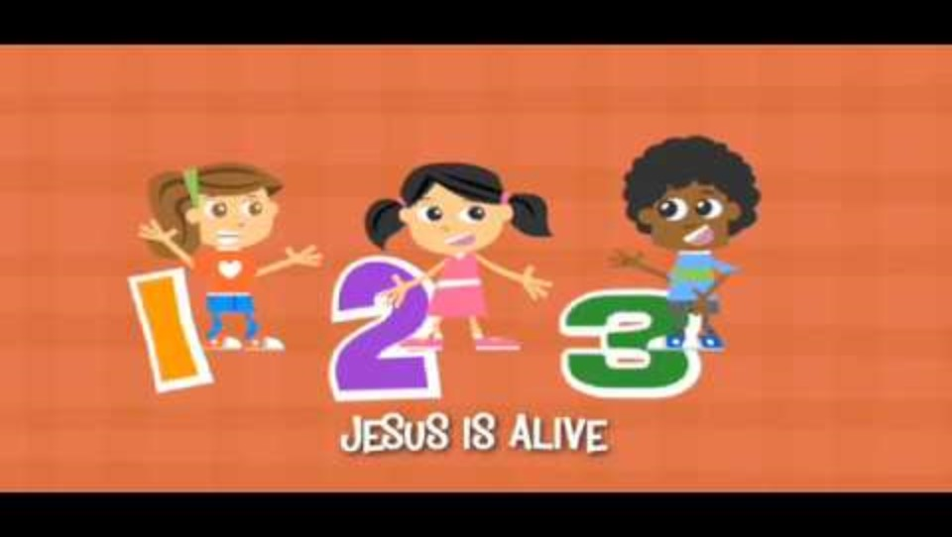
Choral Worship

Slide 11
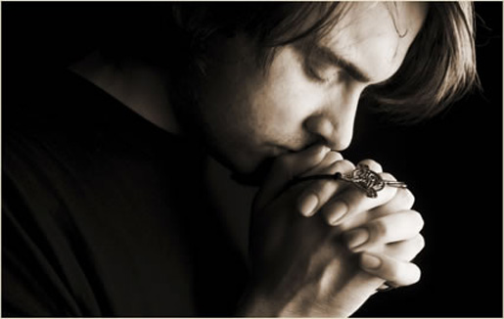
I invite you to
Pray with me.
If you want to make it your prayer, please find your quiet place, read out loud or ask a grown up to help and say
Amen at the end.
If you choose to take a moment to reflect, I invite you to think about
Helping those who are ill

Slide 12
Dear God,
Help us to show mercy and help those in need.
Help us to give love to those who are rejected and suffer.
Give us the strength to open our eyes and see the world.
Give us the ability to stand up for those who cannot
stand up for themselves.
Lord in your mercy,
Hear our prayer,
Amen

Slide 13
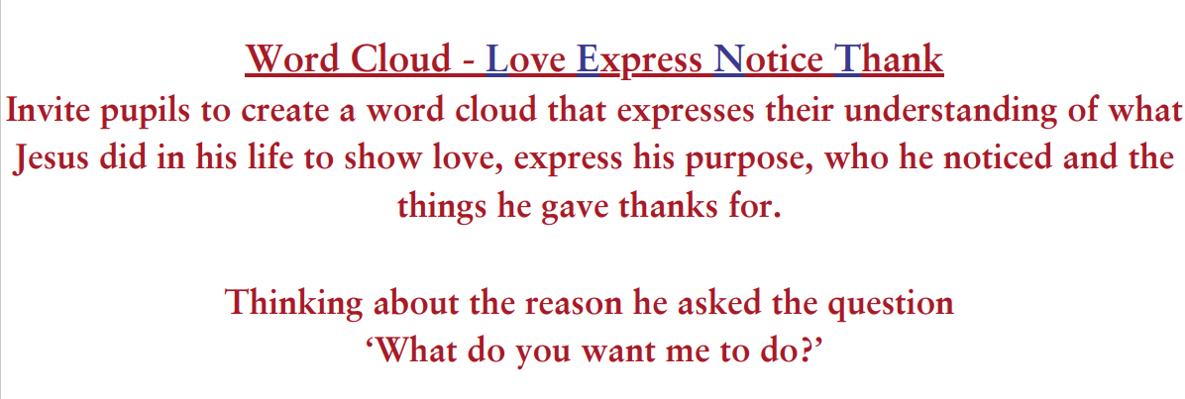


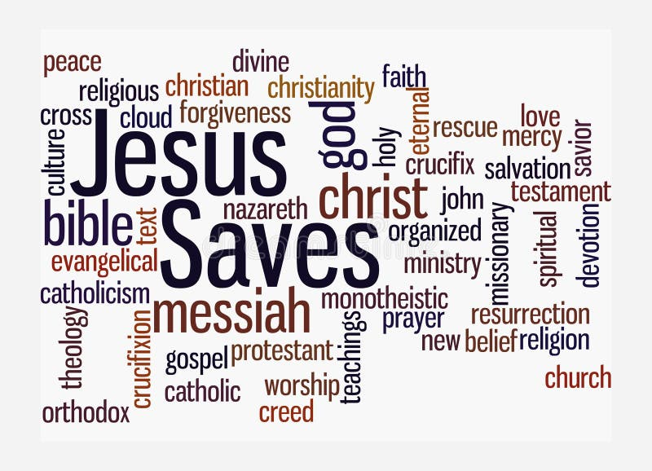
Reflection and Enrichment Choice 1
https://www.presentermedia.com/powerpoint-clipart/jesus-cross-word-cloud-pid-25661
https://www.dreamstime.com/word-cloud-jesus-saves-concept-isolated-white-background-word-cloud-jesus-saves-concept-isolated-white-image241146125
https://www.shutterstock.com/image-vector/jesus-christ-word-cloud-concept-134327660

Slide 14
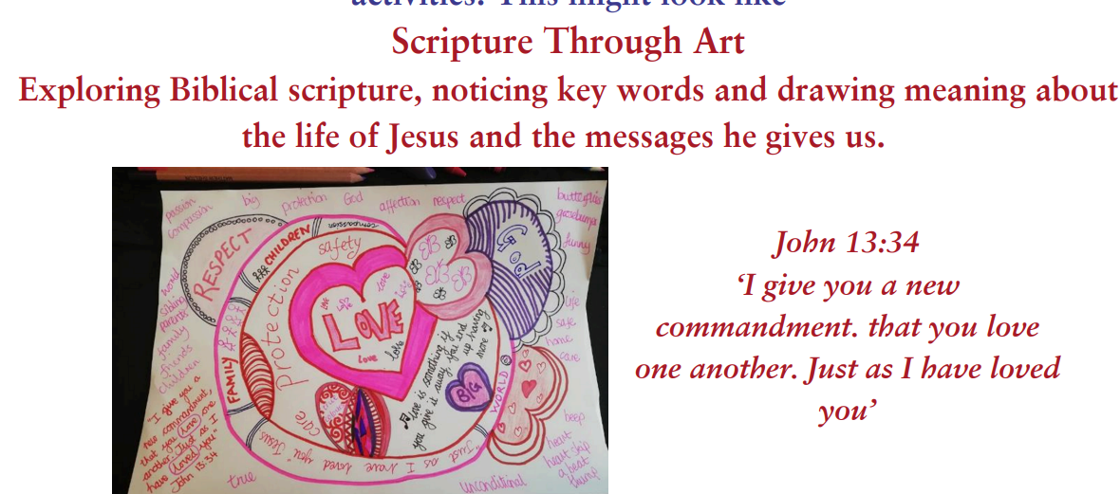
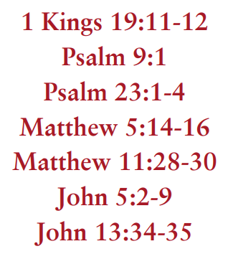
Reflection and Enrichment Choice 2

Slide 15
Go in peace – Bishop’s Lent Challenge

Slide 16


