Slide 1
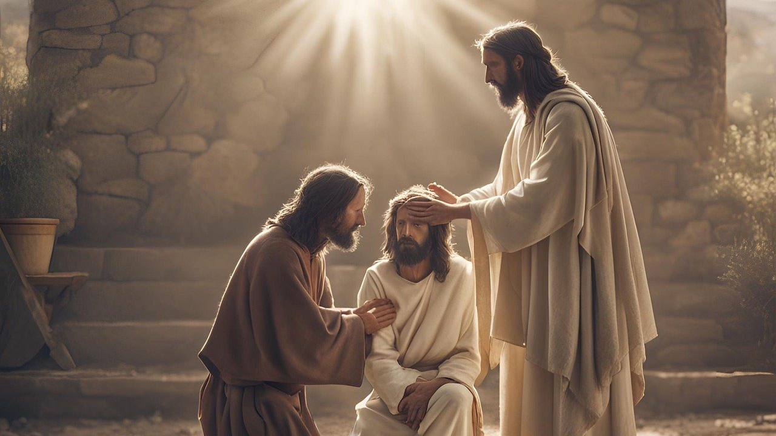
Good Morning – Bishop’s Lent Challenge – Week 5

Slide 2
Worship Leader Wave!

Slide 3
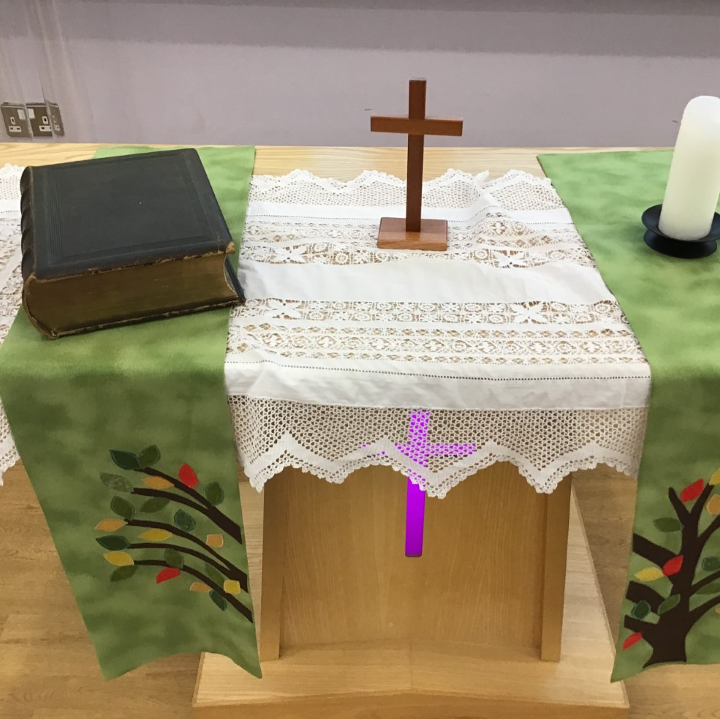
Worship Leader Welcome
We open the Bible as we think about … God the Father
We place the Cross as we think about … Jesus his Son
We light the Candle as we think about … The Holy Spirit

Slide 4
Worship Leader
Greeting
Lead: Jesus’ hands were kind hands…
Response: Doing good to all

Slide 5
Jesus was an amazing man.
Many people had been waiting hundreds of years for God to send someone to save them. God’s people had suffered at the hands of their enemies.
They wanted someone who could free them, who could guide them back to God, who could do special things and who would bring peace to the world.

Slide 6
Many people thought Jesus was indeed the man to do this.
They believed he was the Messiah, the one they had been waiting for.
Some believed he was more than that, some believed he was the Son of God.

Slide 7
Through the gospels, we hear of Jesus performing miracles. He showed himself as someone who could do extraordinary things.

Slide 8
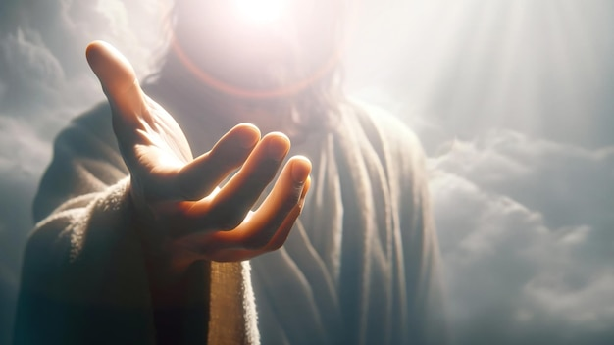
MATTHEW 11:28-30
https://www.freepik.com/premium-ai-image/jesus-reaching-out-his-hand-salvation_134076990.htm

Slide 9
I wonder…
Who you can talk to, to lighten your load?
Who will listen to your worries and woes?
Who really sees you for who you are?
Who will you say ‘share your load, I will give you rest’ ?

Slide 10
Choral Worship

Slide 11
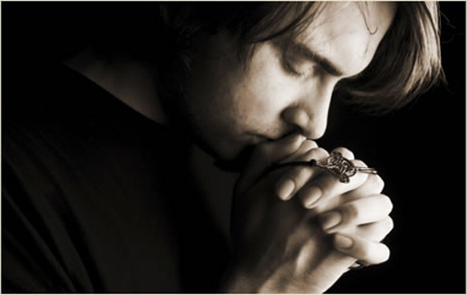
I invite you to
Pray with me.
If you want to make it your prayer, please find your quiet place, read out loud or ask a grown up to help and say
Amen at the end.
If you choose to take a moment to reflect, I invite you to think about
Helping others to share their load

Slide 12
Dear God,
Let me listen to Jesus’ words said
‘Share your load, I will give you rest’
Let me turn you Lord Jesus,
Help me to share my worries and strains.
Let me turn to others,
To offer my listening ears and seeing eyes.
Lord in your mercy,
Hear our prayer,
Amen

Slide 13
Reflection and Enrichment Choice 1

Slide 14
Reflection and Enrichment Choice 2

Slide 15
Go in peace – Bishop’s Lent Challenge

