Slide 1

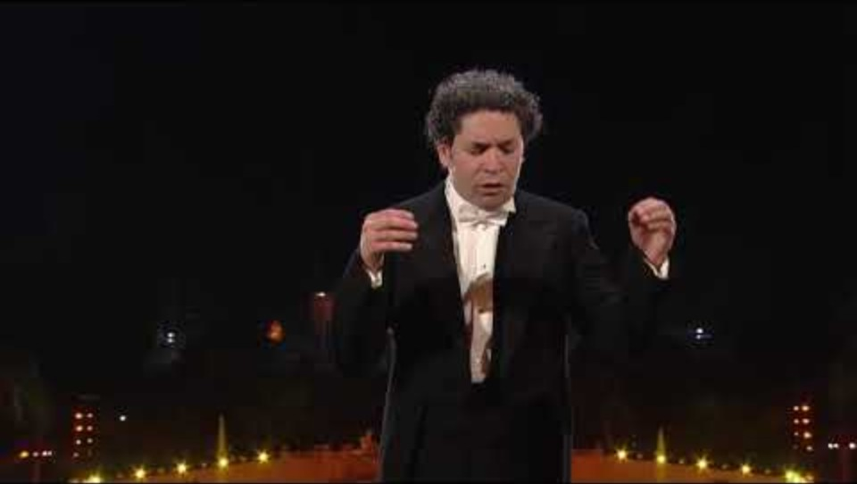

Bishop’s Lent Challenge 2026
“Therefore encourage each other,
Build each other up,
Just as you are doing”
1 Thessalonians 5:11

Slide 2
Bishop’s Lent Challenge 2026
Good Morning

Slide 3

Bishop’s Lent Challenge 2026
Welcome Wave

Slide 4
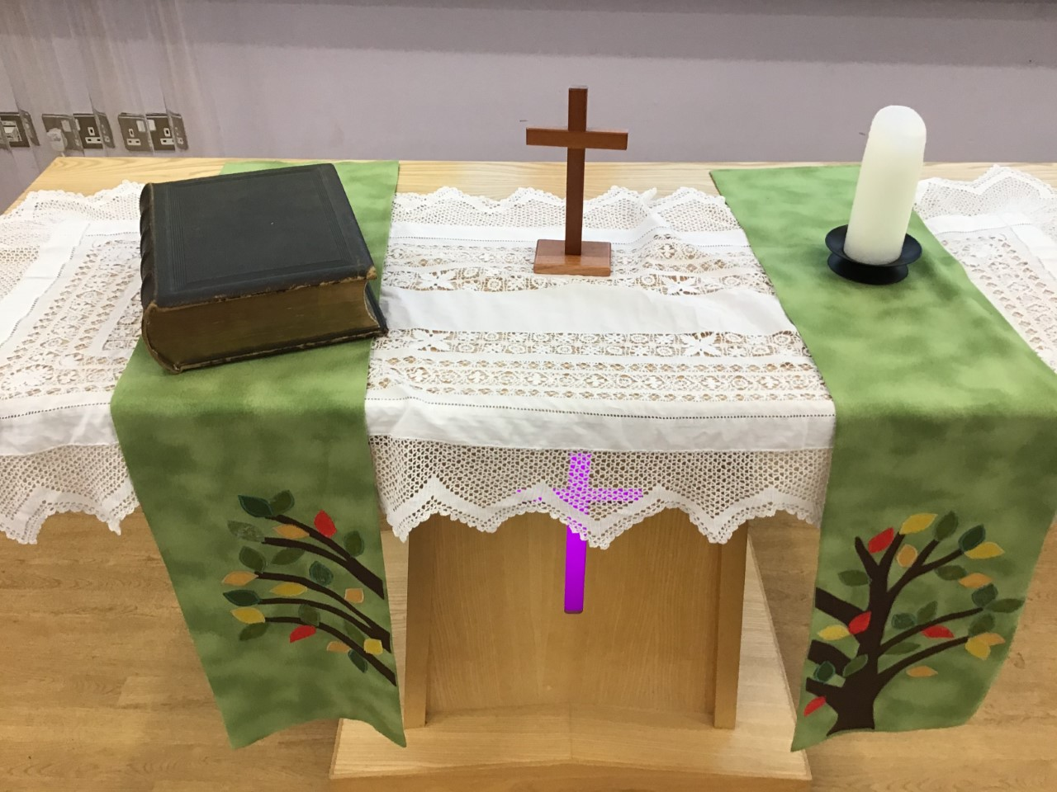
Bishop’s Lent Challenge 2026 -Worship Leader Welcome
We open the Bible as we think about … God the Father
We place the Cross as we think about … Jesus his Son
We light the Candle as we think about … The Holy Spirit

Slide 5



Bishop’s Lent Challenge 2026 -Worship Leader Greeting
Lead: Therefore, encourage and build each up…
Response: Just as we are doing!

Slide 6
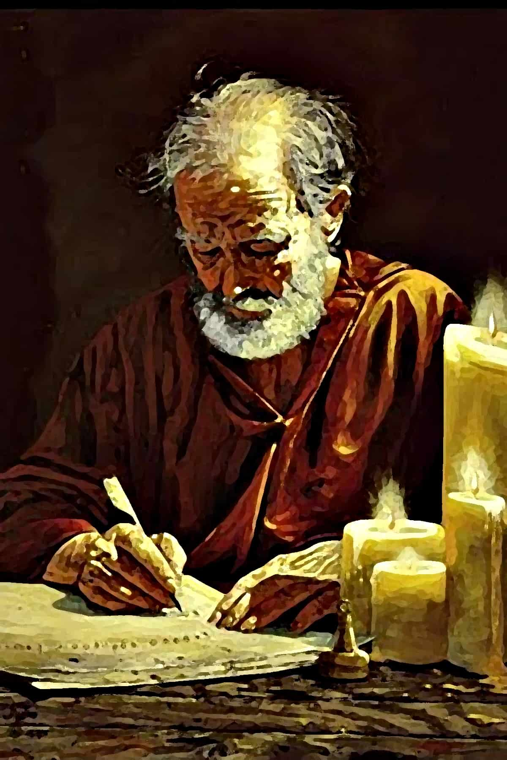
Bishop’s Lent Challenge 2026
In this year's challenge, we meet Paul the Apostle.
He was a Roman citizen who lived in Jesus’ time. As a Roman, he had rights that placed him in a position of power, and this helped to protect him. However, he was also a Pharisee which showed he was from a Jewish family.
When he was a Jewish Pharisee, he hated the early Christians and watched many of them being punished. Then he had encounter with Jesus and his life changed. He made it his mission to bring the gospel further than the Jewish community.

Slide 7
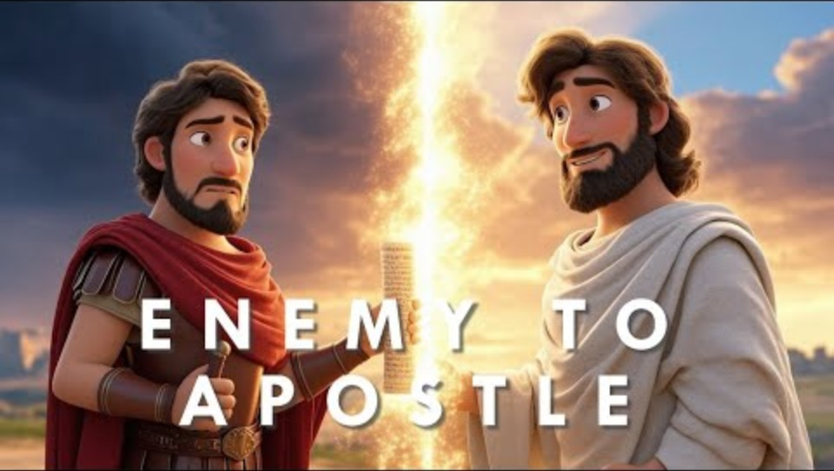
Bishop’s Lent Challenge 2026
https://www.youtube.com/watch?v=20QKYFksIRI&list=RD20QKYFksIRI&start_radio=1
Paul The Apostle – Bible Hero Series – Christian Songs of Worship

Slide 8
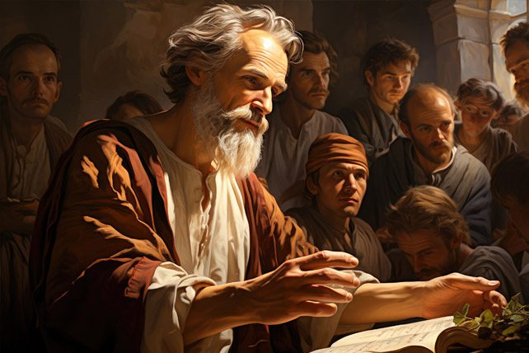
Bishop’s Lent Challenge 2026
He was not one of the 12 disciples, but he was a man who shared the gospel to the world in the first century.
He was one of the most influential figures in the spread of early Christianity and founded many churches and communities in Asia and Europe.
Because he was a Jew and a Roman citizen this meant he could talk to both groups of people.
In fact, he could speak in at least 3 languages which meant as a preacher, he could spread the good news in Jerusalem and soon found himself travelling the world to spread the word further.
https://churchleaders.com/pastors/469579-apostle-paul-missionary-journeys.html

Slide 9
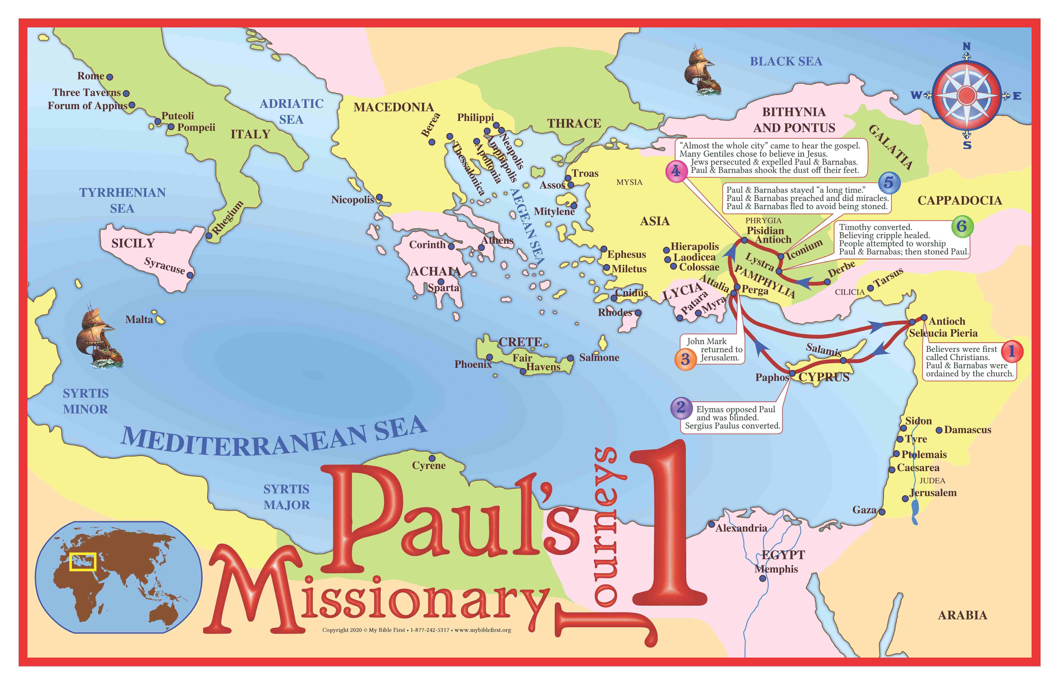
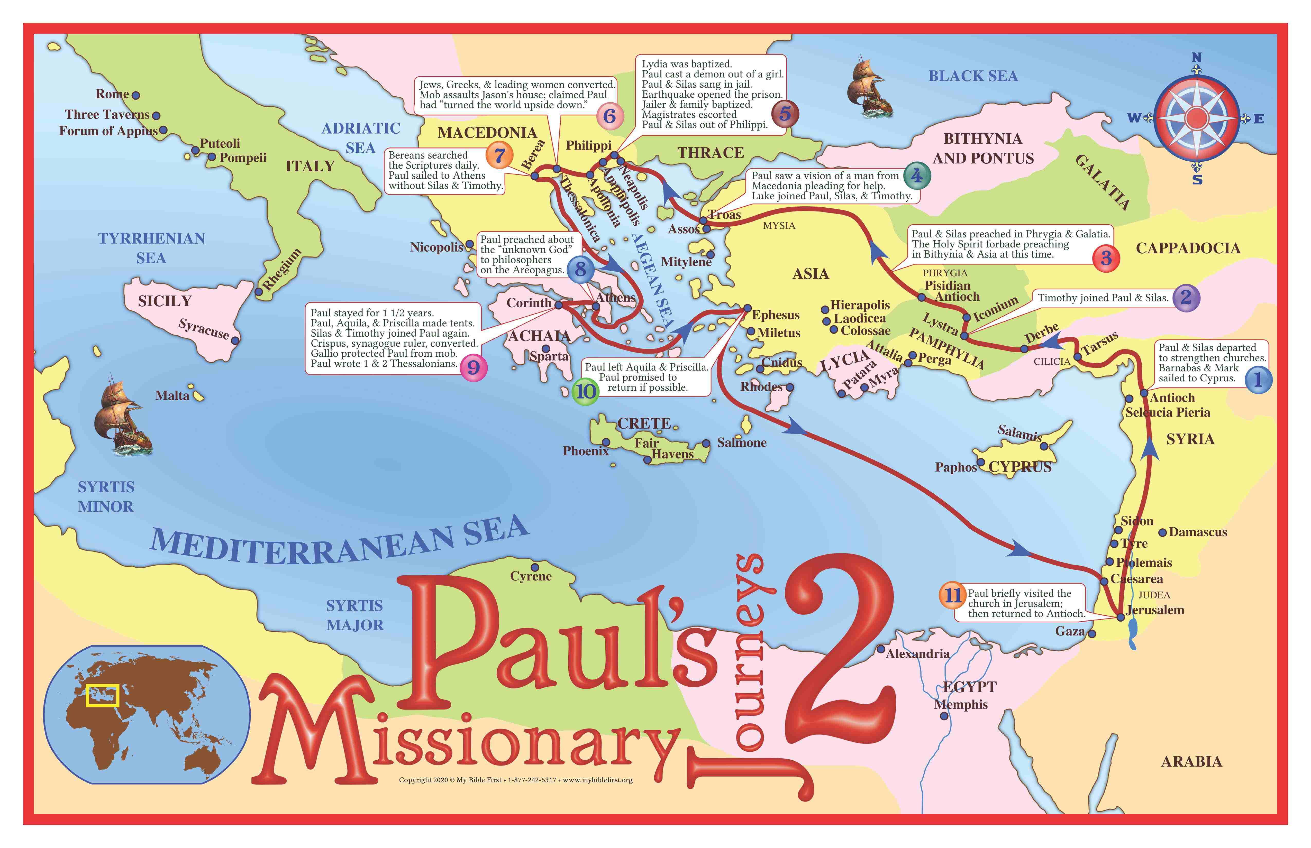
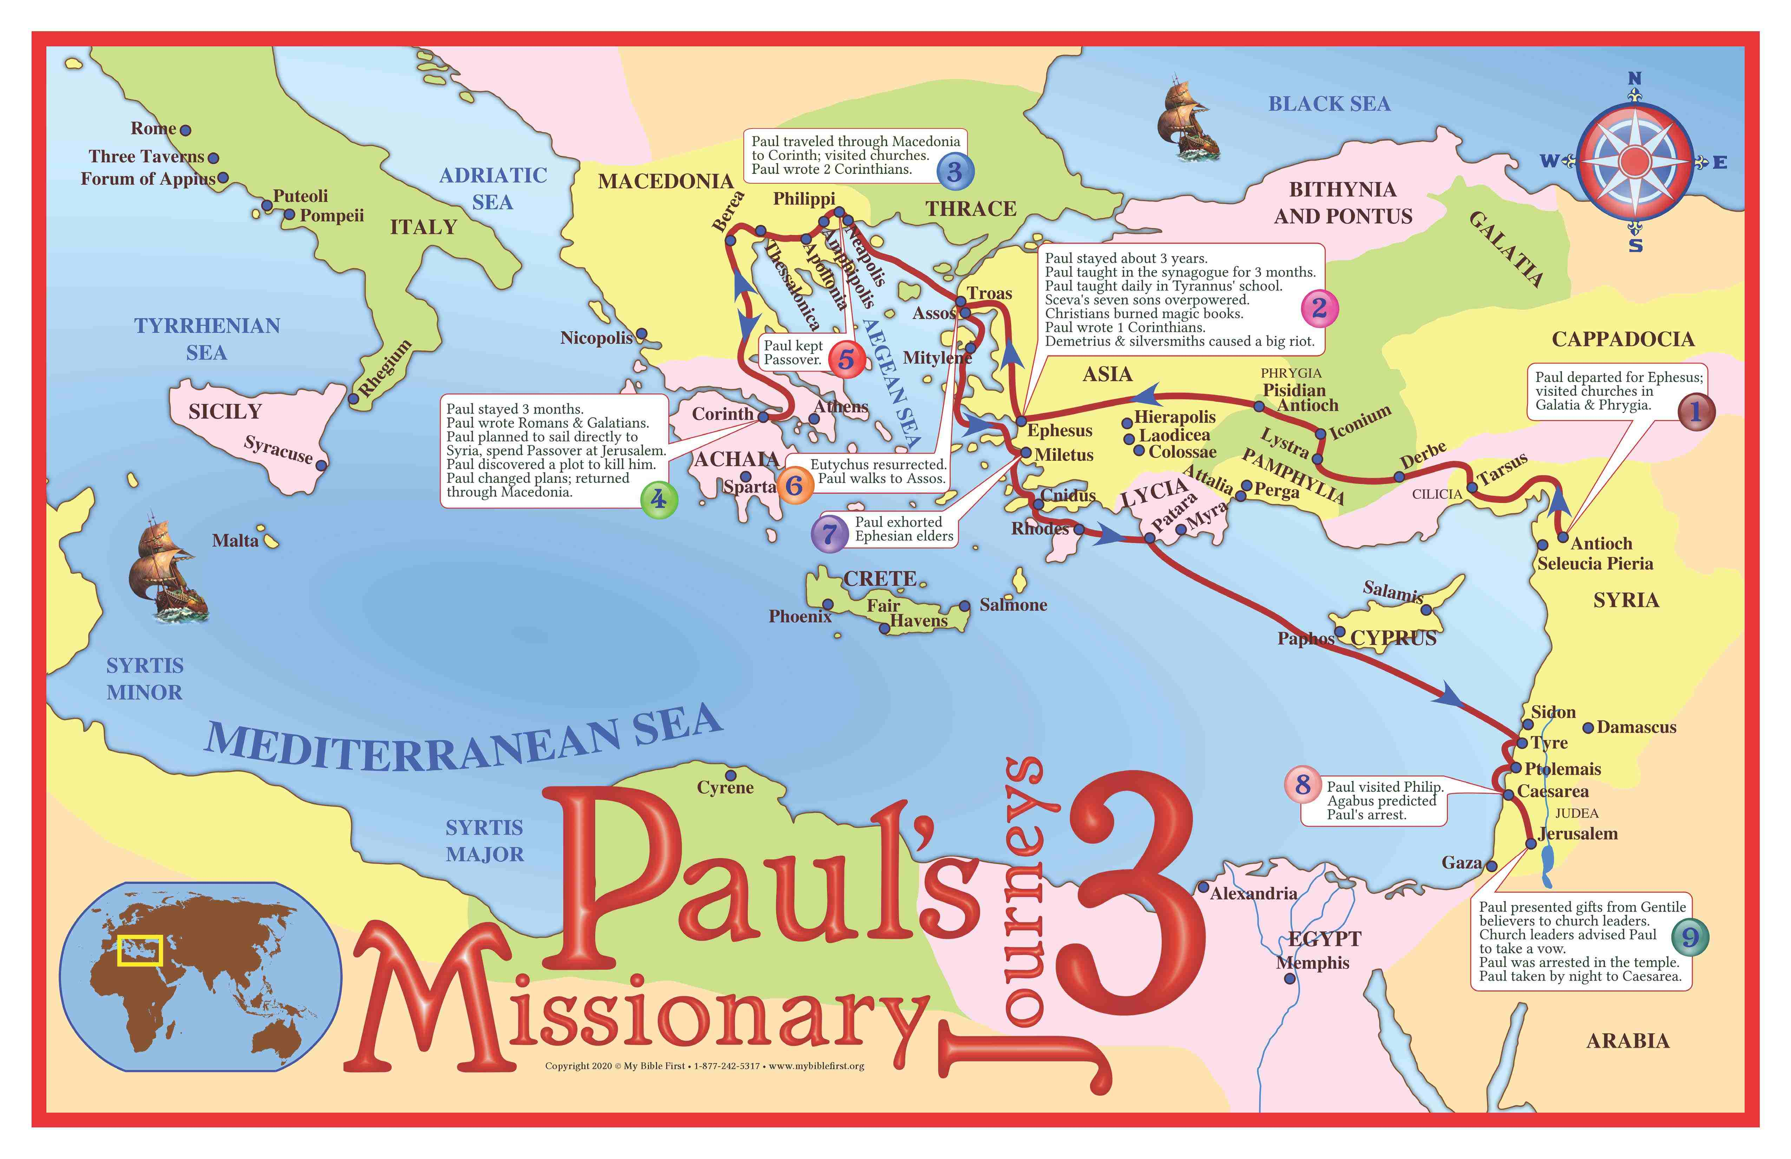
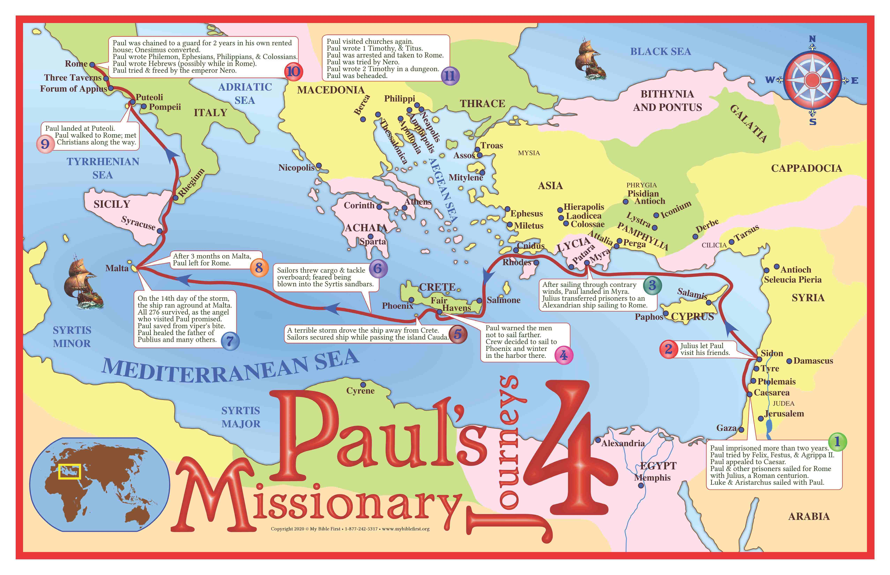
Bishop’s Lent Challenge 2026
He went on four big missions around the world after his conversion.
During his second mission, which lasted three years, many churches were founded in Thessalonica. This is the mission we are interested in.
The Thessalonians were people of a major city in ancient Macedonia (in modern-day northern Greece).
It was a significant port and trade centre during Paul’s time and had a mix of Jews, Greeks, and Roman citizens, which he could communicate with.
https://mybiblefirst.co.uk/store/product/64

Slide 10
Bishop’s Lent Challenge 2026
Thessalonica

Slide 11
Bishop’s Lent Challenge 2026
Thessalonica was the perfect place to preach because he could reach a large and diverse population, including both Jews and Gentiles (non-Jews).
Thessalonica was a city where he could find fellow Jews in the synagogue, providing an existing platform for him to share the Gospel- those waiting for the Messiah aka Jesus.
Thessalonica had a synagogue, allowing Paul to share his message about Jesus with fellow Jews.
Paul's goal was to find people who were searching for God and to share the Gospel with them.
He was eventually forced to leave the city, but many people converted and remained strong in their faith to God and belief in Jesus.
https://mybiblefirst.co.uk/store/product/64

Slide 12
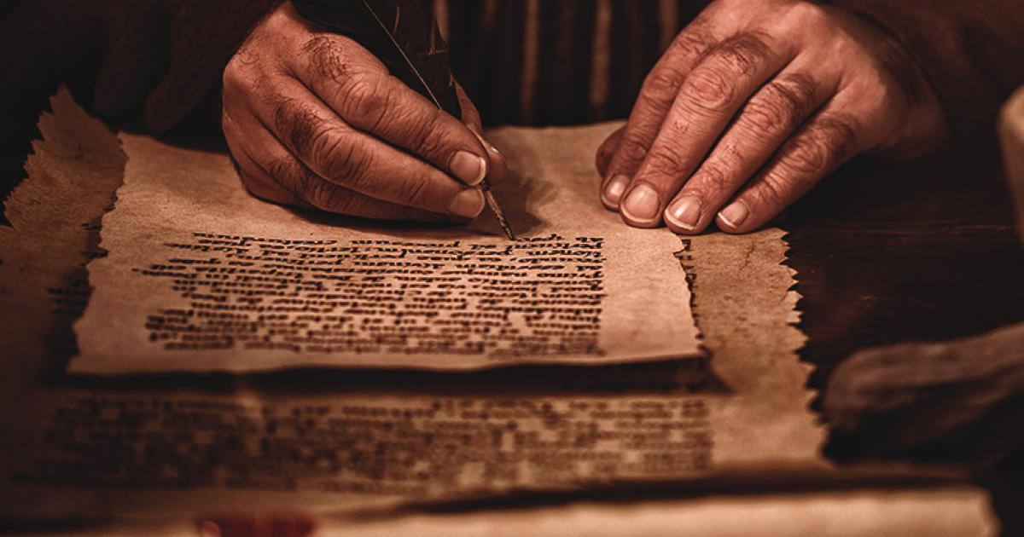
Bishop’s Lent Challenge 2026
As a missionary, Paul would move around spreading the word, especially after being persecuted for preaching the good news.
During his travels, he wrote letters to those converted remind them of God’s love, what it means to be a community and give them praise for loving one another once he had moved on.
Sometimes the letter would educate followers in the way of Jesus.
He would offer praise to them for standing strong in their beliefs and keeping their faith strong, even when being persecuted.
The letters would instruct and encourage them to stay true to God.
https://www.ucg.org/learn/bible-study-aids/what-does-bible-teach-about-grace/what-does-bible-teach-about-grace/pauls

Slide 13
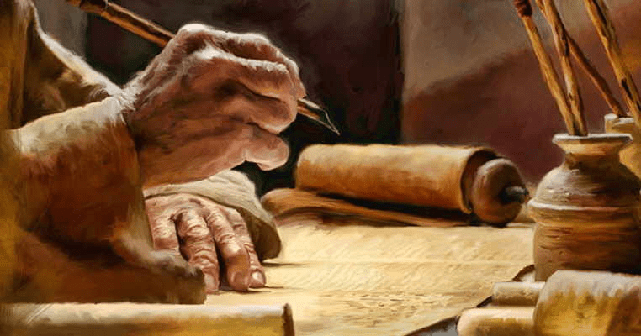
Bishop’s Lent Challenge 2026
Around 13 books in the New Testament as attributed to him. In one of his letters to Thessalonica, he told the people
‘Therefore encourage each other, build each other up, just as you are doing’
Over the next few weeks, we will be looking at what this meant to the people of Thessalonica, how it is still relevant to Christians and how it can impact our school environment.
https://lightofchristjourney.com/2023/08/14/an-angry-paul/

Slide 14


Bishop’s Lent Challenge 2026 –Reflections & Thoughts
I wonder…
Why Paul hurt Christians at first?
What happened when Paul met Jesus?
Why Paul decided to become a follower of Christ?
If you know of any other places Paul visited on his missions? (Rome, Corinth, Ephesus, Philippi)
Was Paul ever persecuted himself for his beliefs in Jesus?
How Paul travelled to different places?
Did Paul travel alone?
What the main message Paul preached?
How many people converted to Christianity because of the good news Paul shared?

Slide 15

Bishop’s Lent Challenge 2026 – Choral Worship
Tell the world – Northpoint Kids
North Point Kids - Tell The World (Lyric Video) ft. Lizi Bailey – YouTube

Slide 16
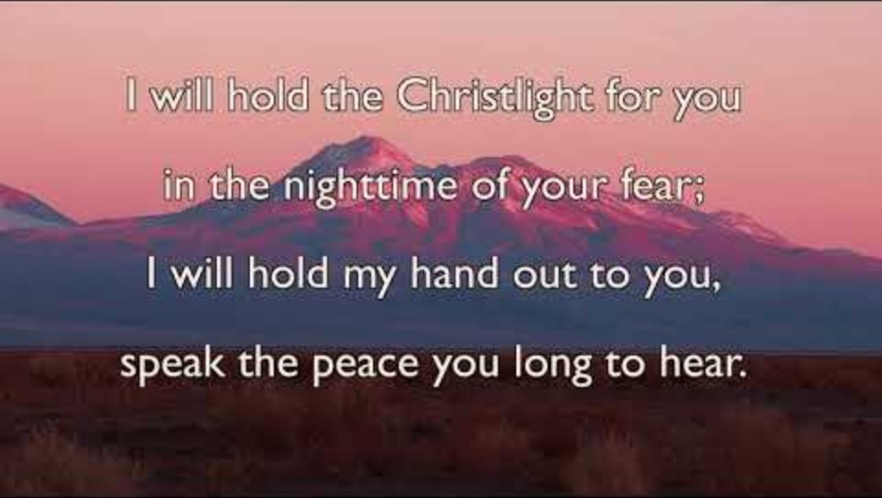
Bishop’s Lent Challenge 2026 – Choral Worship
Brother, Sister, Let Me Serve You
https://www.youtube.com/watch?v=0JahFRDrSCs&list=RD0JahFRDrSCs&start_radio=1

Slide 17
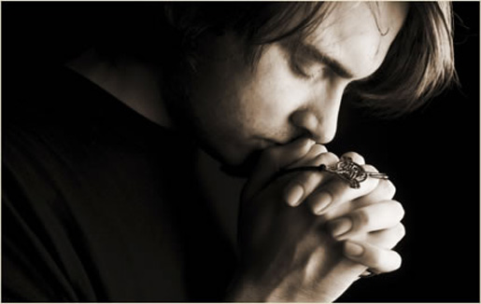
I invite you to
Pray with me.
If you want to make it your prayer, please find your quiet place, read out loud or as a grown up to help and say
Amen at the end.
If you choose to take a moment to reflect, I invite you to think about
How it feels to be encouraged

Slide 18


Bishop’s Lent Challenge 2026 –Prayer & Reflection
Dear God,
Thank You for loving us and giving us heroes in the Bible like Paul.
Thank You for changing Paul’s heart and helping him follow Jesus.
Help us to be brave like Paul, to tell others about Your love,
and to keep trusting You, even when things are hard.
Just like Paul, help us to listen to You, to learn from Your Word,
and share Your Good News with people we meet.
Please help us to show love, joy, peace, and kindness,
just like Paul taught in the Bible.
In Jesus’ name,
Amen.

Slide 19
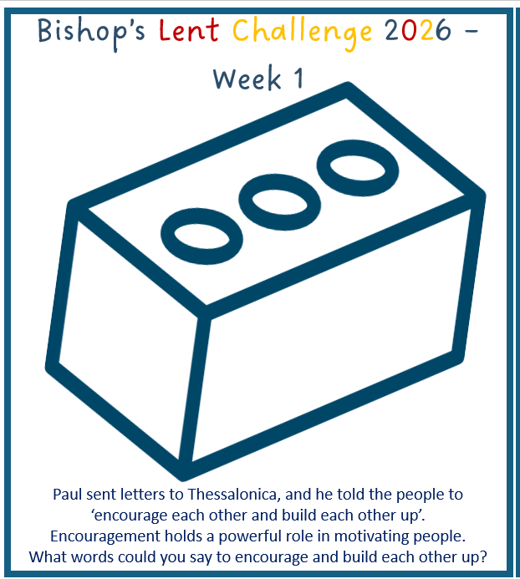

Bishop’s Lent Challenge 2026
Enrichment & Class Reflection

Slide 20
Bishop’s Lent Challenge 2026 -Worship Leader Closing
We close the Bible as we think about … God the Father
We lay down the Cross as we think about … Jesus his Son
We snuff out the Candle as we think about … The Holy Spirit

Slide 21



Bishop’s Lent Challenge 2026 -Worship Leader Leaving
Lead: May you go in peace to…
Response: Encourage and build each other up

Slide 22

Bishop’s Lent Challenge 2026 -Worship Leader Leaving
‘Tell people God’s message. Be ready to do this whether it is convenient or not. Tell people what they need to do. Tell them when they are wrong. Encourage them with great patience and careful teaching’ 2 Timothy 4:2

