Slide 1

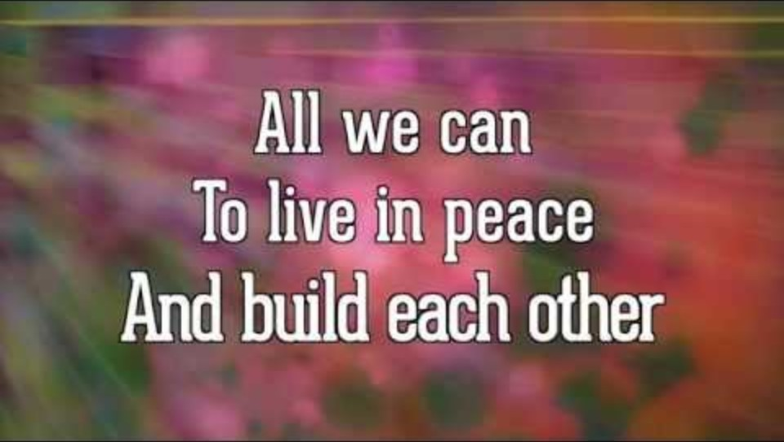
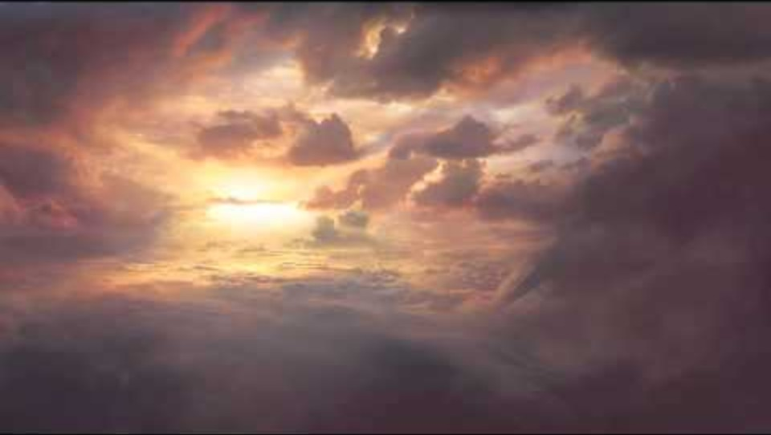

Bishop’s Lent Challenge 2026
“Therefore encourage each other,
Build each other up,
Just as you are doing”
1 Thessalonians 5:11

Slide 2
Bishop’s Lent Challenge 2026
Good Morning

Slide 3
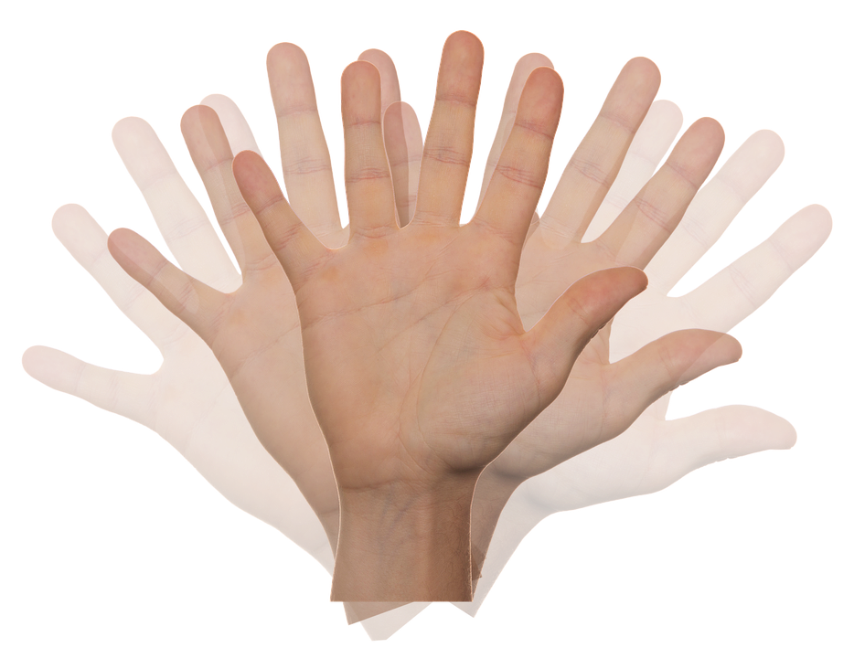
Bishop’s Lent Challenge 2026
Welcome Wave

Slide 4
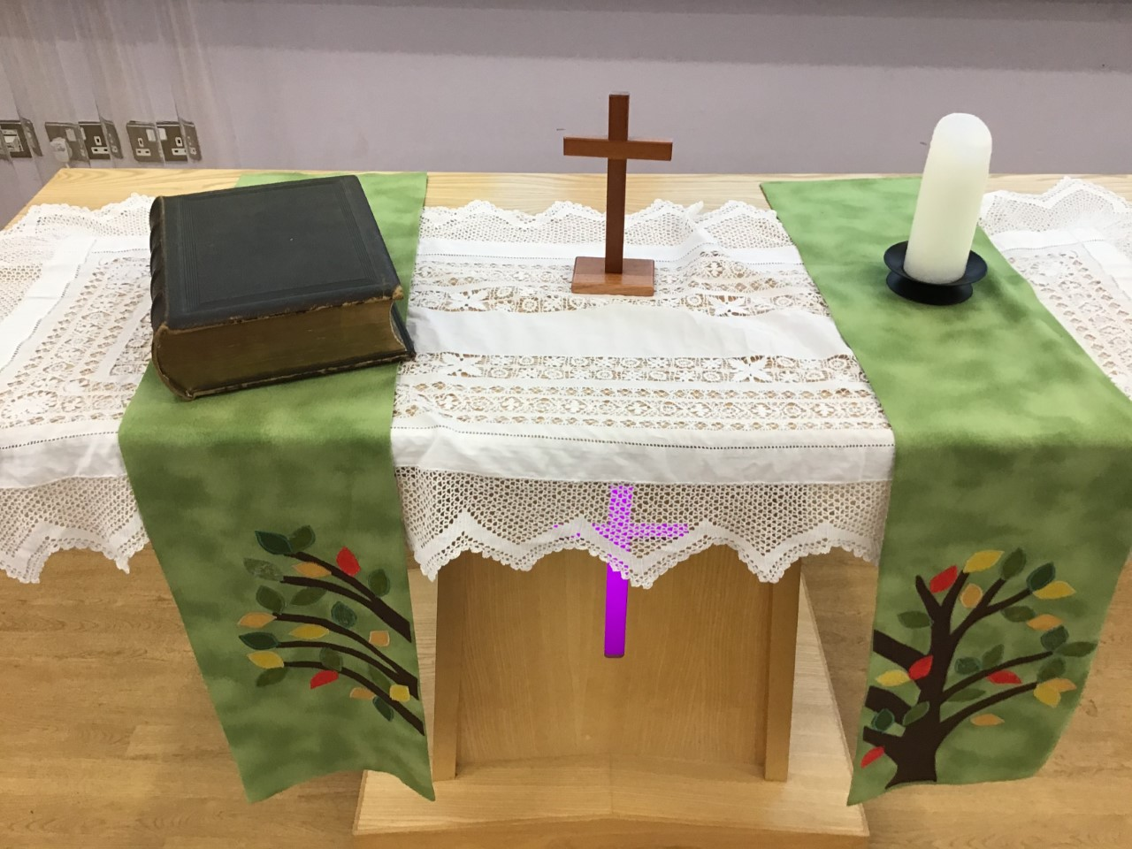
Bishop’s Lent Challenge 2026 -Worship Leader Welcome
We open the Bible as we think about … God the Father
We place the Cross as we think about … Jesus his Son
We light the Candle as we think about … The Holy Spirit

Slide 5



Bishop’s Lent Challenge 2026 -Worship Leader Greeting
Lead: Therefore, encourage and build each up…
Response: Just as we are doing!

Slide 6
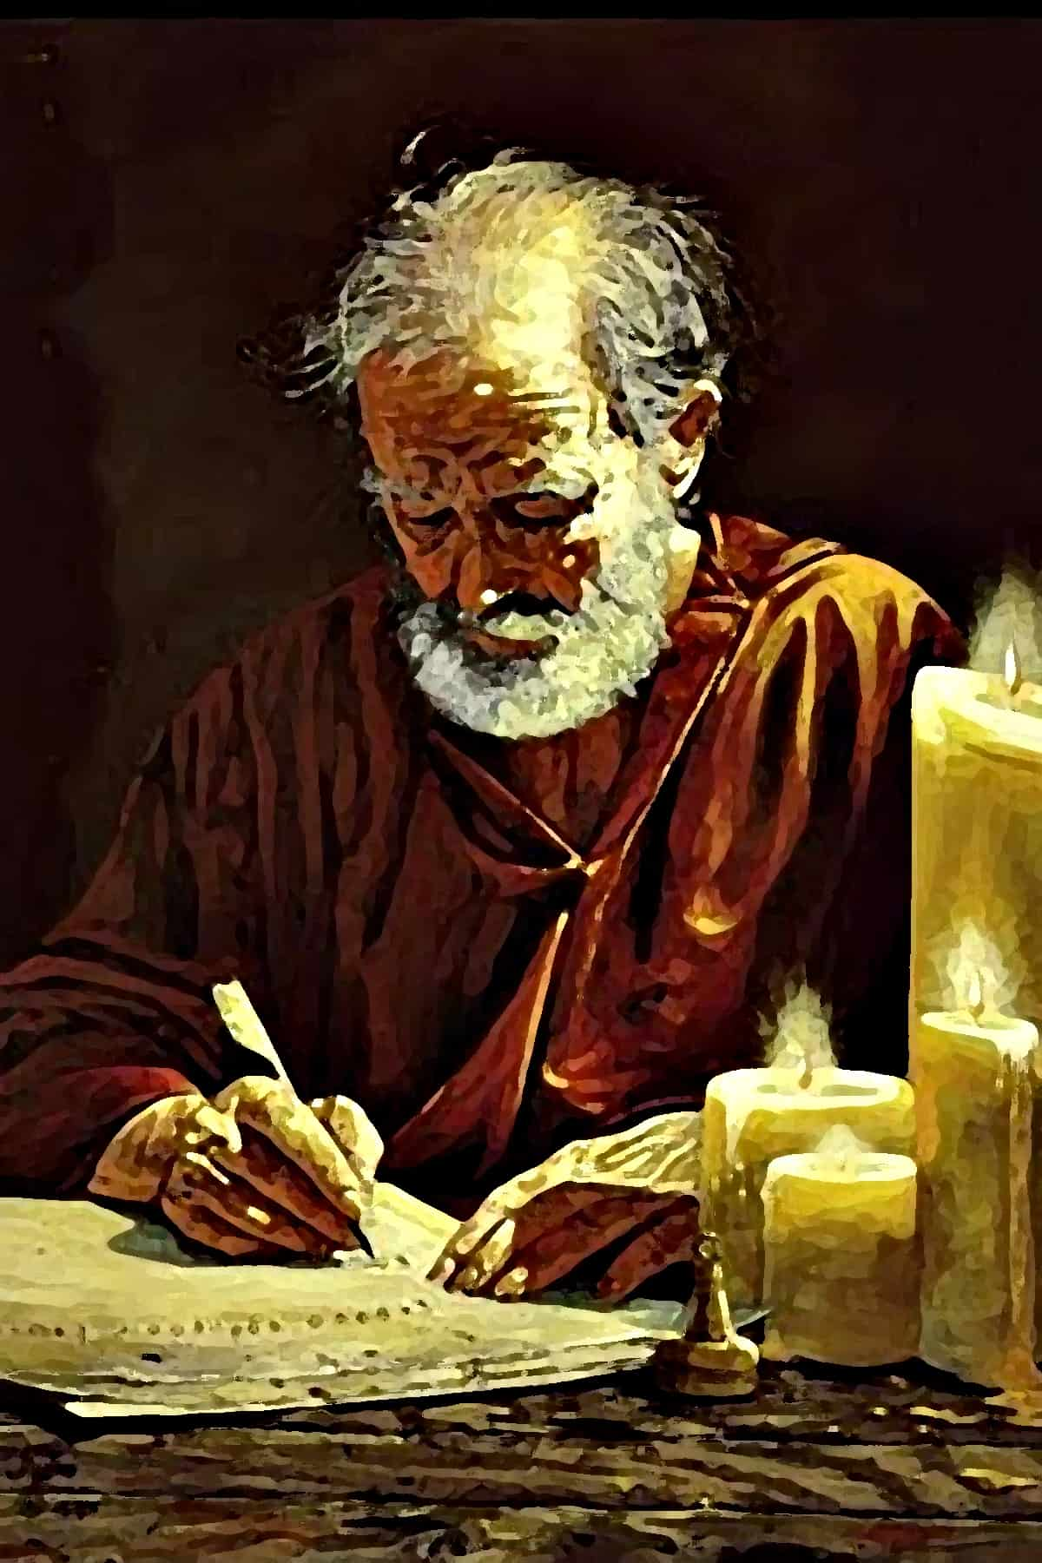
Bishop’s Lent Challenge 2026
Last week, we met Paul the apostle, what can you remember about him?

Slide 7
Bishop’s Lent Challenge 2026
Did you remember…
He was a Roman citizen and Jewish Pharisee
He hated then loved Christians
He was an apostle not a disciple
He went on missionaries and travelled the world to spread the Good News
He was one of the most influential figures in the spread of Christianity
He completed 4 missions
Thessalonica (place) – Thessalonians (book in NT)– why was this a good place to visit?
He spoke at least 3 languages – what did this mean?
He wrote letters to the places he had visited when he moved on – why?
Around 13 books are attributed to him in the New Testament
‘Therefore encourage one another, build each other up, just as you are doing’ is the focus scripture for this challenge

Slide 8
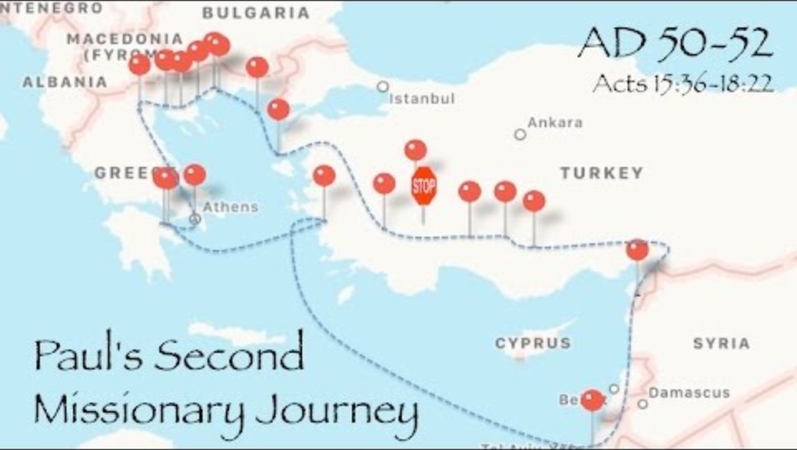
Bishop’s Lent Challenge 2026
Paul’s Missionary Journeys Song
https://www.youtube.com/watch?v=-qRgylHUy-Q&list=RD-qRgylHUy-Q&start_radio=1

Slide 9
Bishop’s Lent Challenge 2026
In his letters to the people of Thessalonica, he wanted to:
Say thank you and encourage them to stay strong in their faith
‘Our message is to encourage you… We are apostles of Christ… We loved you, we shared the good news… we shared our lives with you… we strengthen you, we comforted you, we told you to live good lives with God… we always thank God because of the way you accepted his message… and that message works in you who believe… for you are our hope, our joy… you are our glory’
(1 Thes 2-3, ICB)
Why do you think he sent that in a letter?

Slide 10
Bishop’s Lent Challenge 2026
In his letters to the people of Thessalonica, he wanted to:
Remind them to love one another, just as God loved them
‘We do not need to write to you about having love for your brothers and sisters in Christ. God has already taught you to love each other. And truly you do love the brothers and sisters… now we encourage you to love them more and more’
(1 Thes 4:9-10)
How do you show love to one another?

Slide 11
Bishop’s Lent Challenge 2026
In his letters to the people of Thessalonica, he wanted to:
Give them hope about Jesus’ return
‘The Lord himself will come down from heaven… we will be taken up in the clouds to meet the Lord in the air. And we will be with the Lord forever’
(1 Thes 4:16-17, ICB)
How do you think this made the people of Thessalonica feel? Why would they feel this way?

Slide 12
Bishop’s Lent Challenge 2026
In his letters to the people of Thessalonica, he wanted to:
Tell them to keep doing good, showing love, becoming stronger as a community
‘We pray that the Lord will make your love grow more and more for each other and for all people. We pray that you will love others as we love you and that your hearts will be made strong. Then you will be holy and without fault’
(1 Thes 3:12-13, ICB)
How can we grow in our love for one another as a school?
What can we do?

Slide 13
Bishop’s Lent Challenge 2026
In his letters to the people of Thessalonica, he wanted to:
To encourage and build each other up
‘So, comfort each other, give each other strength, just as you are doing’
(1 Thes 5:11, ICB)
How can we encourage and build each other up in our classes, in our school, in our community, in the world?

Slide 14
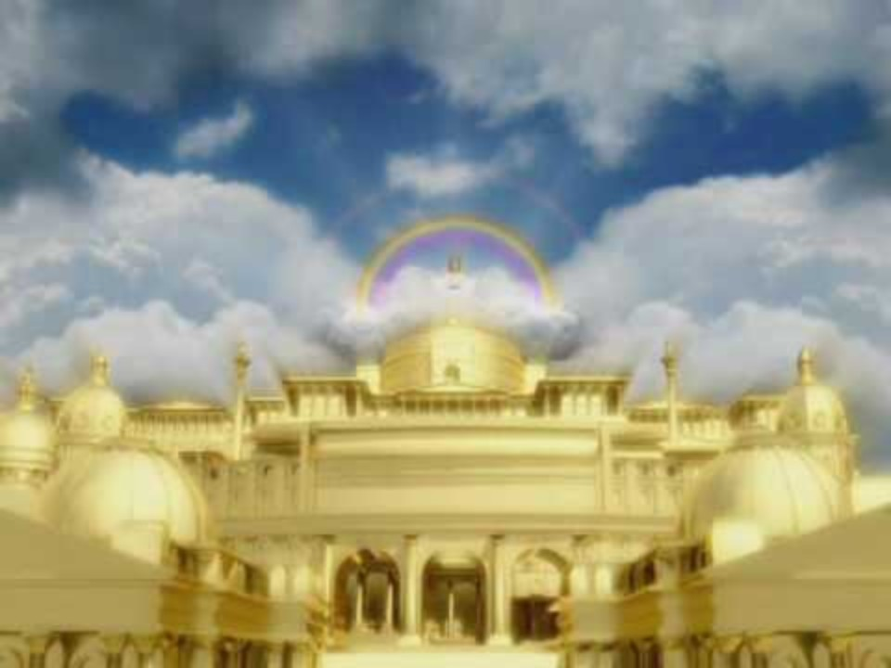
Bishop’s Lent Challenge 2026 – Choral Worship
Tell the world (Go! And tell it to the world)
https://www.youtube.com/watch?v=CEHwDtvK0qQ&list=RDCEHwDtvK0qQ&start_radio=1

Slide 15
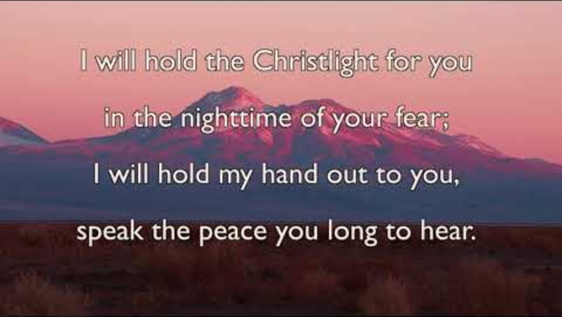
Bishop’s Lent Challenge 2026 – Choral Worship
Brother, Sister, Let Me Serve You
https://www.youtube.com/watch?v=0JahFRDrSCs&list=RD0JahFRDrSCs&start_radio=1

Slide 16


Bishop’s Lent Challenge 2026 –Reflections & Thoughts
I wonder…
Why Paul loved the people of Thessalonica so much?
What it felt like to receive a letter from Paul?
How can I show love to others I cannot see every day?
What Paul would write to the churches today?
What it means to encourage one another?
Why should we encourage and build each other up?
How the people of Thessalonica stayed strong in their faith when they were being persecuted?

Slide 17
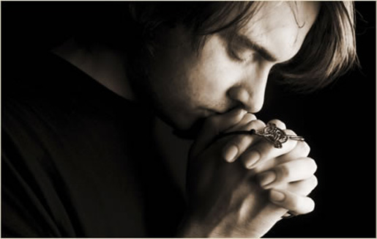
I invite you to
Pray with me.
If you want to make it your prayer, please find your quiet place, read out loud or as a grown up to help and say
Amen at the end.
If you choose to take a moment to reflect, I invite you to think about
Showing love & giving hope

Slide 18


Bishop’s Lent Challenge 2026 –Prayer & Reflection
Dear God,
Thank You for Paul’s letters.
Help me to love others,
To keep doing good,
and to never give up.
Fill my heart with hope, faith and joy.
Amen.

Slide 19
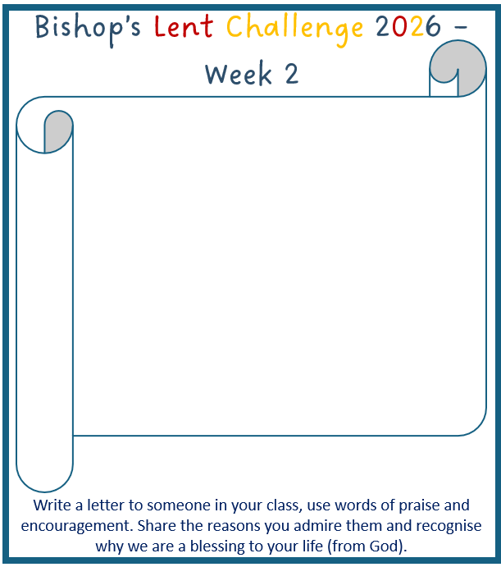

Bishop’s Lent Challenge 2026
Enrichment & Class Reflection

Slide 20
Bishop’s Lent Challenge 2026 -Worship Leader Closing
We close the Bible as we think about … God the Father
We lay down the Cross as we think about … Jesus his Son
We snuff out the Candle as we think about … The Holy Spirit

Slide 21



Bishop’s Lent Challenge 2026 -Worship Leader Leaving
Lead: May you go in peace to…
Response: Encourage and build each other up

Slide 22
Bishop’s Lent Challenge 2026 -Worship Leader Leaving
Just like Paul wrote in his letters; remember to love one another, keep doing what is good, build each other up and be positive!

