Slide 1




Bishop’s Lent Challenge 2026
“Therefore encourage each other,
Build each other up,
Just as you are doing”
1 Thessalonians 5:11

Slide 2
Bishop’s Lent Challenge 2026
Good Morning

Slide 3

Bishop’s Lent Challenge 2026
Welcome Wave

Slide 4
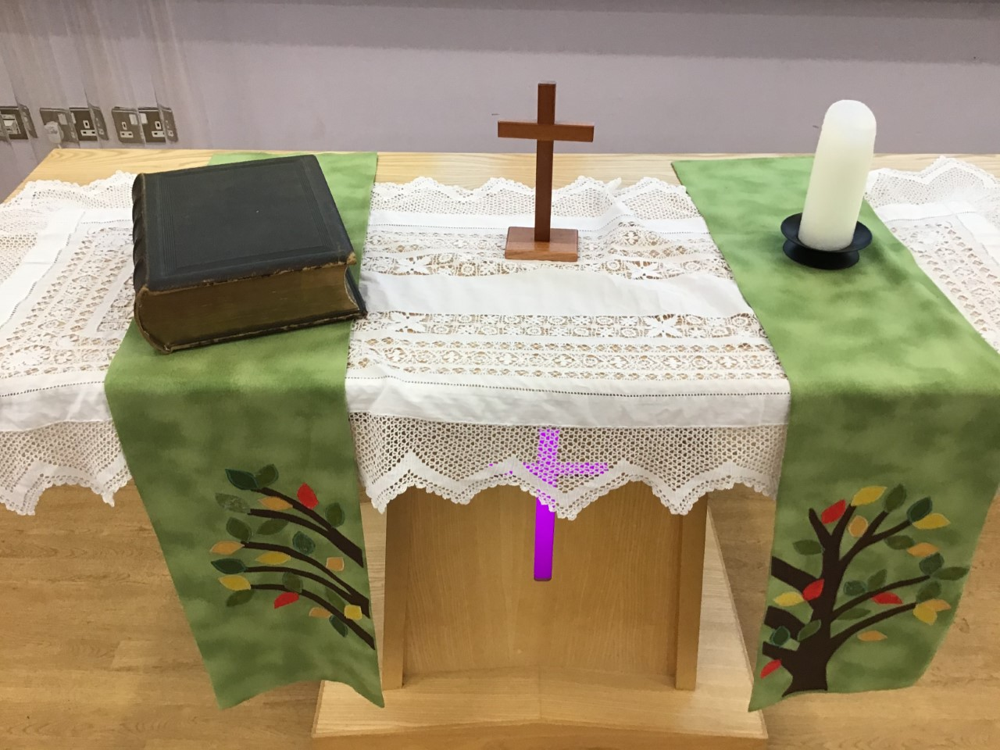
Bishop’s Lent Challenge 2026 -Worship Leader Welcome
We open the Bible as we think about … God the Father
We place the Cross as we think about … Jesus his Son
We light the Candle as we think about … The Holy Spirit

Slide 5



Bishop’s Lent Challenge 2026 -Worship Leader Greeting
Lead: Therefore, encourage and build each up…
Response: Just as we are doing!

Slide 6

Bishop’s Lent Challenge 2026
When Paul was writing his letters, he wanted the readers and listeners to grow in all areas of faith.
One of the areas he wanted people to grow in was their spiritual side as an individual and within a community.
https://www.bibleconnection.com/3-powerful-principles-for-spiritual-growth/

Slide 7
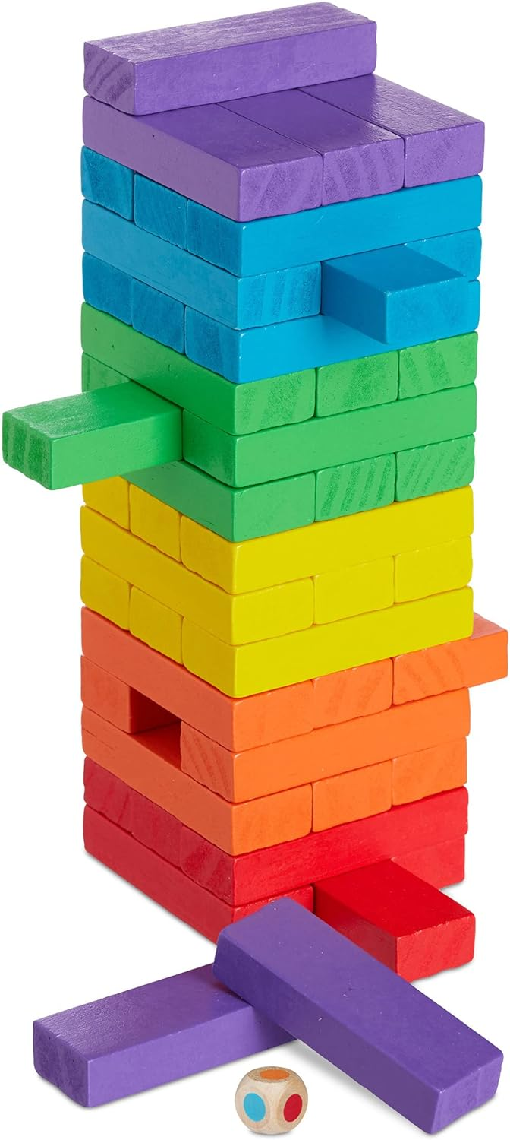
Bishop’s Lent Challenge 2026
He wanted the readers and listeners to know:
Spiritual growth is communal
Encouraging and building each other up helps believers to grow spiritually together
We need others around us to help us to grow as this creates a support network, a sense of accountability, whilst being surrounded in love with element of looking outwards and growing stronger together

Slide 8

Bishop’s Lent Challenge 2026
He wanted the readers and listeners to know:
Encouragement is a motivational tool
It helps others to stay faithful, hopeful and strong
It guides and offers confidence to do the right thing
Speak out with faith, and hope
https://viadvocacy.com/Articles/how-to-stay-motivated-stay-focused-positive

Slide 9
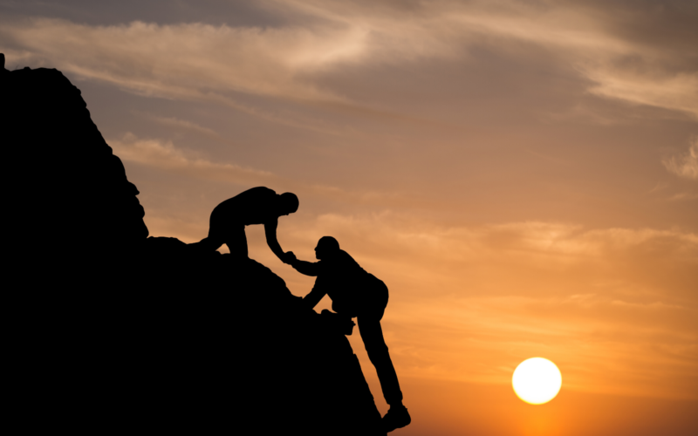
Bishop’s Lent Challenge 2026
He wanted the readers and listeners to know:
Building each other up meant strengthening each other’s faith
Sharing scripture
Praying for and with one another
Speaking and acting in love
Offering wisdom if making unwise choices
Helping others to grow stronger in their faith and belief
https://www.tmai.org/devotional/how-to-encourage-and-build-up/

Slide 10

Bishop’s Lent Challenge 2026
He wanted the readers and listeners to know:
Daily effort
It is something that needs to become part of everyday life
It builds slowly, over time, day-by-day
It means becoming an encourager of others – daily
Spiritual growth is continuous
https://www.moananursery.com/2025/07/09/from-seed-to-bloom-your-comprehensive-guide-to-growing-sunflowers/

Slide 11
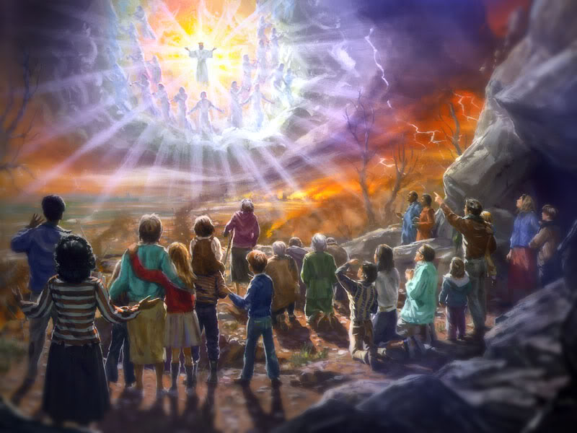
Bishop’s Lent Challenge 2026
He wanted the readers and listeners to know:
Jesus will return one day
And he will see the hearts of those following, the hope and faithful who stayed true
https://redeeminggod.com/jesus-second-coming-in-the-clouds/

Slide 12


Bishop’s Lent Challenge 2026 –Reflections & Thoughts
I wonder…
How it feels when someone encourages you
What you can say to a friend to encourage and build them up
If it is the same for everyone or do we need different things
What it means to build someone up without using bricks or blocks
What Jesus said to people who needed encouraging
What your spiritual growth looks like

Slide 13

Bishop’s Lent Challenge 2026 – Choral Worship
Tell the world – Northpoint Kids
https://www.youtube.com/watch?v=Xwoa4-JcMC8&list=RDXwoa4-JcMC8&start_radio=1

Slide 14
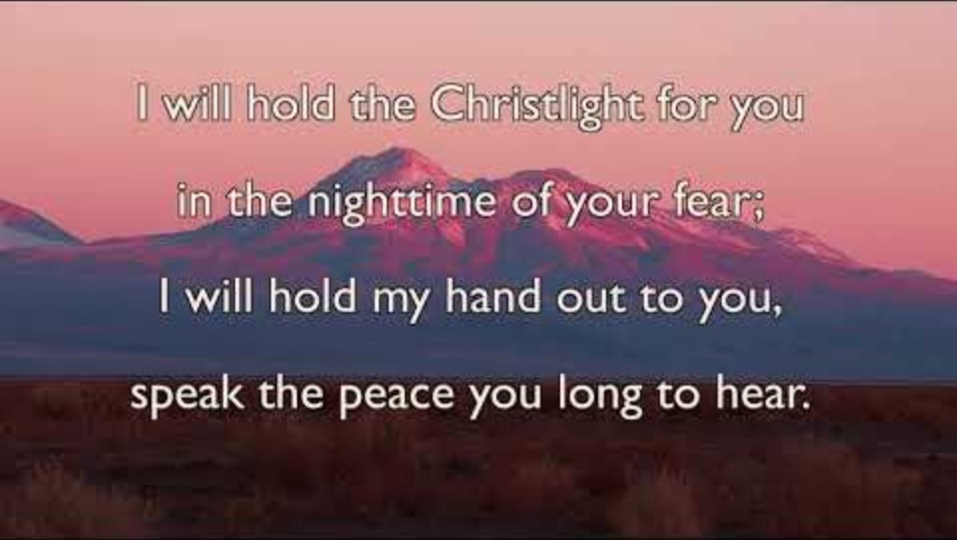
Bishop’s Lent Challenge 2026 – Choral Worship
Brother, Sister, Let Me Serve You
https://www.youtube.com/watch?v=0JahFRDrSCs&list=RD0JahFRDrSCs&start_radio=1

Slide 15
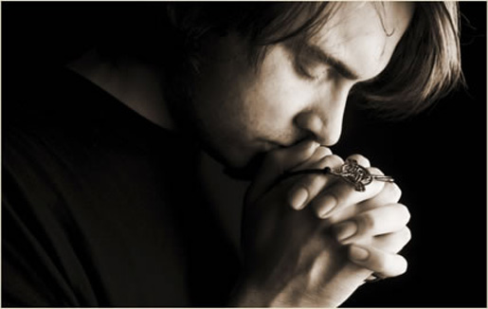
I invite you to
Pray with me.
If you want to make it your prayer, please find your quiet place, read out loud or as a grown up to help and say
Amen at the end.
If you choose to take a moment to reflect, I invite you to think about
Your Spiritual Growth

Slide 16


Bishop’s Lent Challenge 2026 –Prayer & Reflection
Dear God,
Thank You for my friends, family, school and community.
Help me to say kind words and show love.
Help me to build others up, like You build me up.
Make me someone who brings joy, hope and love.
Amen.

Slide 17

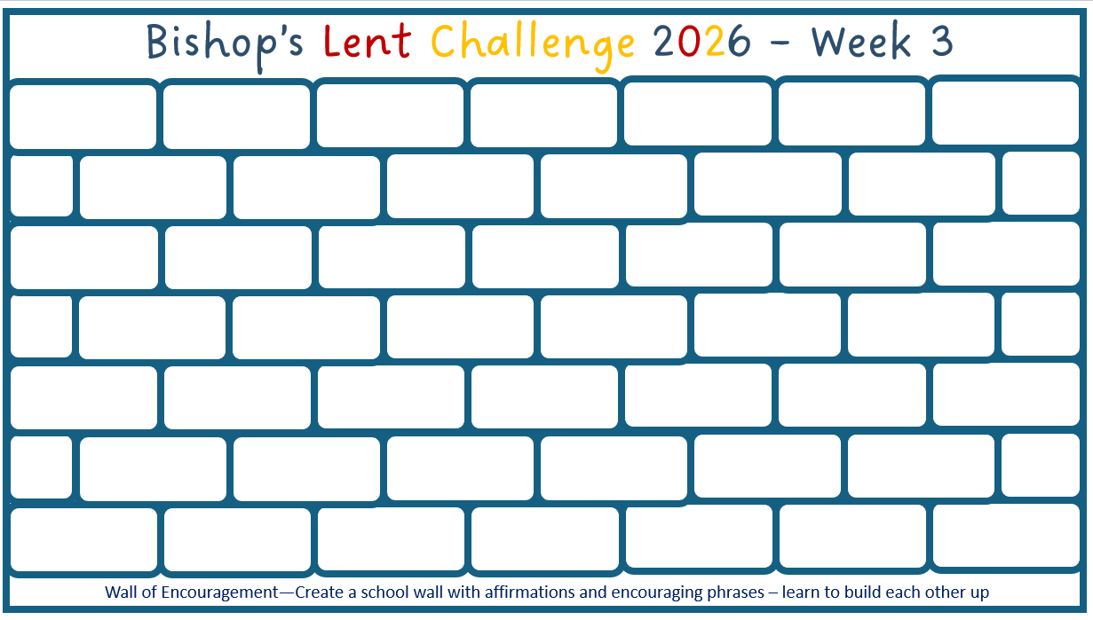
Bishop’s Lent Challenge 2026
Enrichment & Class Reflection

Slide 18
Bishop’s Lent Challenge 2026 -Worship Leader Closing
We close the Bible as we think about … God the Father
We lay down the Cross as we think about … Jesus his Son
We snuff out the Candle as we think about … The Holy Spirit

Slide 19



Bishop’s Lent Challenge 2026 -Worship Leader Leaving
Lead: May you go in peace to…
Response: Encourage and build each other up

Slide 20
Bishop’s Lent Challenge 2026 -Worship Leader Leaving
Jesus wants us to help each other, not just with hands, but with kind words and caring hearts. When we say things like “You can do it!” or “I’ll help you,” we make someone stronger inside. That’s what the Bible means when it says we should “encourage one another and build each other up.” Every time we are kind – with words and actions; we’re helping someone grow.

