Slide 1

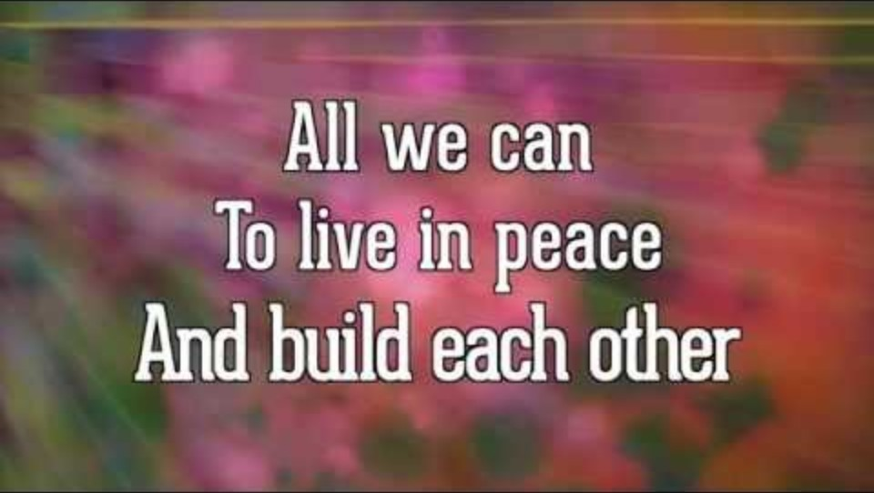
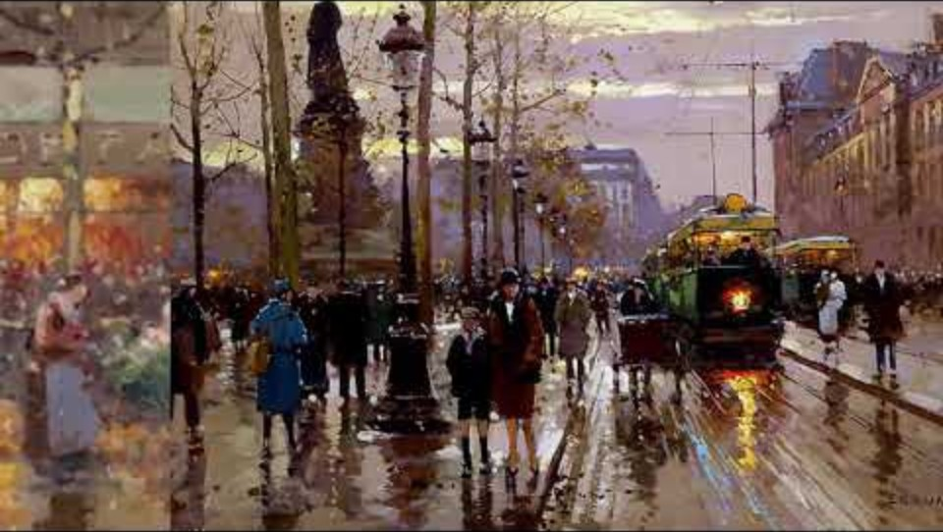

Bishop’s Lent Challenge 2026
“Therefore encourage each other,
Build each other up,
Just as you are doing”
1 Thessalonians 5:11

Slide 2
Bishop’s Lent Challenge 2026
Good Morning

Slide 3
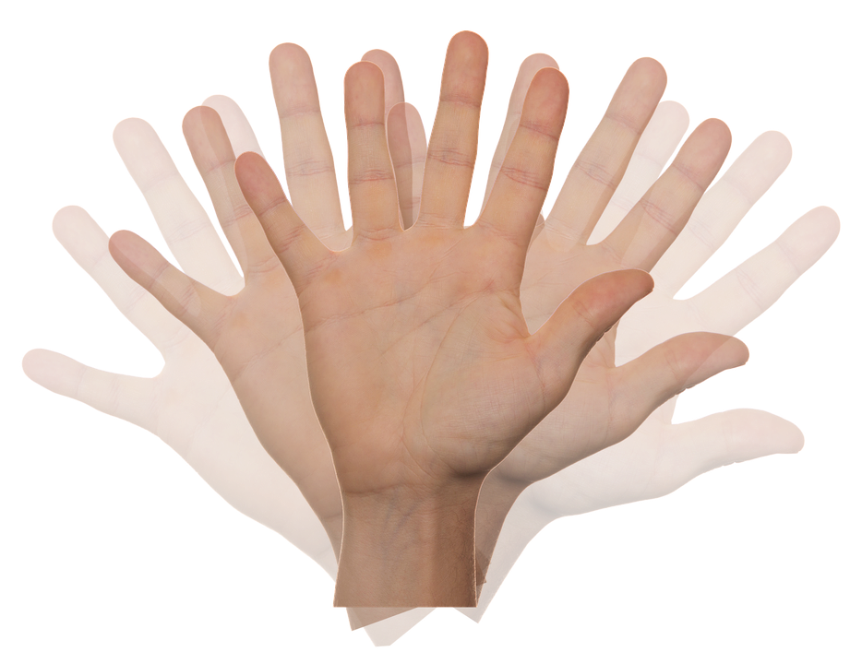
Bishop’s Lent Challenge 2026
Welcome Wave

Slide 4
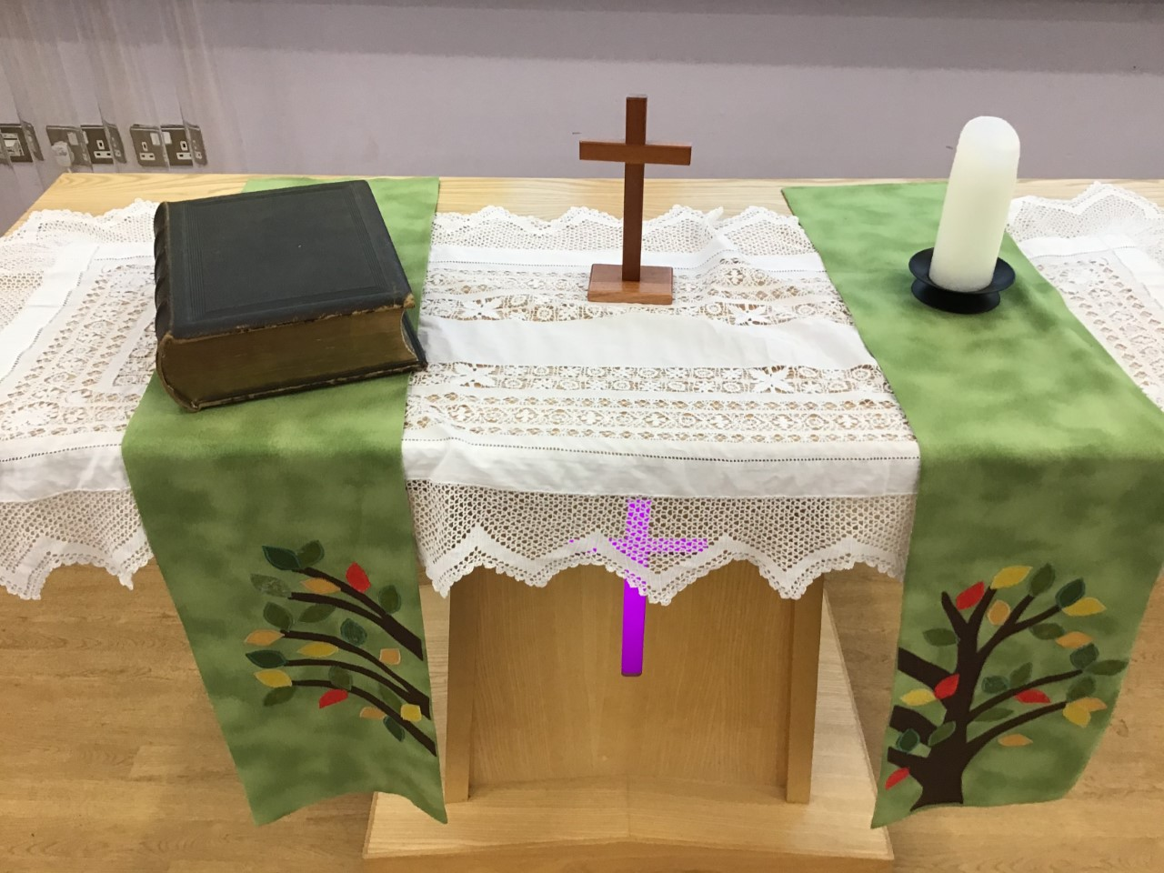
Bishop’s Lent Challenge 2026 -Worship Leader Welcome
We open the Bible as we think about … God the Father
We place the Cross as we think about … Jesus his Son
We light the Candle as we think about … The Holy Spirit

Slide 5



Bishop’s Lent Challenge 2026 -Worship Leader Greeting
Lead: Therefore, encourage and build each up…
Response: Just as we are doing!

Slide 6

Bishop’s Lent Challenge 2026
The letter from Paul to the people in Thessalonica was a way of helping people to recognise and celebrate one another.
We are all unique, wonderfully and fearfully made, in the image of God.
However, with our uniqueness comes our own God given gifts and talents. We are all made special.
https://www.countrylife.co.uk/nature/curious-questions-are-snowflakes-really-all-unique-237000

Slide 7
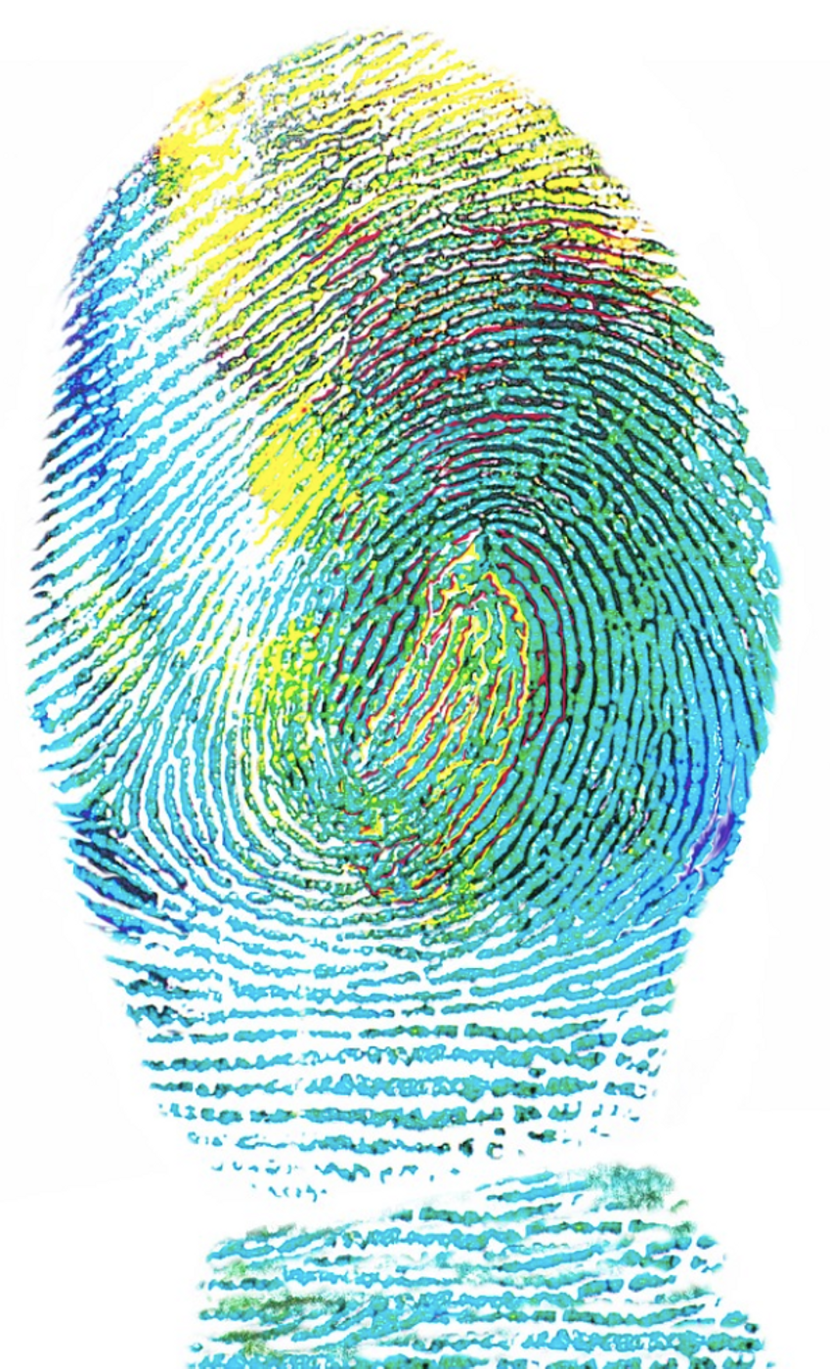
Bishop’s Lent Challenge 2026
We all bring something to the classroom, to the school, to our homes and to the communities we live in.
These should be seen, recognised and celebrated!
There is only one of you!
Others may have a similar gift or talent, but just like our fingertips are unique, we still bring our own twist on our gifts and talents.
https://www.labroots.com/trending/clinical-and-molecular-dx/26658/ai-suggests-fingerprints-unique?srsltid=AfmBOoqRksa4QiTuCFlZ33kJJGouST9KLq3w7ptmc--R00hU7j-UiULk

Slide 8
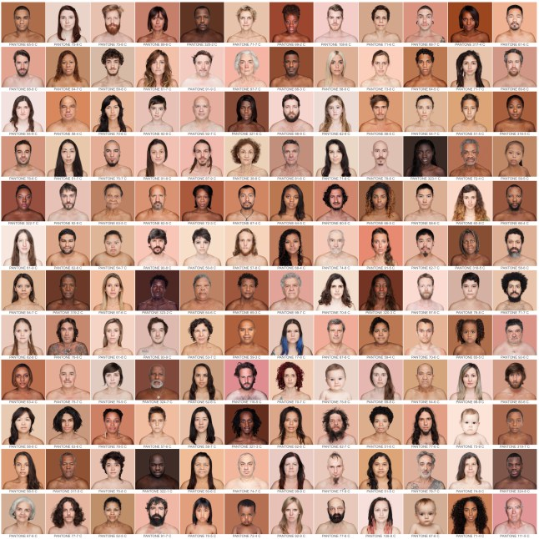
Bishop’s Lent Challenge 2026
We might be good at making people laugh, drawing, singing, being kind, helping others, being a good friend, having great discipline, being spontaneous, showing love, but we all do these in our own way.
https://metro.co.uk/2015/05/12/photographer-angelica-dass-has-taken-pictures-of-over-2500-people-to-prove-were-not-just-black-or-white-5193085/

Slide 9

Bishop’s Lent Challenge 2026
With this comes a big responsibility.
We should notice and encourage these inner gifts because sometimes people do not know why they are a fabulous human being they are.
We often need telling, or guiding to see what others see in us, that we do not see for ourselves.
Therefore, encourage one another and build each other up!
https://manibelde.medium.com/how-to-build-yourself-up-from-nothing-e6fe5efe2053

Slide 10
Bishop’s Lent Challenge 2026
Now turn to someone near you and say something you appreciate about a person in your life, focus on what makes them unique and special.

Slide 11
Bishop’s Lent Challenge 2026
Now turn to someone else near you, tell them something you believe you are good at. Notice how that makes you feel.

Slide 12


Bishop’s Lent Challenge 2026
Finally turn to someone else near you, invite them to say what they think your gifts are. How did that make you feel?

Slide 13
Bishop’s Lent Challenge 2026
God made you wonderfully unique. He gave you special gifts and He wants you to see the gifts inside you and others.

Slide 14


Bishop’s Lent Challenge 2026
When we notice these gifts, and we share with our voices what we see, we build others up, we empower them, we build their confidence and self-esteem.

Slide 15
Bishop’s Lent Challenge 2026
We therefore help each other grow by noticing the good. This is our focus for the week.

Slide 16


Bishop’s Lent Challenge 2026 –Reflections & Thoughts
I wonder…
I wonder what special gifts God has given you
I wonder how it feels when someone notices something you are good at
I wonder if you can help a friend see how amazing they are
I wonder how you can use your gift to make someone smile
I wonder what it means to build someone up with my words
I wonder if being a good listener is a gift from God
I wonder how you can be encouragers at school and at home
I wonder what Jesus would say is special about you

Slide 17
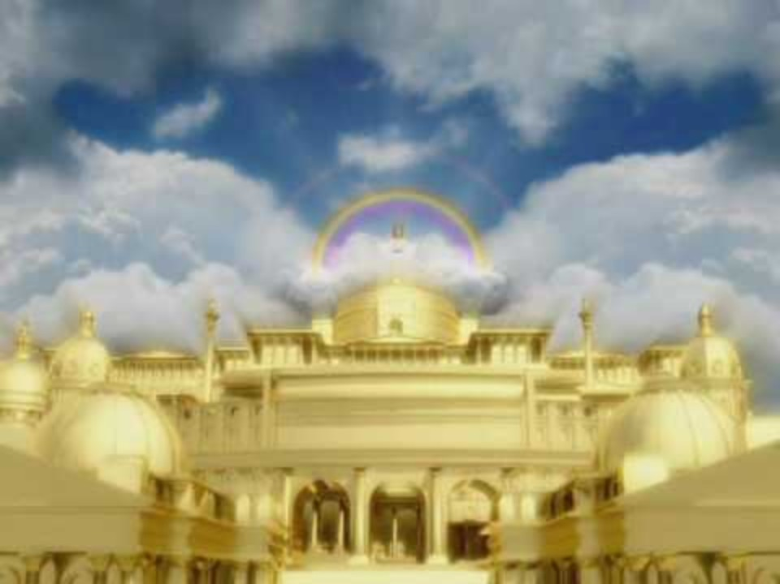
Bishop’s Lent Challenge 2026 – Choral Worship
Tell the world (Go! And tell it to the world)
https://www.youtube.com/watch?v=CEHwDtvK0qQ&list=RDCEHwDtvK0qQ&start_radio=1

Slide 18
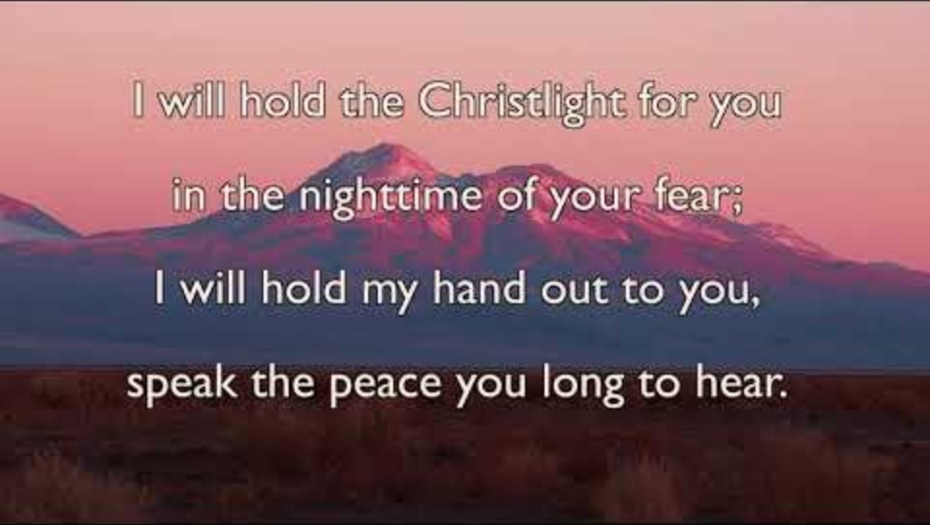
Bishop’s Lent Challenge 2026 – Choral Worship
Brother, Sister, Let Me Serve You
https://www.youtube.com/watch?v=0JahFRDrSCs&list=RD0JahFRDrSCs&start_radio=1

Slide 19
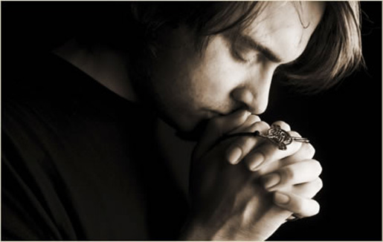
I invite you to
Pray with me.
If you want to make it your prayer, please find your quiet place, read out loud or as a grown up to help and say
Amen at the end.
If you choose to take a moment to reflect, I invite you to think about
Your gifts and talents

Slide 20


Bishop’s Lent Challenge 2026 –Prayer & Reflection
Dear God,
Thank You for making each of us special.
Help me see the good things in others.
Help me to cheer my friends on and tell them when they’re doing great.
Thank You for all the gifts You give us.
Amen.

Slide 21


Bishop’s Lent Challenge 2026
Enrichment & Class Reflection

Slide 22
Bishop’s Lent Challenge 2026 -Worship Leader Closing
We close the Bible as we think about … God the Father
We lay down the Cross as we think about … Jesus his Son
We snuff out the Candle as we think about … The Holy Spirit

Slide 23



Bishop’s Lent Challenge 2026 -Worship Leader Leaving
Lead: May you go in peace to…
Response: Encourage and build each other up

Slide 24
Bishop’s Lent Challenge 2026 -Worship Leader Leaving
God made each of us special, with our own gifts. When we notice and encourage those gifts in each other, we’re doing exactly what Paul told the people of Thessalonica

