Slide 1

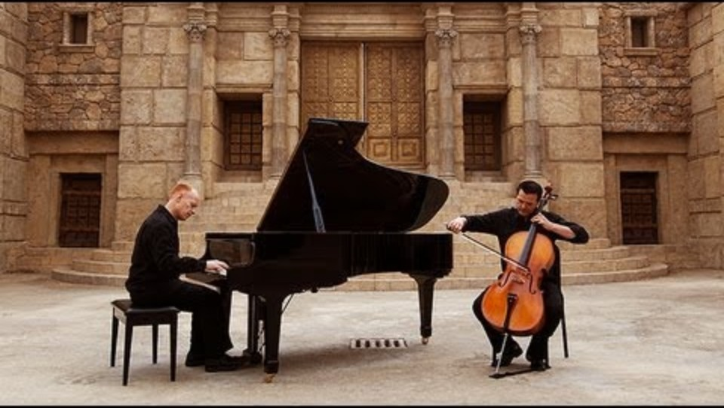

Bishop’s Lent Challenge 2026
“Therefore encourage each other,
Build each other up,
Just as you are doing”
1 Thessalonians 5:11

Slide 2
Bishop’s Lent Challenge 2026
Good Morning

Slide 3

Bishop’s Lent Challenge 2026
Welcome Wave

Slide 4
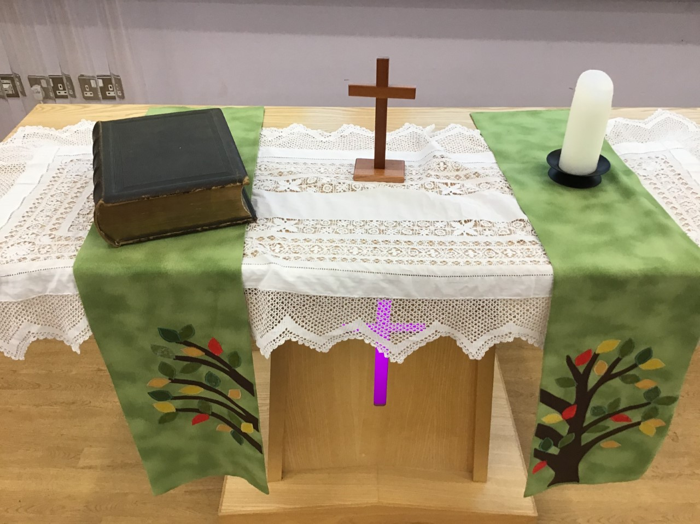
Bishop’s Lent Challenge 2026 -Worship Leader Welcome
We open the Bible as we think about … God the Father
We place the Cross as we think about … Jesus his Son
We light the Candle as we think about … The Holy Spirit

Slide 5



Bishop’s Lent Challenge 2026 -Worship Leader Greeting
Lead: Therefore, encourage and build each up…
Response: Just as we are doing!

Slide 6
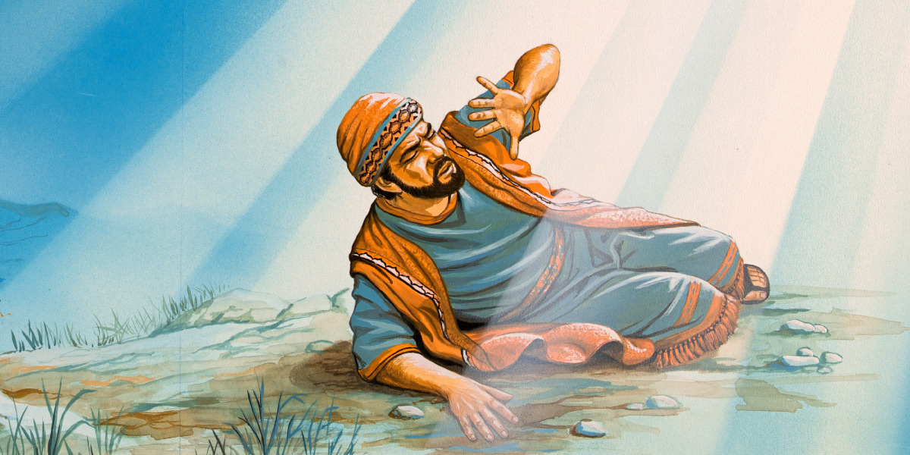
Bishop’s Lent Challenge 2026
Now, remember in week one, Paul hated Christians before he loved them – we will look at this story today in more detail.
https://www.jw.org/en/library/books/bible-stories/7/road-to-damascus/

Slide 7
Bishop’s Lent Challenge 2026
Before he was called Paul, his name was Saul. He didn’t believe in Jesus, and he didn’t like Jesus’ followers. In fact, he was trying to stop them.

Slide 8
Bishop’s Lent Challenge 2026
One day, Saul was walking down a road to a place called Damascus. He wanted to find people who followed Jesus so he could have them put in jail. But something amazing happened.

Slide 9
Bishop’s Lent Challenge 2026
Suddenly, a bright light from heaven shone all around Saul.
He fell to the ground. Then he heard a voice

Slide 10
Bishop’s Lent Challenge 2026
“Saul, Saul, why are you hurting me?”
“Who are you?”
“I am Jesus, the one you are hurting”

Slide 11
Bishop’s Lent Challenge 2026
When Saul stood up, he was blind.
He had to be led by the hand into the city. For three days, Saul could not see, eat or drink anything.

Slide 12
Bishop’s Lent Challenge 2026
God spoke to a kind man named Ananias and told him to go to Saul. Ananias was scared at first. He knew what Saul had done. But he trusted God.

Slide 13
Bishop’s Lent Challenge 2026
He went to Saul, placed his hands on him, and said:
“Jesus sent me so you can see again”. Something like scales fell from Saul’s eyes.
He could see.

Slide 14
Bishop’s Lent Challenge 2026
He was baptised and became a follower of Jesus. From then on, Saul was called Paul, and he spent his life telling others the good news about Jesus. He didn’t just talk about kindness and love – he changed his ways and lived it.

Slide 15
Bishop’s Lent Challenge 2026
He wrote letters to keep people encouraged, supported and helped them to grow in faith – like he did. When things got hard, he kept going. He was bold, he was brave, and he changed. He didn’t wait for the world to change – he was the change!

Slide 16
Bishop’s Lent Challenge 2026
Jesus changed Paul’s heart. He was unkind but changed and became more loving, kind and faithful. We can be like Jesus; we can make a difference to other people’s lives. We can change people’s lives through encouragement and building confidence, just like Paul did.

Slide 17
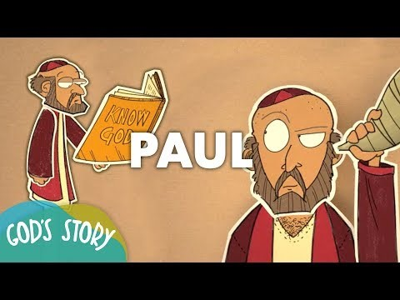
Bishop’s Lent Challenge 2026
Suitable for EYFS and KS1
https://www.yout-ube.com/watch?v=R0p0W_Zbt1s

Slide 18
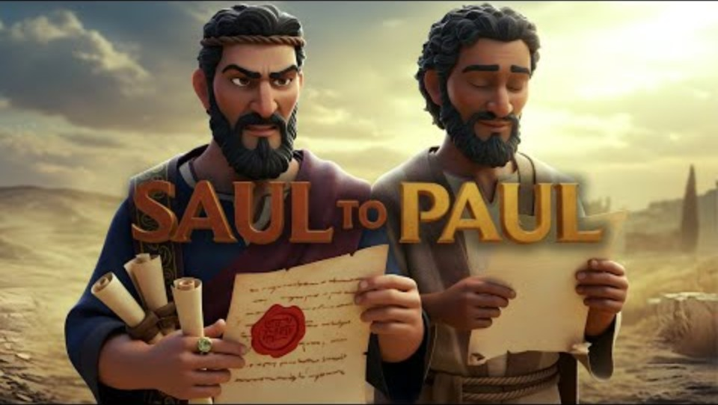
Bishop’s Lent Challenge 2026
Suitable for KS2
https://www.yout-ube.com/watch?v=TTAgRHA2GsY

Slide 19


Bishop’s Lent Challenge 2026 –Reflections & Thoughts
I wonder…
I wonder how Paul was a good example to others.
I wonder how you can be the change in your classroom or home.
I wonder who needs some encouragement today.
I wonder what small thing you can do to make a big difference.
I wonder how you can help someone feel loved like Paul did.

Slide 20

Bishop’s Lent Challenge 2026 – Choral Worship
Tell the world – Northpoint Kids
https://www.youtube.com/watch?v=Xwoa4-JcMC8&list=RDXwoa4-JcMC8&start_radio=1

Slide 21
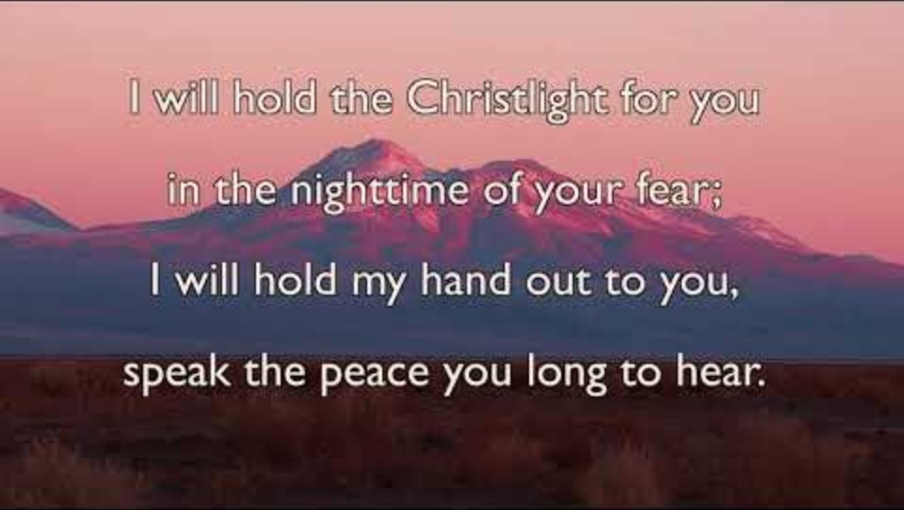
Bishop’s Lent Challenge 2026 – Choral Worship
Brother, Sister, Let Me Serve You
https://www.youtube.com/watch?v=0JahFRDrSCs&list=RD0JahFRDrSCs&start_radio=1

Slide 22
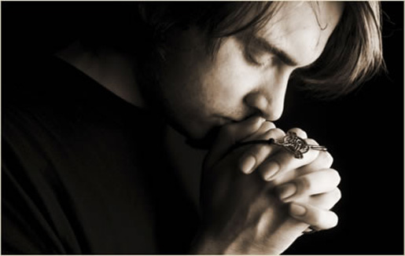
I invite you to
Pray with me.
If you want to make it your prayer, please find your quiet place, read out loud or as a grown up to help and say
Amen at the end.
If you choose to take a moment to reflect, I invite you to think about
Being the change, you want to see in the world

Slide 23


Bishop’s Lent Challenge 2026 –Prayer & Reflection
Dear God,
Thank You for Paul, who showed us how to be brave and kind.
Help me to be the difference I want to see — at school, at home, and with my friends.
Help me to build others up with love, just like Paul taught.
Amen.

Slide 24



Bishop’s Lent Challenge 2026
Enrichment &
Class Reflection
Say thank you to a person who encourages you
Act out a gesture of encouragement
Dice

Slide 25
Bishop’s Lent Challenge 2026 -Worship Leader Closing
We close the Bible as we think about … God the Father
We lay down the Cross as we think about … Jesus his Son
We snuff out the Candle as we think about … The Holy Spirit

Slide 26



Bishop’s Lent Challenge 2026 -Worship Leader Leaving
Lead: May you go in peace to…
Response: Encourage and build each other up

Slide 27

Bishop’s Lent Challenge 2026 -Worship Leader Leaving
Paul didn’t wait for others to be kind first. He chose to be kind. He didn’t wait for people to be strong — he encouraged them to grow strong in Jesus. When we do the right thing, even when it’s hard, we are being the difference — just like Paul.

