Slide 1

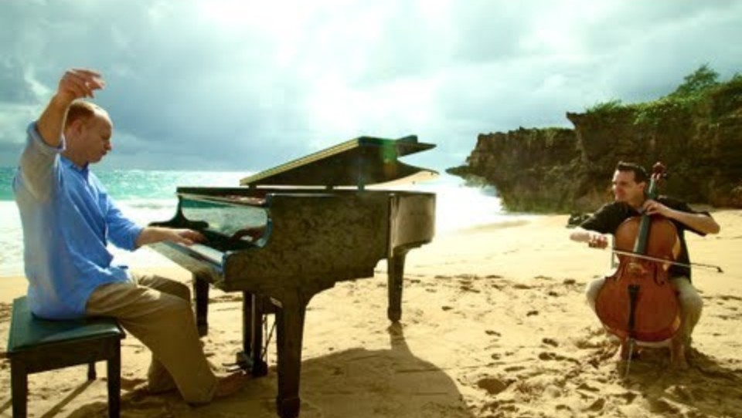

Bishop’s Lent Challenge 2026
“Therefore encourage each other,
Build each other up,
Just as you are doing”
1 Thessalonians 5:11

Slide 2
Bishop’s Lent Challenge 2026
Good Morning

Slide 3

Bishop’s Lent Challenge 2026
Welcome Wave

Slide 4
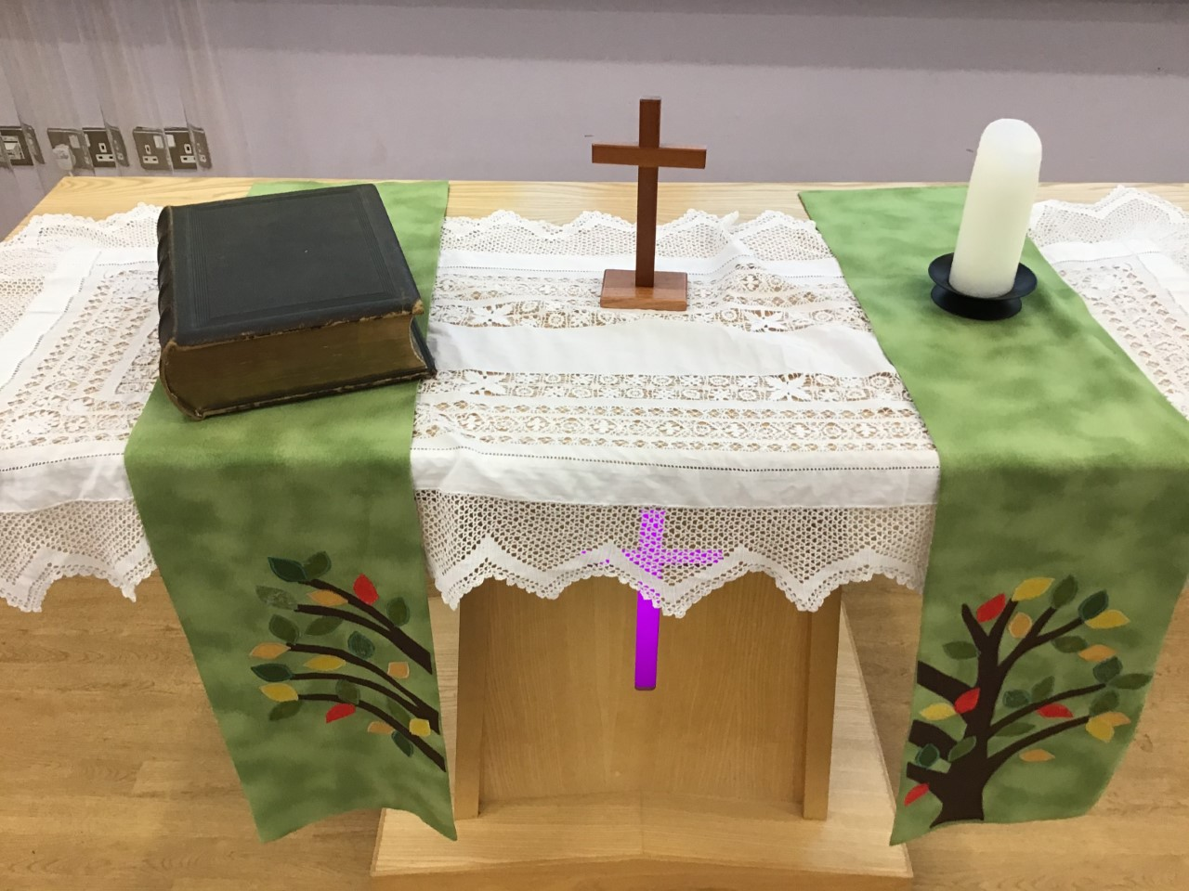
Bishop’s Lent Challenge 2026 -Worship Leader Welcome
We open the Bible as we think about … God the Father
We place the Cross as we think about … Jesus his Son
We light the Candle as we think about … The Holy Spirit

Slide 5



Bishop’s Lent Challenge 2026 -Worship Leader Greeting
Lead: Therefore, encourage and build each up…
Response: Just as we are doing!

Slide 6
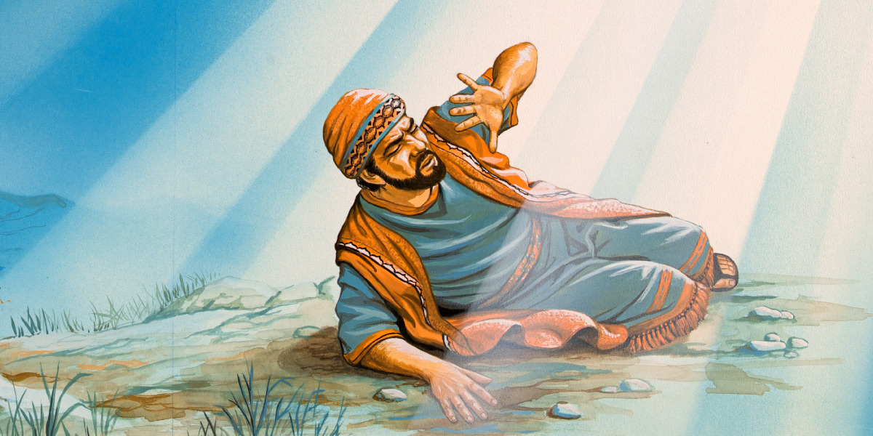
Bishop’s Lent Challenge 2026
Paul’s story is about change, listening to God and new beginnings.
I wonder how his story enables Christians to think about their spiritual development?
https://www.jw.org/en/library/books/bible-stories/7/road-to-damascus/

Slide 7
Bishop’s Lent Challenge 2026
When he was travelling on the road to Damacus, a bright light flashed all around him. He heard the voice of Jesus.
He could not see God. He could not see Jesus. But he encounters God’s presence. This shows that God speaks to people in different ways and not in the way we expect.
I wonder… what do you think God sounds like?
I wonder… what would He say to you?
https://www.jw.org/en/library/books/bible-stories/7/road-to-damascus/

Slide 8
Bishop’s Lent Challenge 2026
Before this spiritual moment, Paul hurt many Christians. However, after this, he chose a new way of living. He showed repentance which means being sorry and choosing to do something different.
It is always possible to make better choices and change the way we act, speak and behave.
I wonder… could you be a better person?
I wonder… what sorry means to you?
https://www.jw.org/en/library/books/bible-stories/7/road-to-damascus/

Slide 9
Bishop’s Lent Challenge 2026
When Paul became blind, he was in the darkness, both physically and spiritually. He had to learn to trust and put his faith in God. Paul also had to accept help from a Christian, who he had seen as an enemy.
For many Christians, having faith means believing and trusting in something that cannot be seen, touch or heard. This can sometimes make them feel lost, scared and uncertain.
I wonder… what does faith mean to you?
I wonder… what makes you feel safe and protected?
https://www.jw.org/en/library/books/bible-stories/7/road-to-damascus/

Slide 10
Bishop’s Lent Challenge 2026
After this experience, Paul decided to spend his life telling others about Jesus and spread love rather than hate.
This life changing experience, helped Paul to discover his purpose, and he learned to serve others rather than punish.
Many Christians believe God has a plan for them, I wonder… what do you think is in your plan?
I wonder… how you spread love around?
I wonder… what it means to serve others?
https://www.jw.org/en/library/books/bible-stories/7/road-to-damascus/

Slide 11

Bishop’s Lent Challenge 2026 – Choral Worship
Tell the world – Northpoint Kids
https://www.youtube.com/watch?v=Xwoa4-JcMC8&list=RDXwoa4-JcMC8&start_radio=1

Slide 12
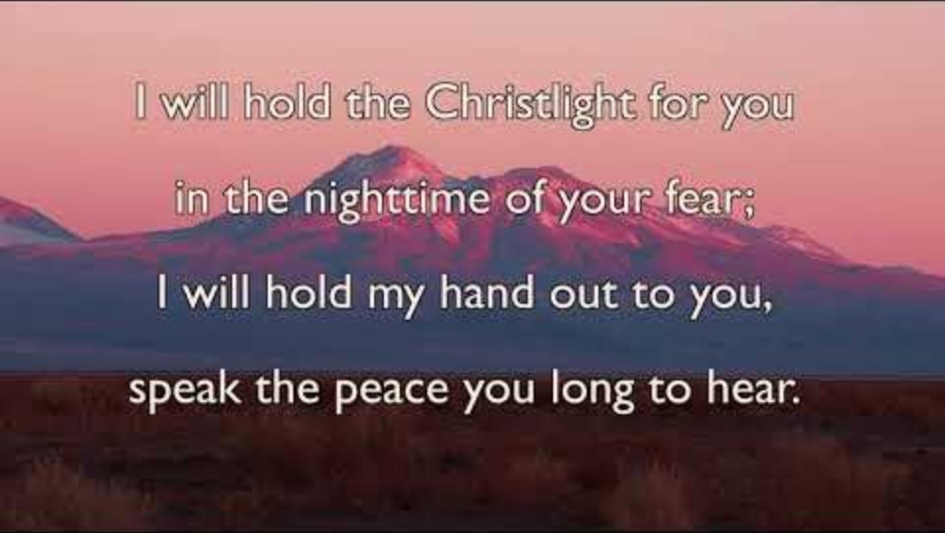
Bishop’s Lent Challenge 2026 – Choral Worship
Brother, Sister, Let Me Serve You
https://www.youtube.com/watch?v=0JahFRDrSCs&list=RD0JahFRDrSCs&start_radio=1

Slide 13
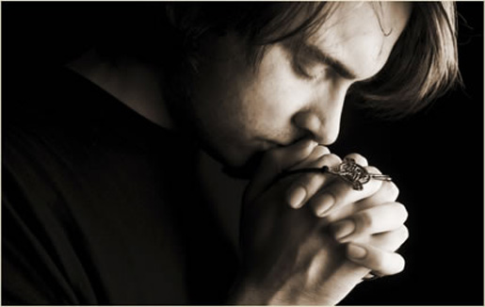
I invite you to
Pray with me.
If you want to make it your prayer, please find your quiet place, read out loud or as a grown up to help and say
Amen at the end.
If you choose to take a moment to reflect, I invite you to think about
Being the change, you want to see in the world

Slide 14


Bishop’s Lent Challenge 2026 –Prayer & Reflection
Dear God,
Help us to hear your voice and to listen when you speak to us, even when it is quiet in our hearts.
Help us to be wise in our actions, speech and attitudes, even when things are hard.
Help us to have the courage to change and to trust you when we need direction.
Help us to be brave and to make good choices.
Amen

Slide 15


Bishop’s Lent Challenge 2026
Final Enrichment & Class Reflection
Create a quiet, calm, reflective space in the classroom. Sit in a circle.
Light a candle and invite pupils to think about times they’ve needed to change or be brave.
Take a moment to think about what you will do differently. How will you grow and change?
Invite them into God’s space to ask for His guidance and wisdom
Use this space to write your own reflections and learning
OR
Use this space to draw patterns and shapes as you reflect and think about the I wonders…

Slide 16
Bishop’s Lent Challenge 2026 -Worship Leader Closing
We close the Bible as we think about … God the Father
We lay down the Cross as we think about … Jesus his Son
We snuff out the Candle as we think about … The Holy Spirit

Slide 17



Bishop’s Lent Challenge 2026 -Worship Leader Leaving
Lead: May you go in peace to…
Response: Encourage and build each other up

Slide 18


Bishop’s Lent Challenge 2026 –Reflections & Thoughts
Final Reflections
I wonder how Paul felt to hear Jesus’ voice?
I wonder why God chose Paul?
I wonder how you feel when you realise something needs to change?
I wonder who you turn to when you need help?
I wonder what it feels like to have faith in God?
I wonder how God might call us to make a change today?
I wonder what news beginnings God might have planned for humanity?

