Slide 1

Bishop’s Lent Challenge 2026 – Week 1
Bishop’s Lent Challenge 2026 – Week 1
Paul sent letters to Thessalonica, and he told the people to ‘encourage each other and build each other up’.
Encouragement holds a powerful role in motivating people. What words could you say to encourage and build each other up?
Paul sent letters to Thessalonica, and he told the people to ‘encourage each other and build each other up’.
Encouragement holds a powerful role in motivating people. What words could you say to encourage and build each other up?

Slide 2
Bishop’s Lent Challenge 2026 – Week 2
Bishop’s Lent Challenge 2026 – Week 2
Write a letter to someone in your class, use words of praise and encouragement. Share the reasons you admire them and recognise why we are a blessing to your life (from God).
Write a letter to someone in your class, use words of praise and encouragement. Share the reasons you admire them and recognise why we are a blessing to your life (from God).

Slide 3
Bishop’s Lent Challenge 2026 – Week 3
Wall of Encouragement—Create a school wall with affirmations and encouraging phrases – learn to build each other up

Slide 4
Bishop’s Lent Challenge 2026 – Week 4
Bishop’s Lent Challenge 2026 – Week 4
Gift Spotting —Notice and share each other’s gifts and talents, share your praises with one another, build each other up
Gift Spotting —Notice and share each other’s gifts and talents, share your praises with one another, build each other up

Slide 5
Say something kind to someone in your class
Say thank you to a person who encourages you
Bishop’s Lent Challenge 2026 – Week 5
Give an encouraging message to someone in class
Describe how it feels to be encouraged by someone
Act out a gesture of encouragement
Share something you admire about someone

Slide 6

Bishop’s Lent Challenge 2026 – Week 5 Class Worship
Bishop’s Lent Challenge 2026 – Week 5 Class Worship
Use this candle to write your own spiritual reflections and learning about Paul. If you choose ask God for his guidance and wisdom
Use this candle to write your own spiritual reflections and learning about Paul. If you choose ask God for his guidance and wisdom

Slide 7
Bishop’s Lent Challenge 2026 – Week 5 Class Worship
Bishop’s Lent Challenge 2026 – Week 5 Class Worship
Use this candle to doodle and reflect on the questions and your wonders. If you choose ask God for his guidance and wisdom.
Use this candle to doodle and reflect on the questions and your wonders. If you choose ask God for his guidance and wisdom.

Slide 8
Bishop’s Lent Challenge 2026 – Enrichment
Bishop’s Lent Challenge 2026 – Enrichment
Scripture through Art
‘Therefore encourage each other, build each other up, just as you are doing’ 1 Thessalonians 5:11
Scripture through Art
‘Therefore encourage each other, build each other up, just as you are doing’ 1 Thessalonians 5:11

Slide 9
Bishop’s Lent Challenge 2026 – Enrichment
Bishop’s Lent Challenge 2026 – Enrichment
Dear Diary,
Dear Diary,
Write a fictional diary entry from the perspective of a child working in a brick kiln.
Write a fictional diary entry from the perspective of a child working in a brick kiln.

Slide 10
Bishop’s Lent Challenge 2026 – Enrichment
Bishop’s Lent Challenge 2026 – Enrichment
Awareness Posters – Design a poster or presentation about bonded labour and how we can act as change makers to help.
Awareness Posters – Design a poster or presentation about bonded labour and how we can act as change makers to help.

Slide 11
Bishop’s Lent Challenge 2026 – Enrichment
Context: Many workers in brick factories are trapped in debt bondage. They borrow money from a factory owner and are forced to work under unfair conditions to "repay" the loan, often for years.
Problem: A worker is promised £5 per 1,000 bricks made. She makes 4,000 bricks in a day. But the owner deducts £3 every day for "tools" and "lodging”
Question:
How much is the worker actually paid per day?
How much should she be paid?
What is the difference?
Problem: A family of 4 works in a brick kiln. One child should be in school, but instead, they help make 1,000 bricks a day. The family earns 50p per brick.
Question:
How much extra income does the child bring in per week (6 days)?
What is the long-term cost if the child misses 5 years of school?
Problem: A worker takes a loan of £1000 from the factory owner to pay for his wife’s medical bills. He agrees to work to repay the loan, but he is only paid £20 per day, even though he earns the owner £100 per day.
Question:
If the owner deducts £15 per day toward the loan repayment, how many days will it take to repay £1000?
How much profit does the owner make from the worker per day?
Problem: A family earns £180 per week at a brick kiln. Their living costs (food, rent, clothes, school) total £240 per week.
Question:
What is their weekly shortfall?
How much debt will they accumulate in 3 months if this continues?
Debt Dominoes – using real world maths to understand how exploitation happens in brick factories - Reflection Questions
Why is it unfair if a worker earns only a small portion of the value they produce? What could be done to improve these working conditions?
Why might children end up working instead of going to school? How does the debt keep families trapped?

Slide 12
Bishop’s Lent Challenge 2026 – Enrichment
Match each of the statements or images with the correct right from the ‘UN Convention on the Rights of the Child (UNCRC)’. Compare to working in a brick factory. Which rights are being denied?
A girl goes to school every day and has books to read | Right to a safe home and family life (Article 27) | A child works 10 hours a day stacking bricks in the hot sun
A boy gets medicine when he is sick | Right to an education (Article 28) | A child cannot go to school because they must work to help the family
A child plays football with friends after school | Right to good nutrition (Article 24) | A child coughs often from brick dust but never sees a doctor
A child has enough food and clean water to drink | Right to express opinions and be heard (Article 12) | A child eats one meal a day and drinks dirty water from a well
A girl tells her teacher how she feels and is listened to | Right to rest and play (Article 31) | A child is never asked how he feels and is shouted at by employers
A family lives together safely in a clean home | Right to health care (Article 24) | A family sleeps on the floor inside the factory, with no bathroom

Slide 13
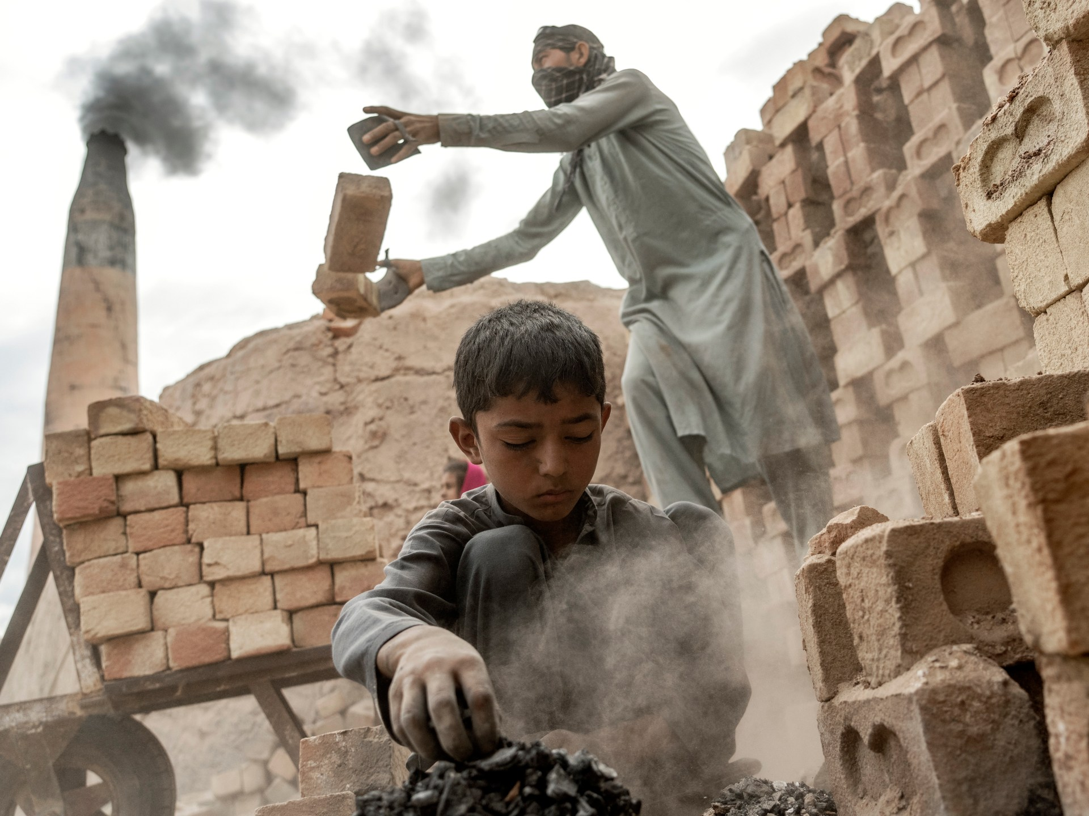
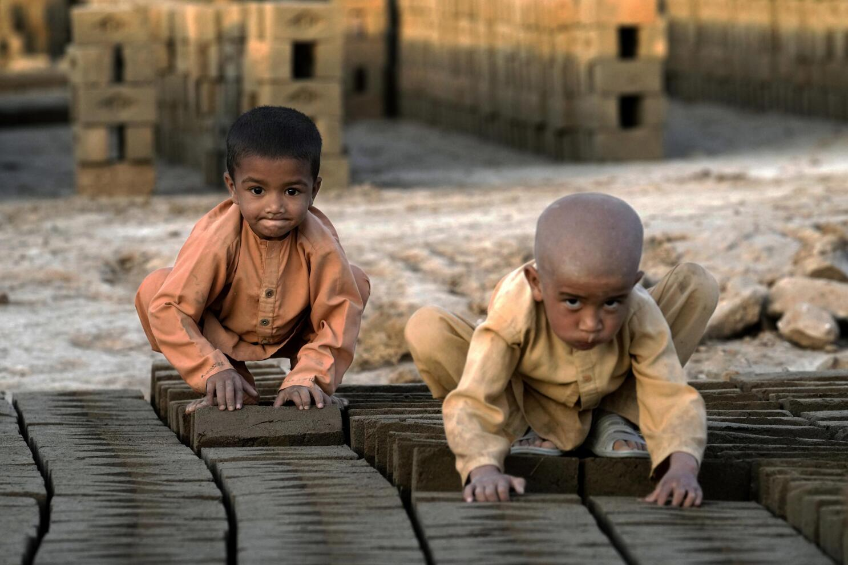
Bishop’s Lent Challenge 2026 – Enrichment
Bishop’s Lent Challenge 2026 – Enrichment
After match the statements from the ‘UN Convention on the Rights of the Child (UNCRC)’ and comparing to working in a brick factory. Here are some reflection questions:
After match the statements from the ‘UN Convention on the Rights of the Child (UNCRC)’ and comparing to working in a brick factory. Here are some reflection questions:
How does it feel to see these rights denied to some children?
Why do you think this happens?
How could you help?
How does it feel to see these rights denied to some children?
Why do you think this happens?
How could you help?

