Slide 1


Bishops’ Lent Challenge 2024
This is the time
‘For I know the plans I have for you… plans to give you hope and a future’
Jeremiah 29:11
Week Five – Restoration

Slide 2
Welcome and Response
This is the time
We can make a difference

Slide 3
Stewardship
When God had created the world, he told humans they would be the caretakers.
This responsibility is called ‘Stewardship’.
Whether you believe in God or not, it is all of humanity’s responsibility to preserve and protect the world for future generations.
This means we need to try our best to keep the world going, to not ruin it and to make sure our babies, and the babies of the future, have a place to called home which is safe and harmonious.

Slide 4
What kind of small things can we do that will make a big difference?
Plant some flowers
Look after the school grounds
Reduce, reuse, recycle
Compost food waste
Reuse rain water
Tend to a herb garden
Pick up litter

Slide 5
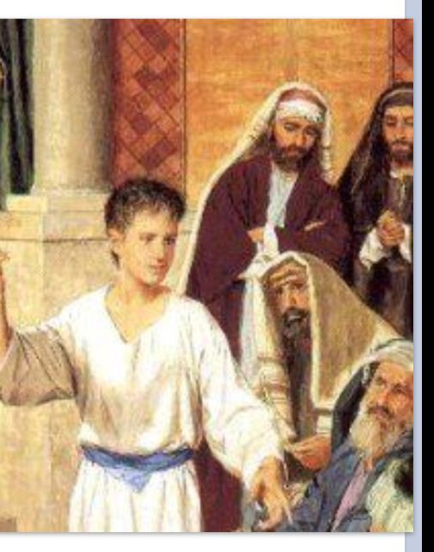
BIBLE FOCUS - Luke 2: 41-52
Jesus As a Boy
⁴¹ Every year Jesus’ parents went to Jerusalem for the Passover Feast. ⁴² When Jesus was 12 years old, they went to the feast as they always did. ⁴³ When the feast days were over, they went home. The boy Jesus stayed behind in Jerusalem, but his parents did not know it. ⁴⁴ Joseph and Mary travelled for a whole day. They thought that Jesus was with them in the group. Then they began to look for him among their family and friends, ⁴⁵ but they did not find him. So they went back to Jerusalem to look for him there. ⁴⁶ After three days they found him. Jesus was sitting in the Temple with the religious teachers, listening to them and asking them questions. ⁴⁷ All who heard him were amazed at his understanding and wise answers. ⁴⁸ When Jesus’ parents saw him, they were amazed. His mother said to him, “Son, why did you do this to us? Your father and I were very worried about you. We have been looking for you.”
⁴⁹ Jesus asked, “Why did you have to look for me? You should have known that I must be where my Father’s work is!” ⁵⁰ But they did not understand the meaning of what he said.
⁵¹ Jesus went with them to Nazareth and obeyed them. His mother was still thinking about all that had happened. ⁵² Jesus continued to learn more and more and to grow physically. People liked him, and he pleased God.

Slide 6
What can we learn from this story?
When Mary found Jesus, she questioned why he had behaved in this way and not followed them when they left. Jesus told his mother it was obvious where he would be …in his father’s house. She did not fully understand what Jesus meant.
The church teaches Christians that it is important to listen to the voices of the young because they speak the loudest and clearest.

Slide 7
Other examples of children in the bible
Jesus asks the disciples not to stop children coming to him (Mark 10:13-15).
In the Old Testament, think of God calling and speaking to the young boy Samuel, not to the experienced old priest Eli (1 Samuel 3).
When it comes to anointing a king, it is, unusually, the youngest son of Jesse, David, who is chosen (1 Samuel 16:10-13).
The Bible teaches us that those who are young and their gifts are to be valued.

Slide 8
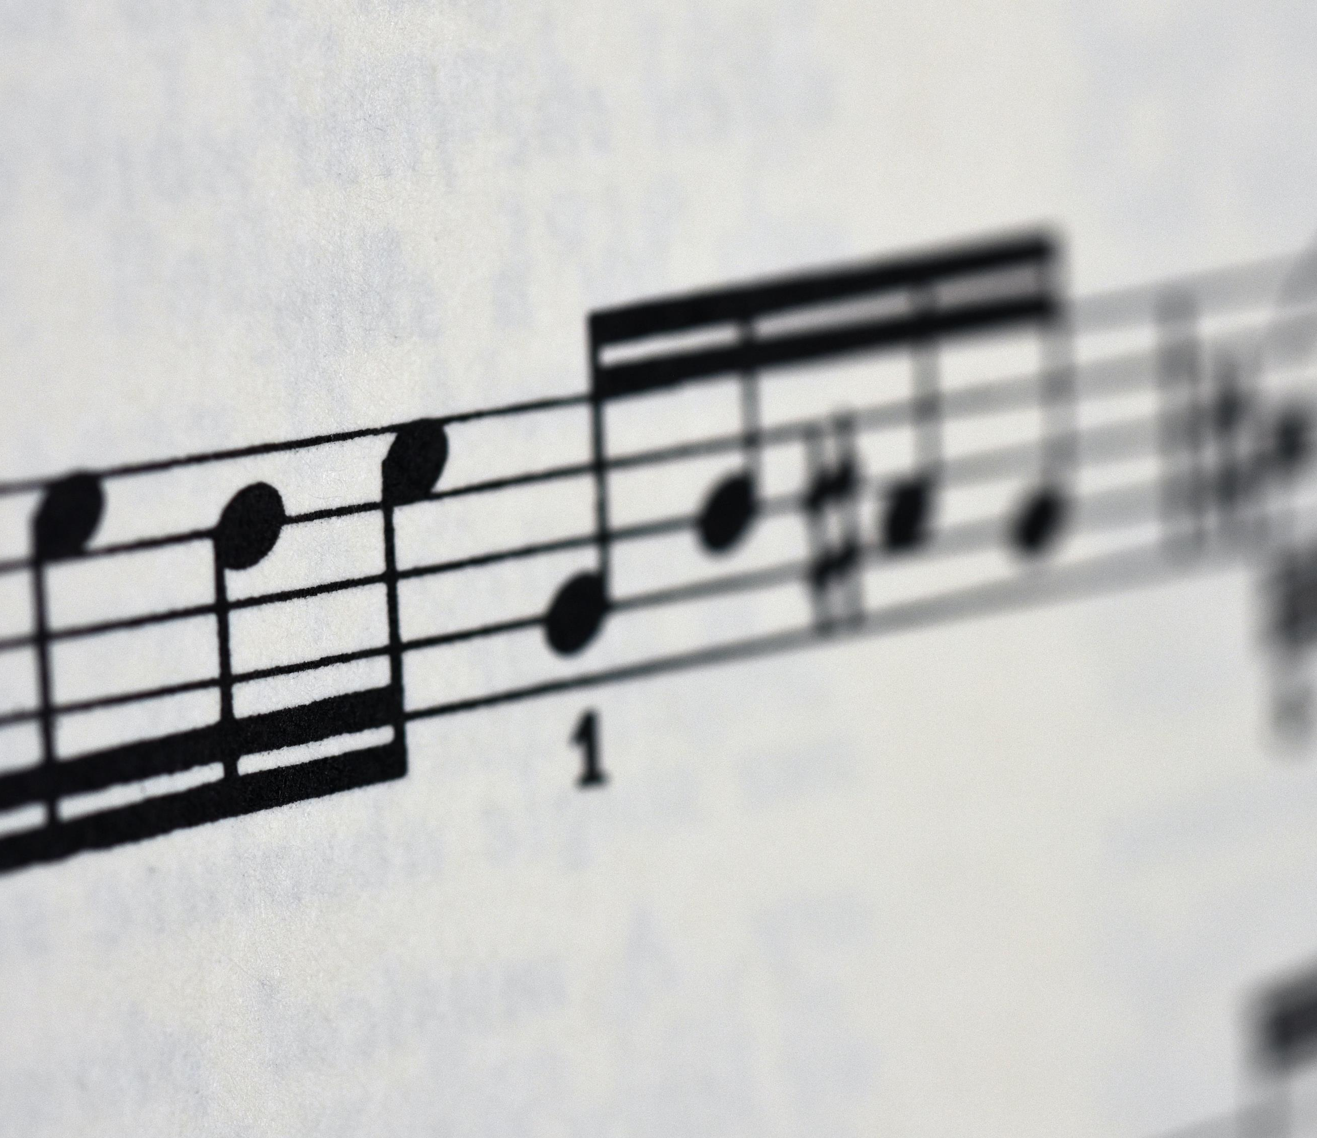
Let’s Sing!
Choose
Every Move I Make – CJ and Friends Worship
OR
Together – Out of the Ark
OR
Sing from your heart – Young Voices Choir

Slide 9
Let’s Sing!
https://www.youtube.com/watch?v=MPvnZILn6EY&list=RDMPvnZILn6EY&start_radio=1

Slide 10

Let’s Sing!
https://www.youtube.com/watch?v=v2ufruc-mvY

Slide 11
Let’s Sing!
https://www.youtube.com/watch?v=rG_20mxFH8c

Slide 12
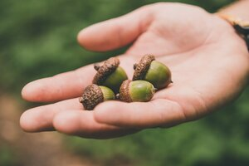
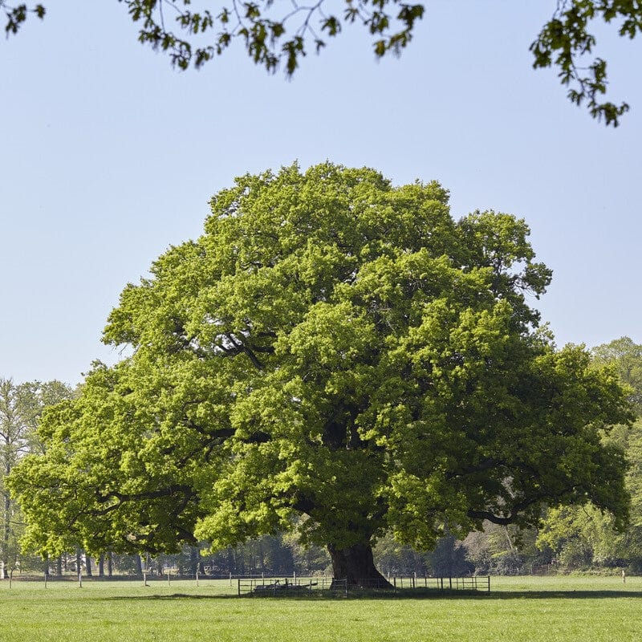
Questions and Reflection
What small actions can make a big impact for the future generations?
"The moment we decide to fulfil something, we can do anything." What does Greta Thunberg mean by this statement?
Did you know … Little people can make big differences?
From the tiny acorn, a mighty oak tree grows.
Be like an acorn, grow and make a mighty change.

Slide 13
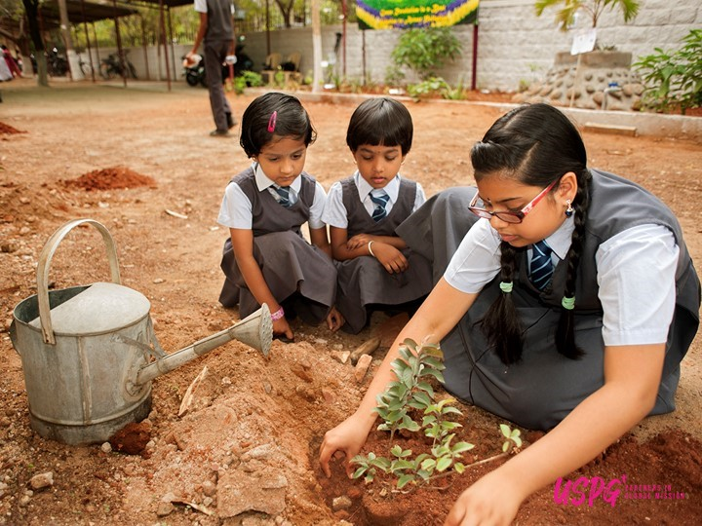
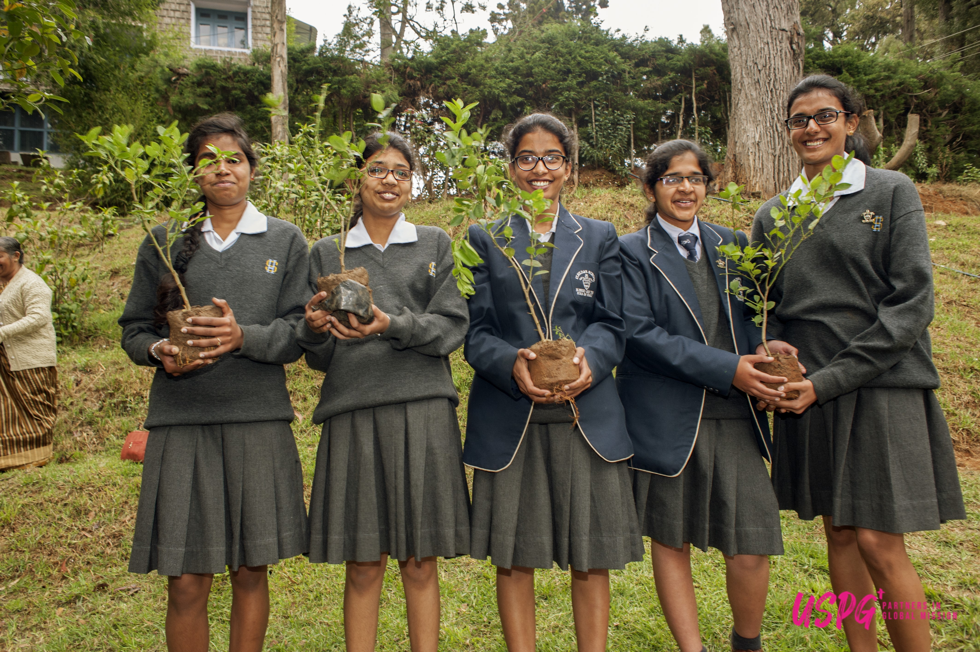
This is what is happening in South India
Green Audits
Air quality and waste management
Eco spirituality

Slide 14
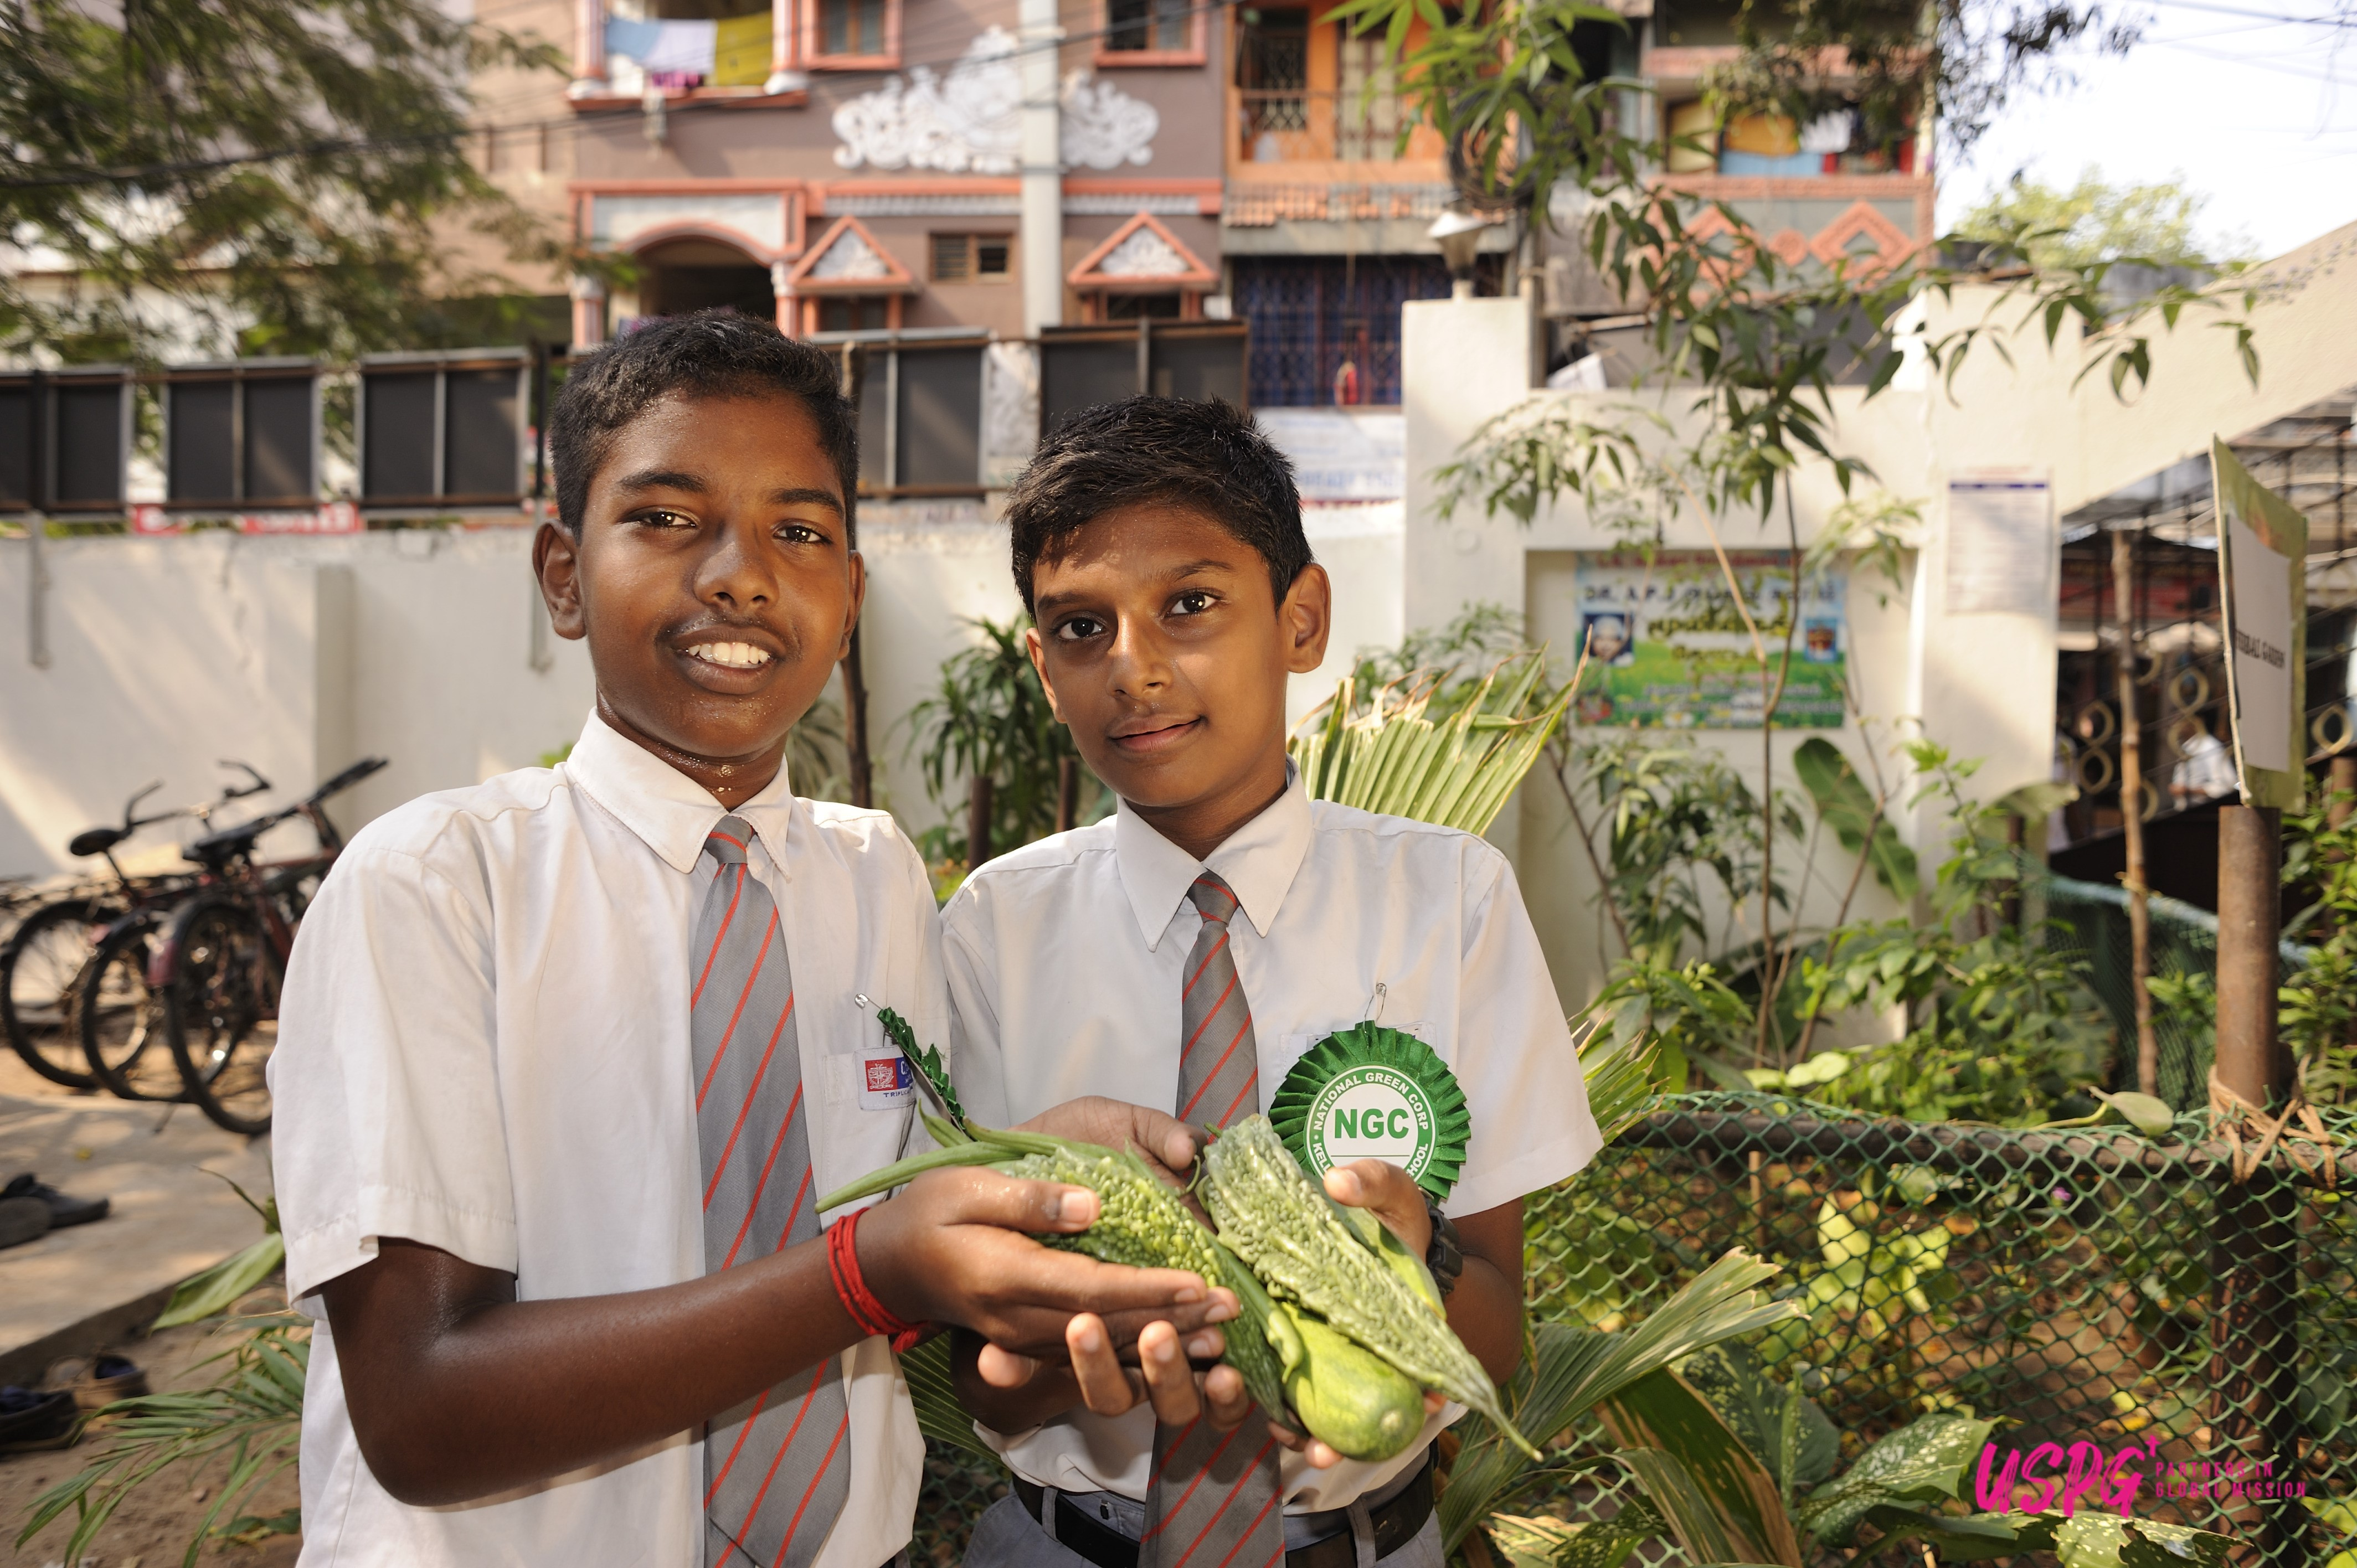
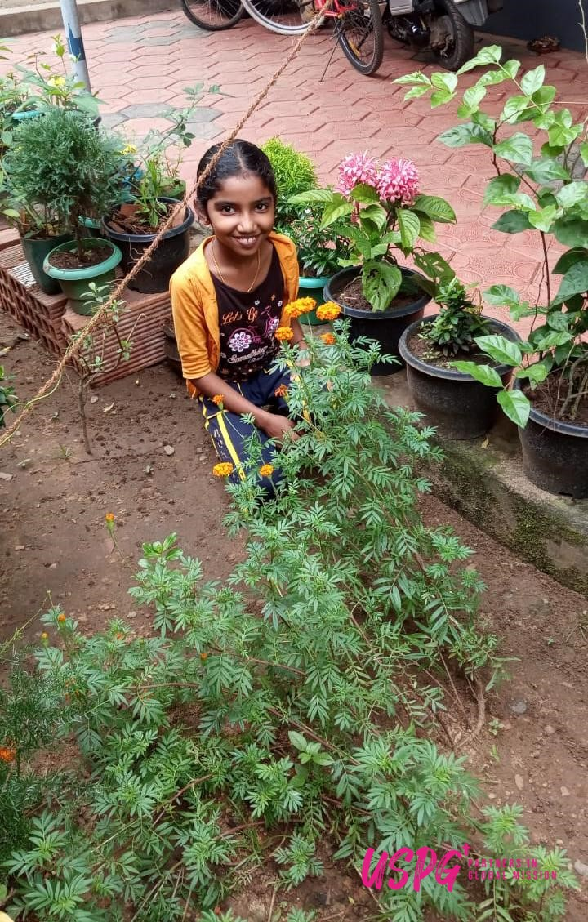
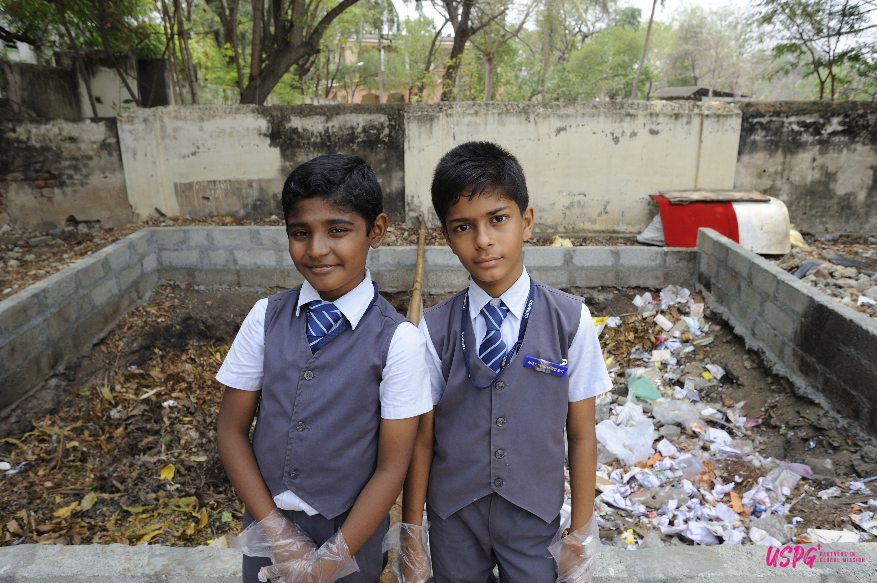
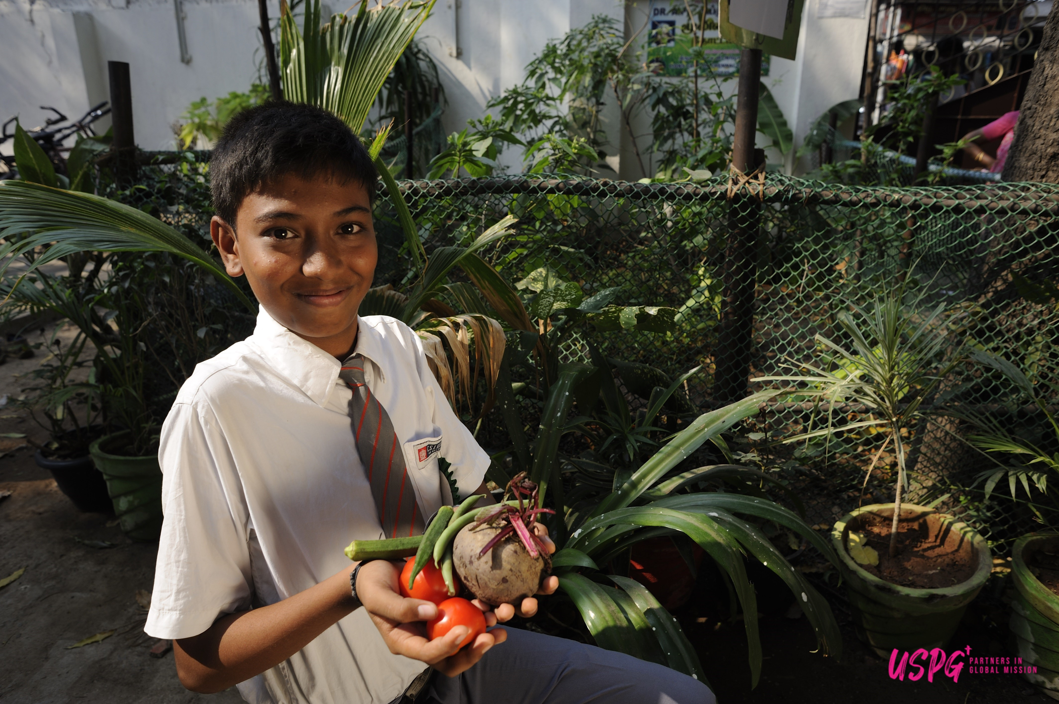
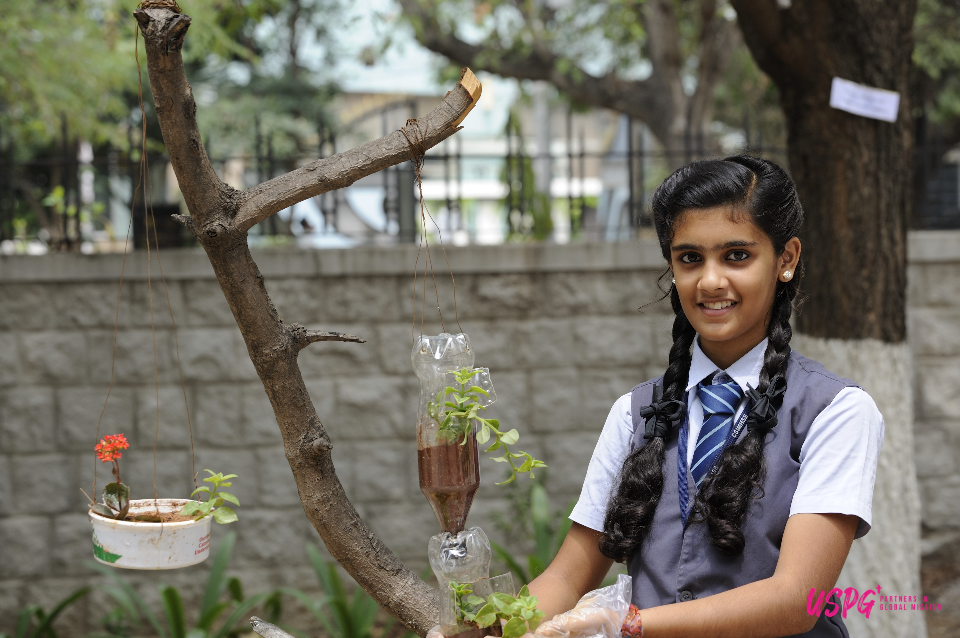
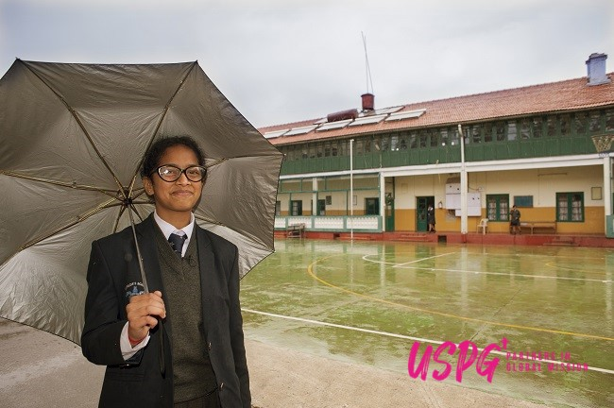
Champions of the environment
Trained in eco spirituality

Slide 15

Prayer
Father of everlasting compassion,
You see your children growing up in an uncertain and confusing world:
Show them the path of life enable them to triumph over failure and frustration,
To hold fast their faith in you and to keep alive their joy in your Creation;
through Jesus Christ our Lord,
Amen
(USPG Prayer - For a time such as this)

Slide 16
Go and Do!
If you were to become agents of change, what changes would you want to see and make –
in our school
in our local environment
nationally
globally?
What small things can we do to make the biggest difference for the future generations?
This week, look at how much energy you consume.
Take steps to reduce the electricity, gas or oil you use in your school. Does your school have energy efficient light bulbs? Can the classrooms turn the thermostat down by 2 degrees? Are the doors and windows closed properly? Does everyone switch off their lights when you leave the room? Work together to make changes in your school.

