Slide 1


Bishops’ Lent Challenge 2024
This is the Time
‘For I know the plans I have for you… plans to give you hope and a future’
Jeremiah 29:11
Week Four – Salvation
Romans 8: 18-25

Slide 2
Welcome and Response
This is the time
We can make a difference

Slide 3
Key Question
What does it mean to suffer?
What does suffering look like?
The dictionary says ‘suffering is the state of undergoing pain, distress, or hardship’

Slide 4
¹⁸ We have sufferings now. But the sufferings we have now are nothing compared to the great glory that will be given to us. ¹⁹ Everything that God made is waiting with excitement for the time when God will show the world who his children are. The whole world wants very much for that to happen. ²⁰ Everything that God made was changed to become useless. This was not by its own wish. It happened because God wanted it. But there was this hope: ²¹ that everything God made would be set free from ruin. There was hope that everything God made would have the freedom and glory that belong to God’s children.
²² We know that everything God made has been waiting until now in pain, like a woman ready to give birth. ²³ Not only the world, but we also have been waiting with pain inside us. We have the Spirit as the first part of God’s promise. So we are waiting for God to finish making us his own children. I mean we are waiting for our bodies to be made free. ²⁴ We were saved, and we have this hope. If we see what we are waiting for, then that is not really hope. People do not hope for something they already have. ²⁵ But we are hoping for something that we do not have yet. We are waiting for it patiently.
Romans 8: 18-25

Slide 5
In the book of Romans, we learn about suffering and pain.
In life we all suffer
But we shouldn’t be disheartened because God gives us hope
On Earth, there will be times when we struggle
We may suffer pain but God is with us and nothing can separate us from His love
The book of Romans offers some light and hope
Revelations ‘One day everything that was ever created… will fulfill God’s intended purpose’ and there will be no more sadness or tears. This offers hope to many who follow God.
Life still has meaning and purpose because Jesus helps us in our struggles
In heaven we will have joy and happiness that will make the suffering fade away

Slide 6
Romans 8:25 ‘People do not hope for something they already have’.
What do you think this means?

Slide 7
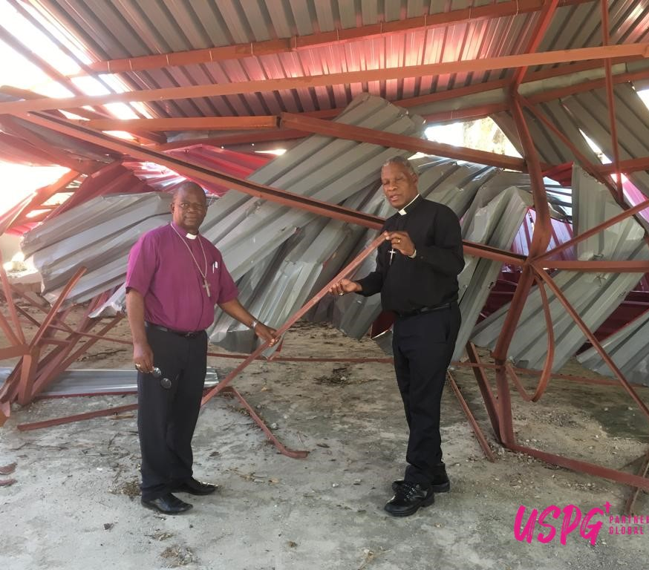
In Mozambique, its geographic location means as a country, it suffers from climate change greatly. In the last 2 decades, the country has been damaged by long severe droughts in the central and southern region, devastating cyclones and almost yearly flooding - especially in the central and northern regions (USPG). Millions of people suffer, thousand of people die and many cannot find a way to recover from the damages in their lives.
Cyclone damage on a church building in Mozambique

Slide 8
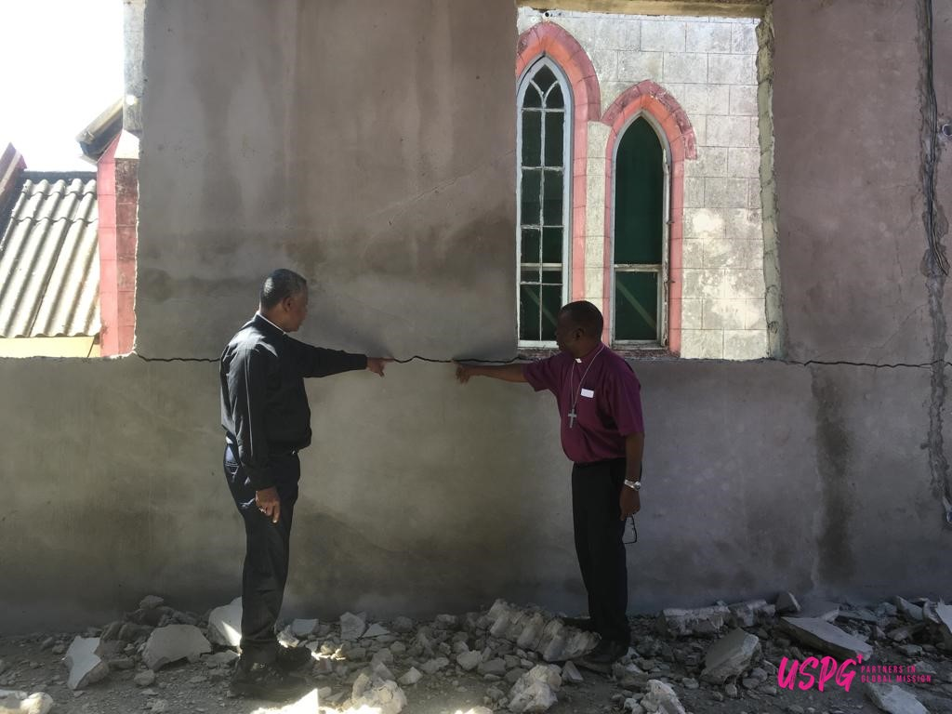
In Mozambique, there is chronic hunger, lack of sanitation and large amounts of poverty across the country. To make things harder, people have to live in constant fear of terrorism and conflict. But, there is a sign of hope…….

Slide 9
There are Churches in Mozambique who are actively working together to address climate change and tackle the economic crisis.
They are trying to educate the young – teaching about resilience, response and climate change.
They are planting more trees to make the land more fertile and trying to reduce pollution.
Do you think this helps those who suffering? Does it offer hope?

Slide 10
Questions for Reflection
What gives you hope?
What makes you suffer?
How can you offer others hope?
What ways can you stop others from suffering?

Slide 11
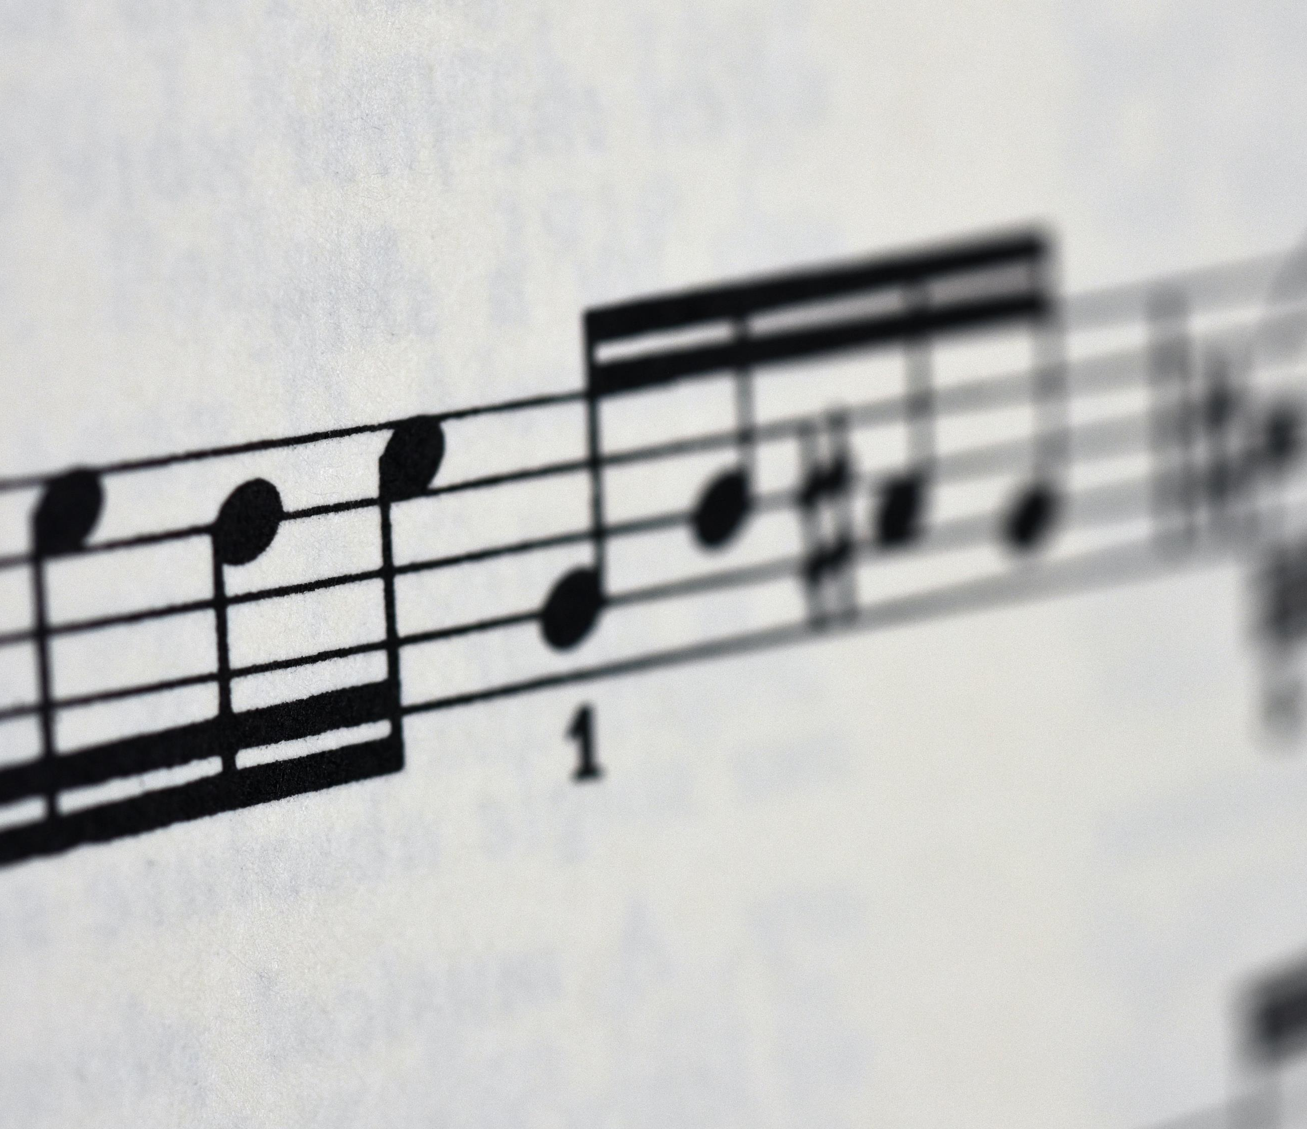
Let’s sing!
Choose
Hope – Allstars Kids Worship
OR
Hope – Worship for everyone
OR
Hopeity Hope - Lyric Video (Songs of Some Silliness) – Hillsong Kids

Slide 12

Let’s sing!
https://www.youtube.com/watch?v=r_t5xitQjIc

Slide 13
Let’s sing!
https://www.youtube.com/watch?v=u_JUlnIlLts

Slide 14
Let’s sing!
https://www.youtube.com/watch?v=Y6gqbmxhnuQ

Slide 15
Message and Reflection
In a time such as this, we need to start changing things now, before it is too late.
What is our hope and how can we achieve it as part of a school community?

Slide 16

Prayer:
Dear God,
Our climate is changing and we are changing it.
We know our carbon footprint and failures thinks about the consequences of our actions is damaging your world.
We have been slow to react. We are sorry for all the times we knew the right thing to do but chose convenience instead.
Amen
(USPG Prayer - For a time such as this)

Slide 17
Go and Do!
Give up travelling in your car for a week.
Instead walk, cycle or take public transport.
If this means that getting to places takes a little bit longer use that time to reflect on what you have learnt over the past 6 weeks.
Think about those who walk to school no matter the weather, terrain or distance.

