Slide 1
Bishops’ Lent Challenge 2024 This is the time ‘For I know the plans I have for you… plans to give you hope and a future’ Jeremiah 29:11
Week One – Flooding

Slide 2
Welcome and Response
This is the time, Lord
We can make a difference

Slide 3
Summary of Genesis chapters 6-9 – the story of Noah and the Flood
When God made the world, on day 6, He said ‘It was very good’. He created a wonderful world, filled with awe, wonder, nature, humans and animals. But, the ‘goodness’ did not last long. After Adam and Eve ate the fruit from the tree they were commanded not to eat, they were made to leave the Garden of Eden and start to make their own path. God tried to help humans over many years but things continued to get worse and the world was no longer ‘good’. So, he chose a special man, who was blameless not sinless, to save his world. That man was called Noah. God spoke to Noah and asked him to build a boat, with very specific instructions and with a very special purpose. Noah would be the first saviour of humanity. God said Noah needed to give people an opportunity to repent – this means to turn back to God, say sorry for their sinful ways and to start living how God wanted them to live. So, whilst he built the boat he spoke to the people. They did not listen and consequently God sent a huge flood to wipe the sin away. All life on Earth, except from Noah and his family died. After 40 days and nights of rain, then 150 days waiting for the floods to disappear, Noah and his family left the boat. God made a covenant (a promise, a deal) with Noah that he would never flood the whole world again and he put his signature in the sky with a rainbow.

Slide 4
So….. If that’s the case… why do we have flooding today?
God promised never to flood the world again out of his anger
HOWEVER:
We now have flooding today because of:
Heavy rainfall
Overflowing rivers
Dry or soggy ground
Climate change
Global warming
The more we mis-use and exploit the earth, the more issues and problems we will have with flooding. However, humans can act now to preserve and protect for future generations

Slide 5
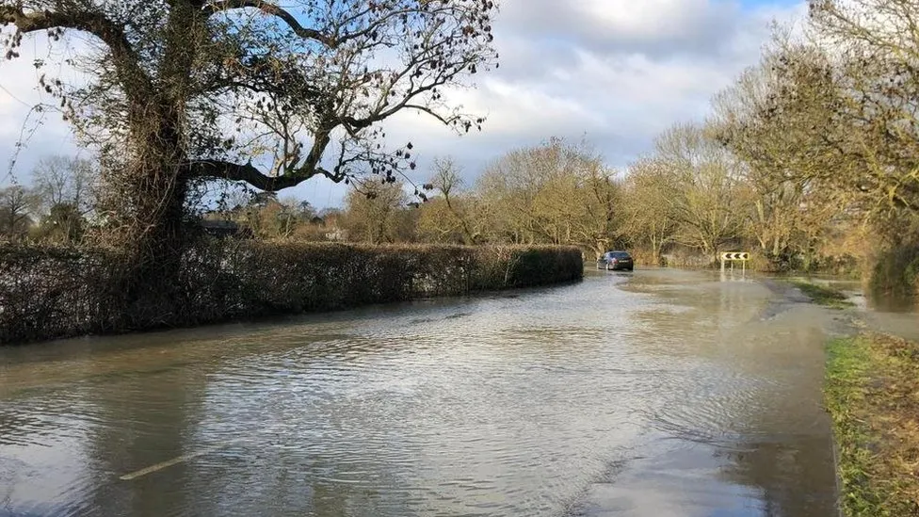
Examples of why places flood
https://www.bbc.co.uk/teach/class-clips-video/geography-ks3-river-flooding/zmdq7nb
A short video to watch – embedded on next page
Flooding between Grantchester and Trumpington

Slide 6
https://www.youtube.com/watch?v=ioNsn4JB4EY

Slide 7
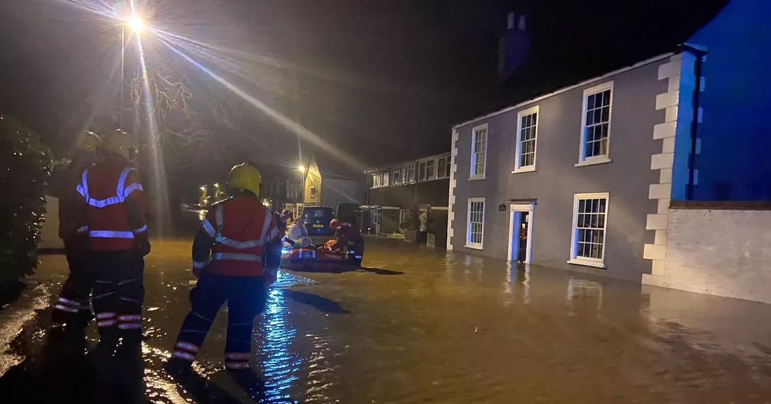
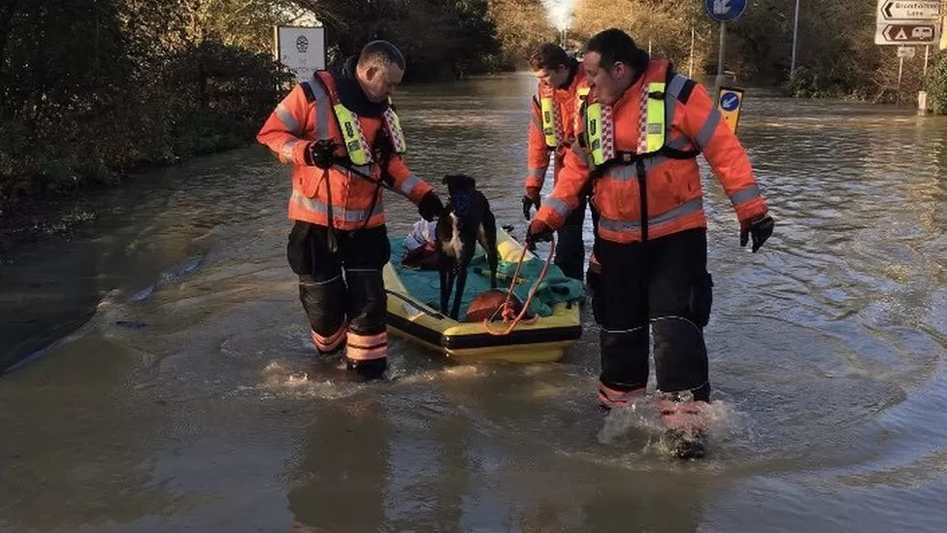
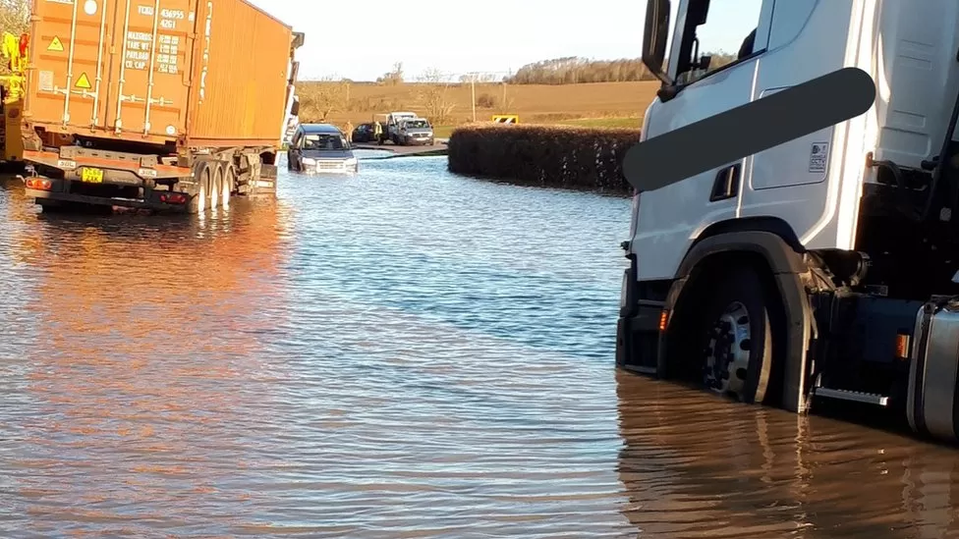
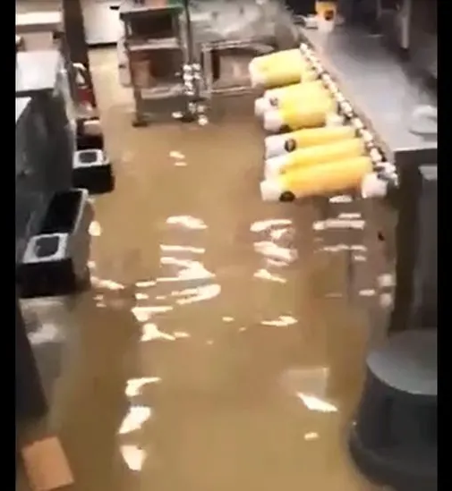
Flooding in Buckden, 2023
Flooding in Alconbury Dec 2023
Flooding of McDonalds at St Ives, December 2023
B645 at Stonely flooded – December 2023

Slide 8
Going Deeper
How can we prevent future mass flooding events?
How can we educate people about the dangers of flooding?
What is the impact of flooding?
How can I make a difference?
How can I help those who are suffering from flood damage?

Slide 9
Time to sing
Sing Up: Drop in the ocean
Peace like a river
Rise and Shine

Slide 10
Let’s sing! Choose
Drop in the Ocean – Sing Up Song
OR
Peace like a river – Listener Kids
OR
Rise and Shine – Christian Songs for Kids

Slide 11
Let’s sing!
https://www.youtube.com/watch?v=7it5W1FVtTs

Slide 12
Let’s sing!
https://www.youtube.com/watch?v=olBzSdX1vF4

Slide 13
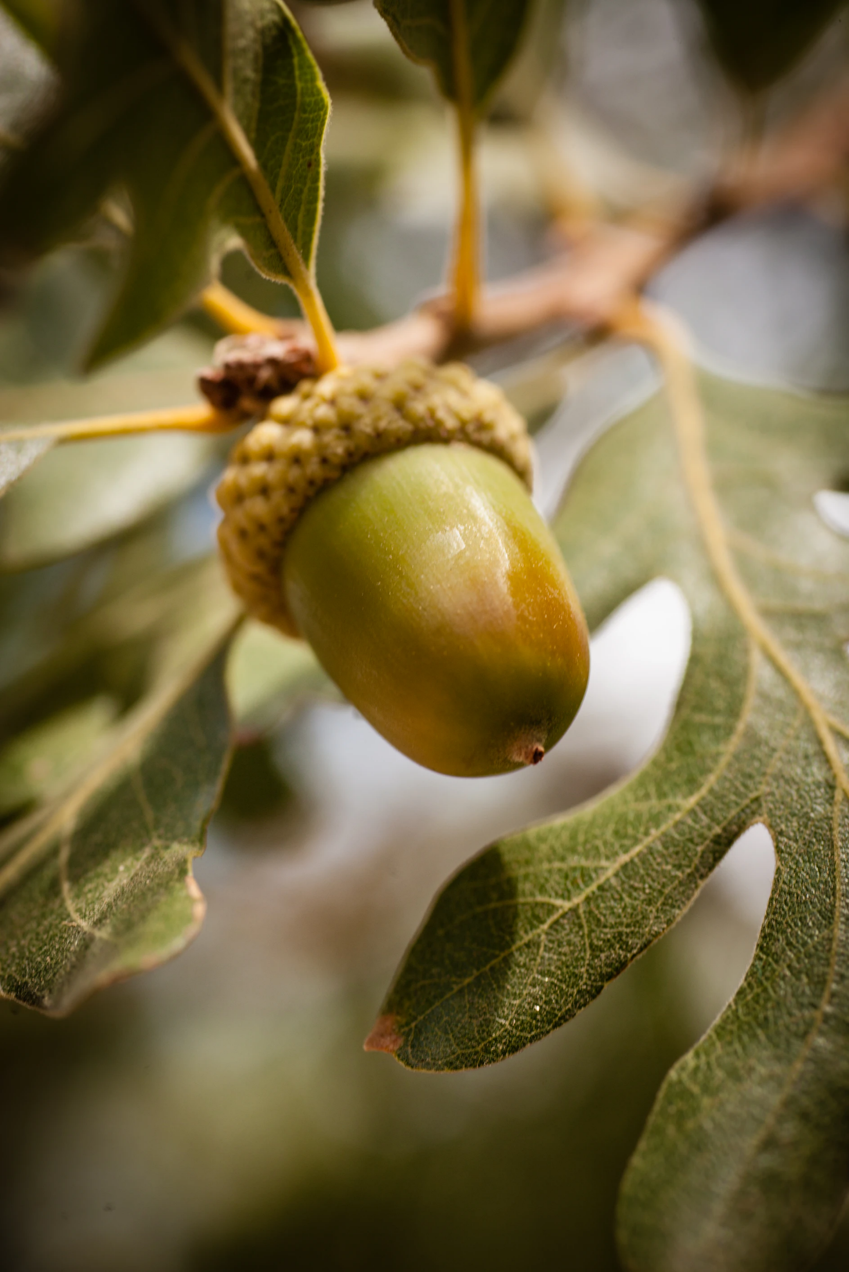
We may only be small now but just like the acorn grows into an oak tree, we will grow big and mighty. We can make a big difference for the future little ones.

Slide 14
Reflection God put a rainbow in the sky to show his covenant with humans. What do you think about when you see a rainbow? Is it God talking to us?

Slide 15
Prayer:
Dear Lord,
We pray for those who have responsibility to act and respond quickly to help those who suffer from flooding.
We pray for those who struggle from the results of flooding. Let the world be generous in helping them to find new places to live and food to eat.
We pray for the human race to make wiser decisions and become agents of change to help the future generations.
Amen

Slide 16
Go and Do!
This week look at how you use water.
Take steps to reduce your water consumption.
Turn the tap off while brushing your teeth.
Time your shower and then reduce the time you spend in the shower by half.
Ask your parents to run the short cycle on your dishwasher and always make sure it is full or use a cooler temperature on the washing machine.
Try to make sure the taps are turn off properly after using the toilet.

