Slide 1
Bishops’ Lent Challenge 2024 This is the time ‘For I know the plans I have for you… plans to give you hope and a future’ Jeremiah 29:11
Week Three – Creation

Slide 2
Welcome and Response
This is the time, Lord
We can make a difference

Slide 3
Moments of Awe and wonder A Look at Psalm 8 and 19 from the ICB
8 Lord our Master, your name is the most wonderful name in all the earth! It brings you praise in heaven above. ² You have taught children and babies to sing praises to you. This is because of your enemies. And so you silence your enemies and destroy those who try to get even.
³ I look at the heavens, which you made with your hands. I see the moon and stars, which you created. ⁴ But why is man important to you? Why do you take care of human beings? ⁵ You made man a little lower than the angels. And you crowned him with glory and honour. ⁶ You put him in charge of everything you made. You put all things under his control: ⁷ all the sheep, the cattle and the wild animals, ⁸ the birds in the sky, the fish in the sea, and everything that lives under water.
⁹ Lord our Master, your name is the most wonderful name in all the earth!

Slide 4
Moments of Awe and wonder A Look at Psalm 8 and 19 from the ICB
19 The heavens tell the glory of God. And the skies announce what his hands have made. ² Day after day they tell the story. Night after night they tell it again. ³ They have no speech or words. They don’t make any sound to be heard. ⁴ But their message goes out through all the world.
It goes everywhere on earth. The sky is like a home for the sun. ⁵ The sun comes out like a bridegroom from his bedroom. It rejoices like an athlete eager to run a race. ⁶ The sun rises at one end of the sky, and it follows its path to the other end. Nothing hides from its heat.
⁷ The Lord’s teachings are perfect. They give new strength. The Lord’s rules can be trusted. They make plain people wise. ⁸ The Lord’s orders are right. They make people happy. The Lord’s commands are pure. They light up the way. ⁹ It is good to respect the Lord. That respect will last forever. The Lord’s judgments are true. They are completely right. ¹⁰ They are worth more than gold, even the purest gold. They are sweeter than honey, even the finest honey. ¹¹ They tell your servant what to do. Keeping them brings great reward.
¹² No one can see all his own mistakes. Forgive me for my secret sins. ¹³ Keep me from the sins that I want to do. Don’t let them rule me. Then I can be pure and free from the greatest of sins.
¹⁴ I hope my words and thoughts please you. Lord, you are my Rock, the one who saves me.

Slide 5
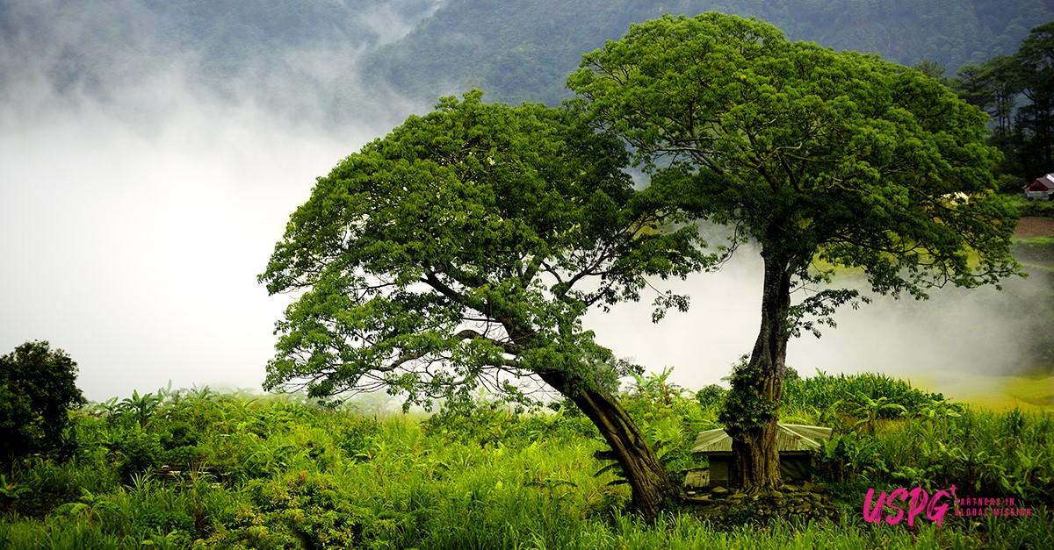
The Philippines
In the Philippines, there is a great amount of commercial interest in the land.
This means large companies are taking land to develop their business.
As a result, vast amounts of forests are being stripped of trees.
Mountains are being mined to find copper, coal and gold.
In addition to this, agricultural land which is used for growing crops have been poisoned and rivers/lakes are being polluted.
Filipinos native to these lands are also suffering, loss of homes, land and opportunities to earn.

Slide 6
Compare and contrast The Psalms and the reality
The psalmist paints an almost picture perfect view of creation
Christians would say that human greed and sin have spoiled that perfection.
What is your perception of Creation before the Fall?
Is the world still perfect?
Is the Philippines just one example or are there more?

Slide 7
Going Deeper
Questions to think about and discuss
What beautiful things do you notice in creation?
What is unfamiliar or strange in the description in the psalms?
How realistic is this?
How similar is this to your experience of the world around you?

Slide 8
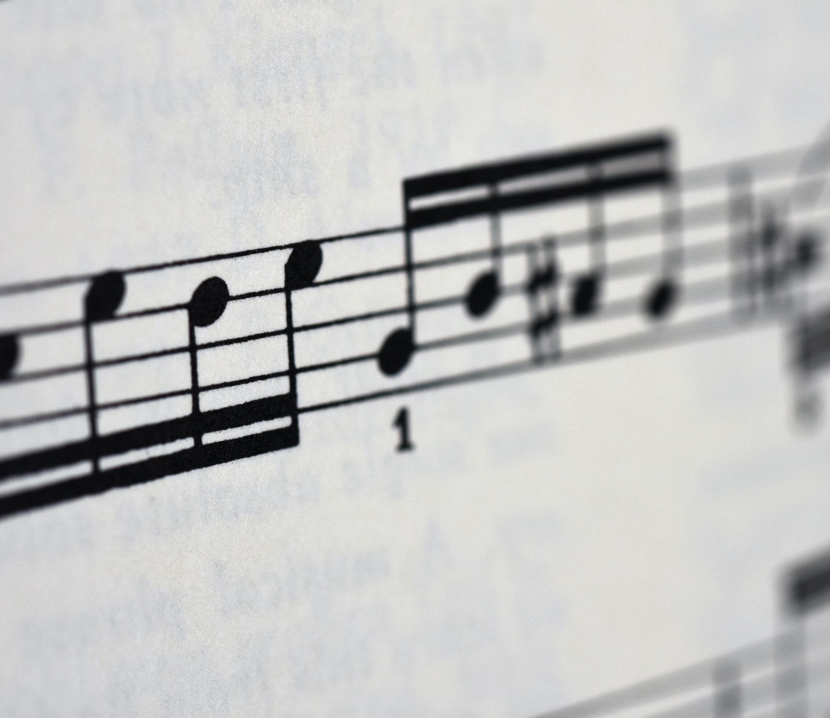
Let’s Sing Choose
What a wonderful world – Playing for Change
For the Beauty of the Earth – traditional hymn
OR
Power in me – YVTV (Young Voices)

Slide 9
Let’s Sing
https://www.youtube.com/watch?v=ddLd0QRf7Vg

Slide 10
Let’s Sing
For the Beauty of the Earth (Tune: Dix - 4vv) [with lyrics for congregations] - YouTube

Slide 11
Let’s Sing
https://www.youtube.com/watch?v=yNHNDGWMrM0

Slide 12
Message and Reflection We should say thank you for what we have, well done for what has been achieved and work towards becoming agents of change for the future generations. How can we make the world good again?

Slide 13
Prayer:
You are present in the whole universe and in the smallest of your creatures.
You embrace with your tenderness all that exists.
Pour out upon us the power of your love,
that we may protect life and beauty.
Fill us with peace, that we may live
as brothers and sisters, harming no one.
Amen
(USPG Prayer - For a time such as this)

Slide 14
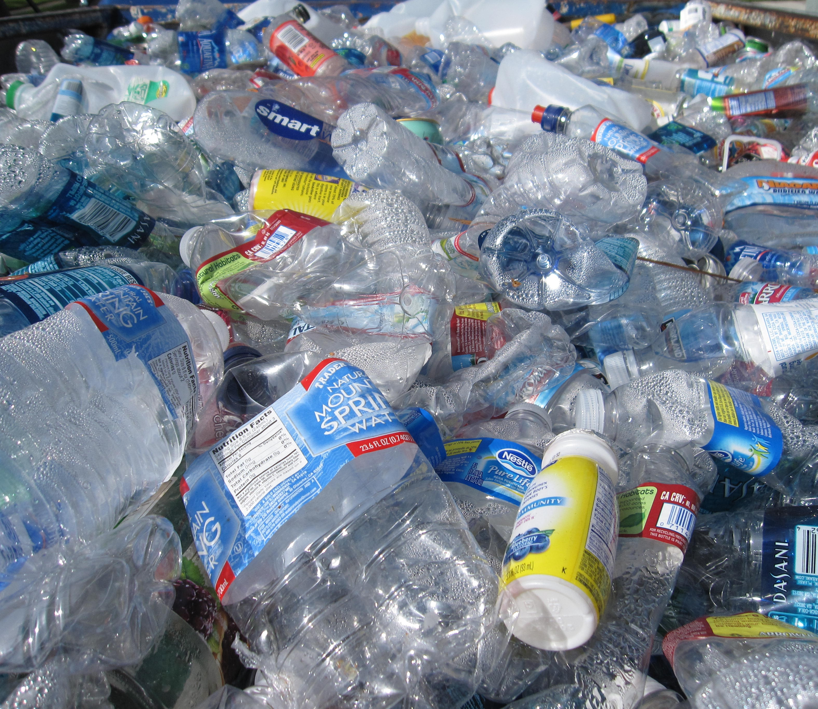
Go and Do!
This week focus on how much plastic you use.
At least 8 million tons of plastic end up in our oceans each year. Marine wildlife is often entangled in plastic causing death and injuries.
Can you look at ways to reduce the amount of plastic we use?
Can you create posters for making people more aware of the damage?
Can you bring a re-usuable bottle or pots to reduce plastic bags for food?
Photo by tanvi sharma on Unsplash

