Slide 1


Bishops’ Lent Challenge 2024
This is the time
‘For I know the plans I have for you… plans to give you hope and a future’
Jeremiah 29:11
Week Two – God’s Covenant

Slide 2
Welcome and Response
This is the time
We can make a difference

Slide 3
Game Time…!
On my Island
Join me on my island if you can add to the list….

Slide 4
Looking back on the Flood
After the flood, imagine how Noah would have felt? How could they live on the earth now?
GOD’S COVENANT WITH NOAH
Noah and his family will be fruitful and multiply in number. What does that mean? Who has God said that to before?
Noah and his family will have dominion over the animals/ be the masters of the world. What does that mean? Who will they be masters of? What does the word dominion mean?
Humans may now eat animals.
Humans may not kill one another as we are made in God’s image so all human life is sacred.

Slide 5
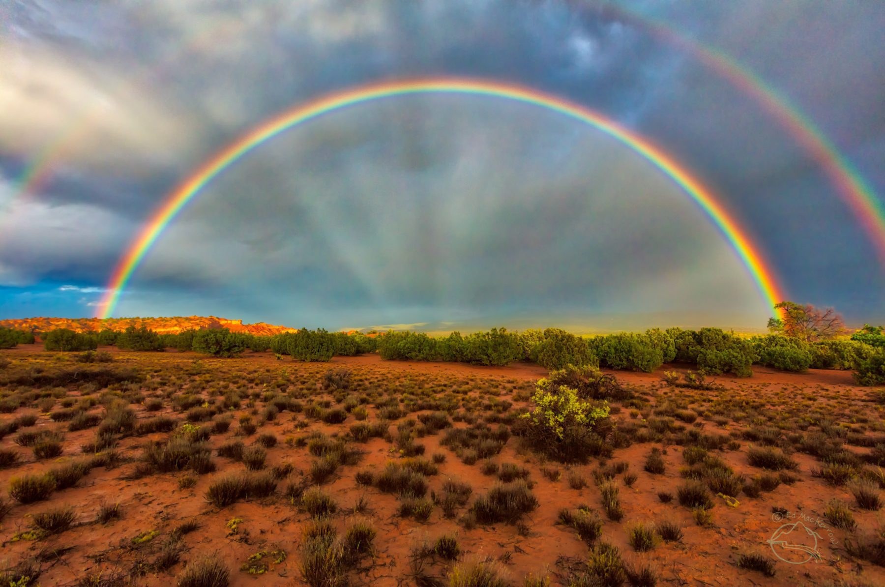
This covenant was with Noah but God tells him that it applies to all of humankind, for all future generations. It became a covenant with creation as it involved every living thing. God gave Noah a visual sign in the sky – like a signature on deal and sealed his covenant with a rainbow.

Slide 6
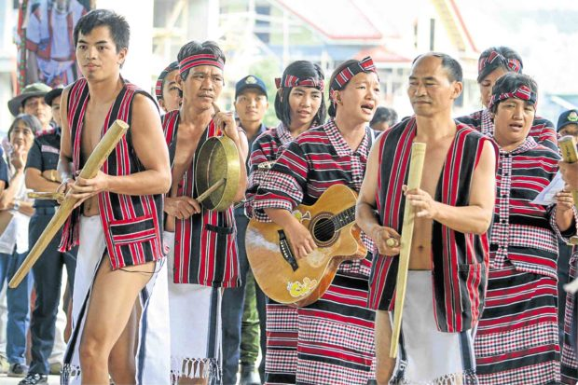
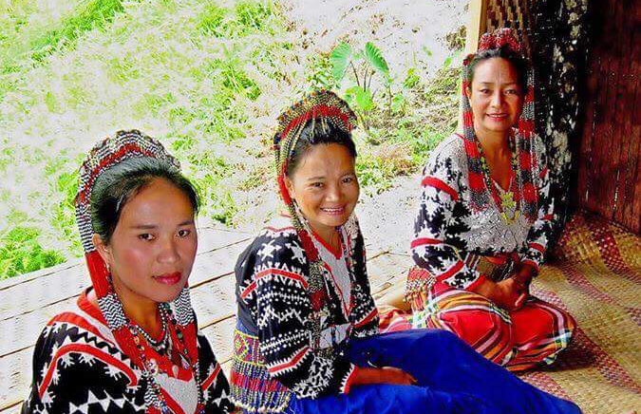
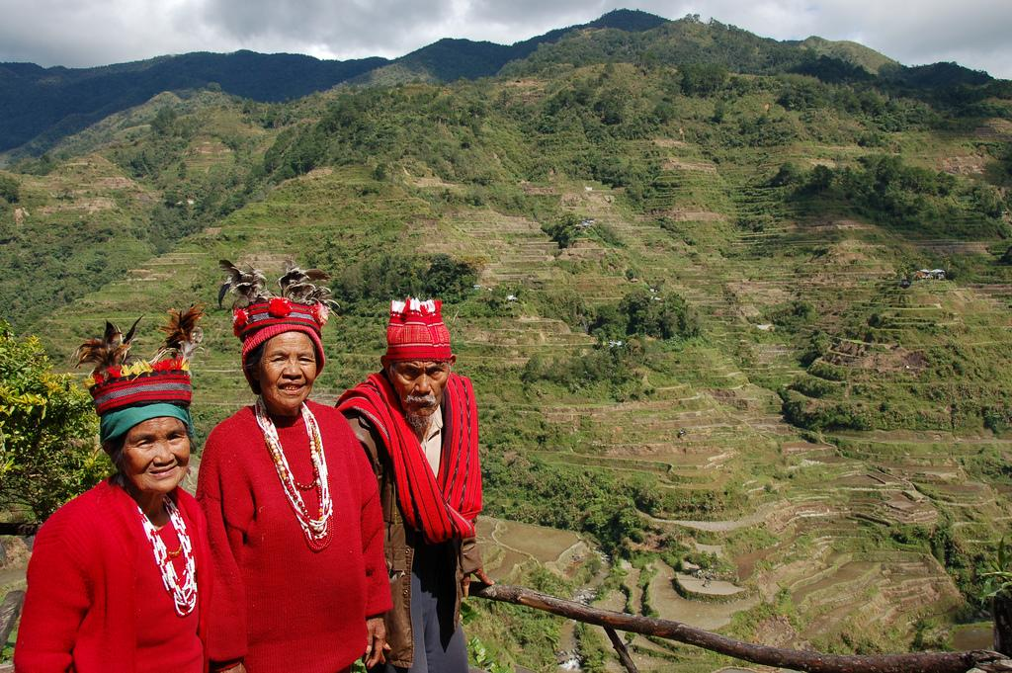
Worldviews on our Earth
Lumad – indigenous peoples of the Philippines
Igorot – people groups from the mountain regions of Cordillera
Beliefs
Human beings share the earth with spirits of trees, rivers, rocks, hills and mountains
Therefore: don’t damage, harm or abuse nature for fear of upsetting the spirits. If human actions destroy nature then the spirits will cause illness, misfortune and disaster. Only way to restore this is through rituals
Inayan Belief – do to others (including nature) what you would have them do to you
Do these have anything in common? Can you make any links with Noah and God’s Covenant?

Slide 7
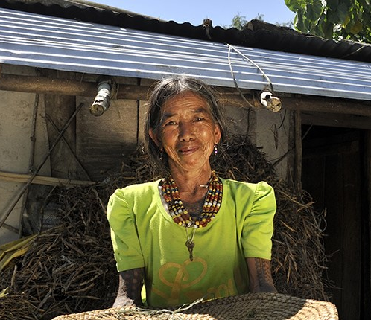
Going Deeper
What do you/humans have in common with other living creatures?
What makes us different?
In what ways do you feel like a part of nature?
In what ways do you feel separate?
How can Christians learn from other worldviews?
How do we ensure that indigenous worldviews and voices are heard and not lost?

Slide 8
Let’s sing!
Choose:
When I look – KidSpring Children’s Ministry
Or
Waymaker – Allstars Kids Club
Videos have been embedded on the next two slides

Slide 9

Let’s sing!
https://www.youtube.com/watch?v=4iW9MN7vMpQ

Slide 10
Let’s sing!
https://www.youtube.com/watch?v=BirWynZ9Pdo

Slide 11
Message and Reflection
Remember all life is sacred, human, animals and nature.
Christians believe that humans are made in God’s image, how do you show that all life is sacred?

Slide 12
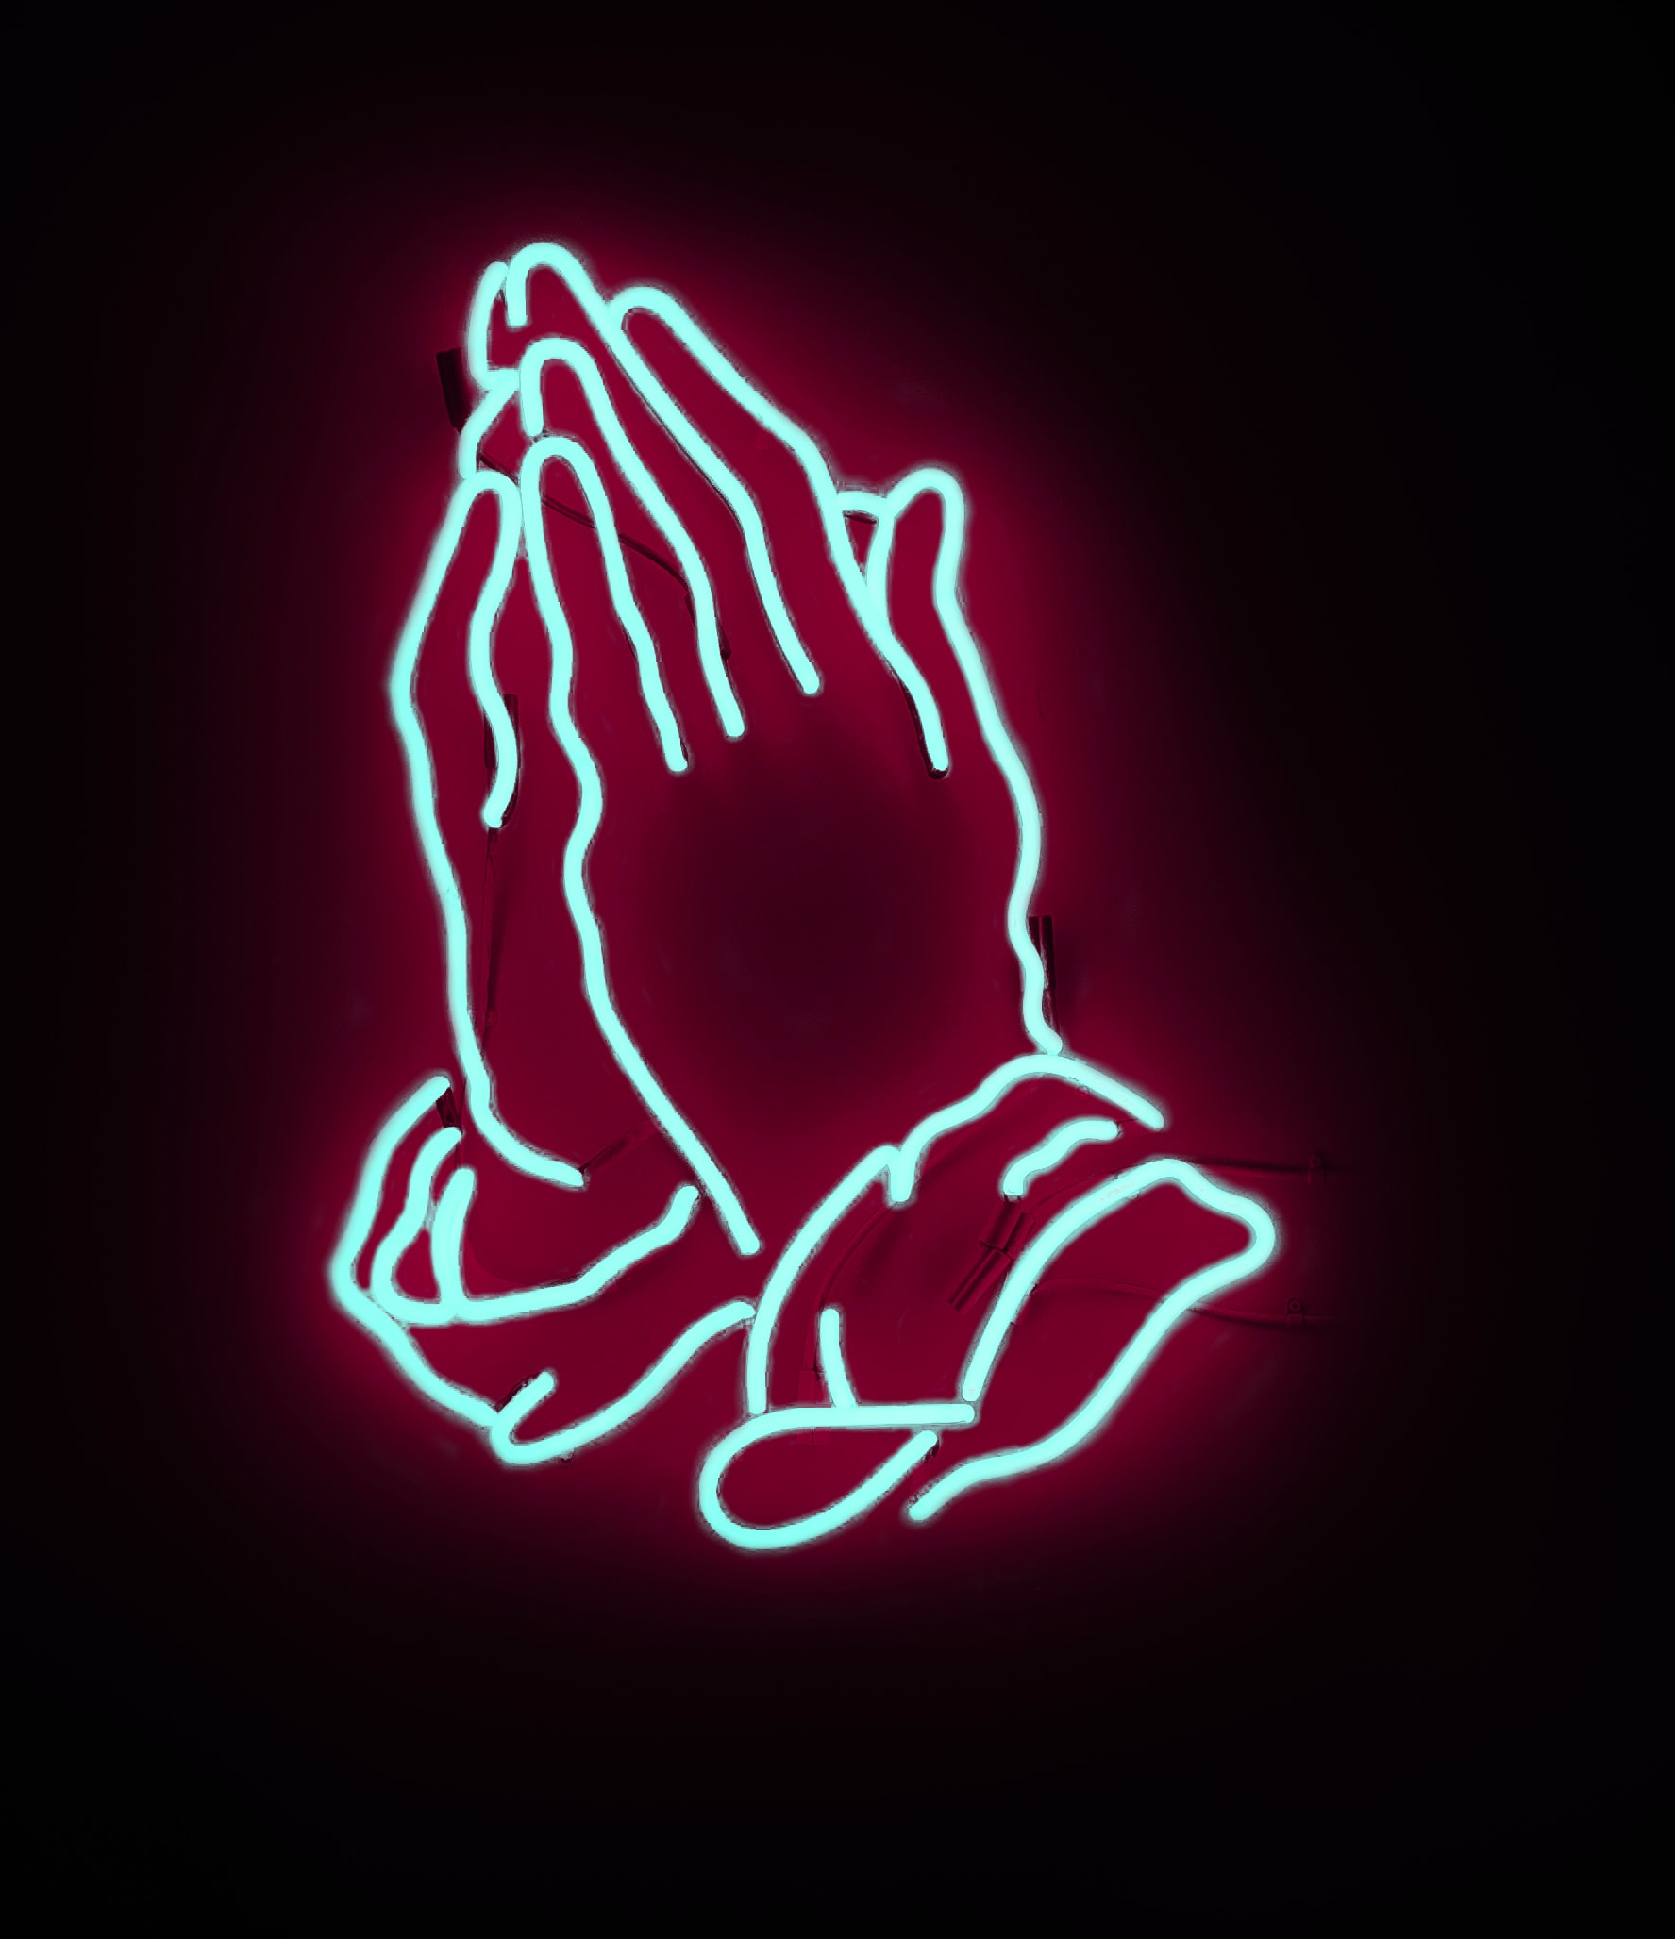
Prayer
Creator God,
Breathing your own life into being, you gave us the gift of life: you placed us on this Earth with its minerals and waters, flowers and fruits, living creatures of grace and beauty. You gave us the care of the Earth.
Teach us, Creator God of Love, that the Earth and all its fullness is yours, the world and all who dwell in it. Call us yet again to safeguard the gift of life.
Amen
(From USPG ‘For such a time as this’)

Slide 13
Go and Do!
Go on a nature walk, notice all of nature around you, take photographs.
Talk about how things change over the months and years.
Look at ways to make your environment more beautiful:
- Can you plant some bulbs or flowers?
- Can you collect any lost rubbish?
- Can you tidy away things that have been left out?
- Can you help to trim some of the bushes?
- Can you collect some of the dead leaves?

